Slide 1
Job Analysis
Necessary precursor to doing other HR functions
  A systematic description of the duties entailed in performing the job and the context in which it is done
  Info yielded:
    Job Description – situational inventory
      Duties, tasks, supervision, work environment
    Job or Worker Specification – person inventory
      Knowledge, skills, temperament, physical abilities
  Mandated by Uniform Guidelines on Employee Selection procedures (Section 14.C.3)
    Essential for supporting selection, training, & promotion decisions

Slide 2
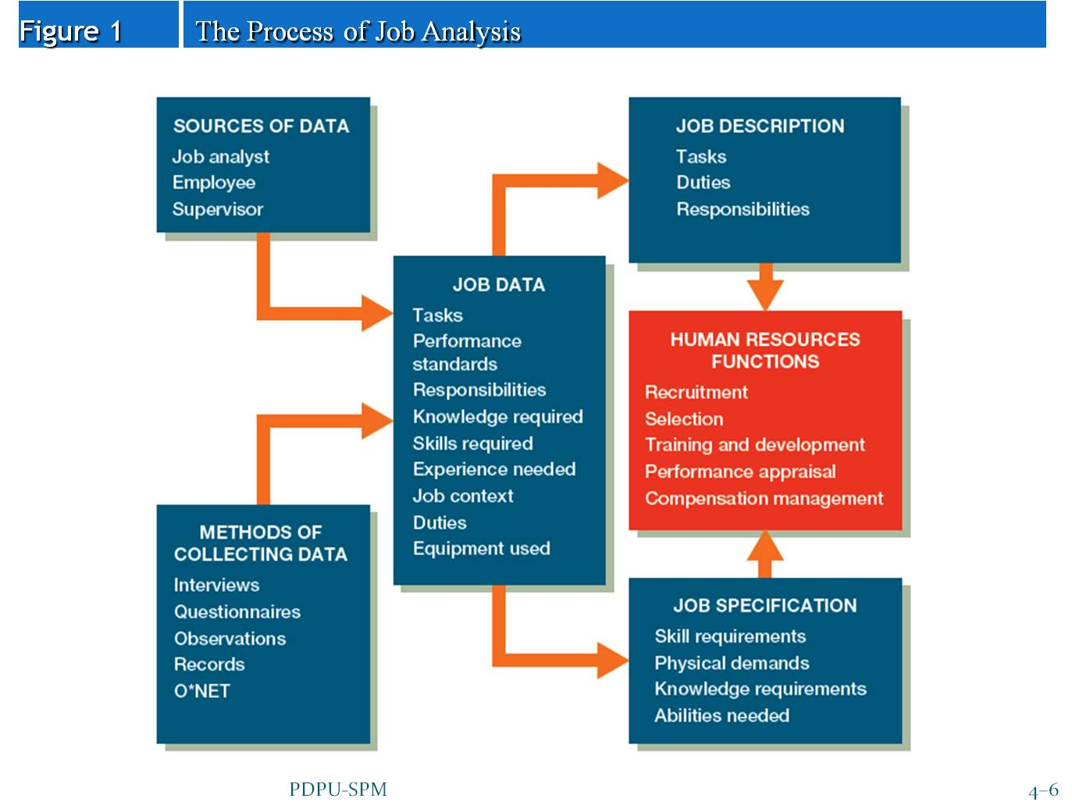
Job Analysis Process
Bohlander & Snell 15ed

Slide 3
Levels of Analysis
Job Family
Computing and account recording jobs
Occupation
Accountant clerk
Bookkeeper
Teller
Budget clerk
Job
Bookkeeper in firm A
Bookkeeper in firm B
Bookkeeper in firm C
Position
Person 1 in firm A who performs tasks 1,2,3
Person 2 in firm A who performs tasks 1,2,3
Person 3 in firm A who performs tasks 1,2,3
Task
1. Enter financial transactions in account journals
2. Verify accuracy of ledger entries
3. Calculate employee wages from time cards
Element
1. Gather time cards
2. Using calculator multiply hours worked by hourly wage rate
3. Enter total employee earnings
Employee Attribute
Previous clerical experience
Mathematical aptitude

Slide 4
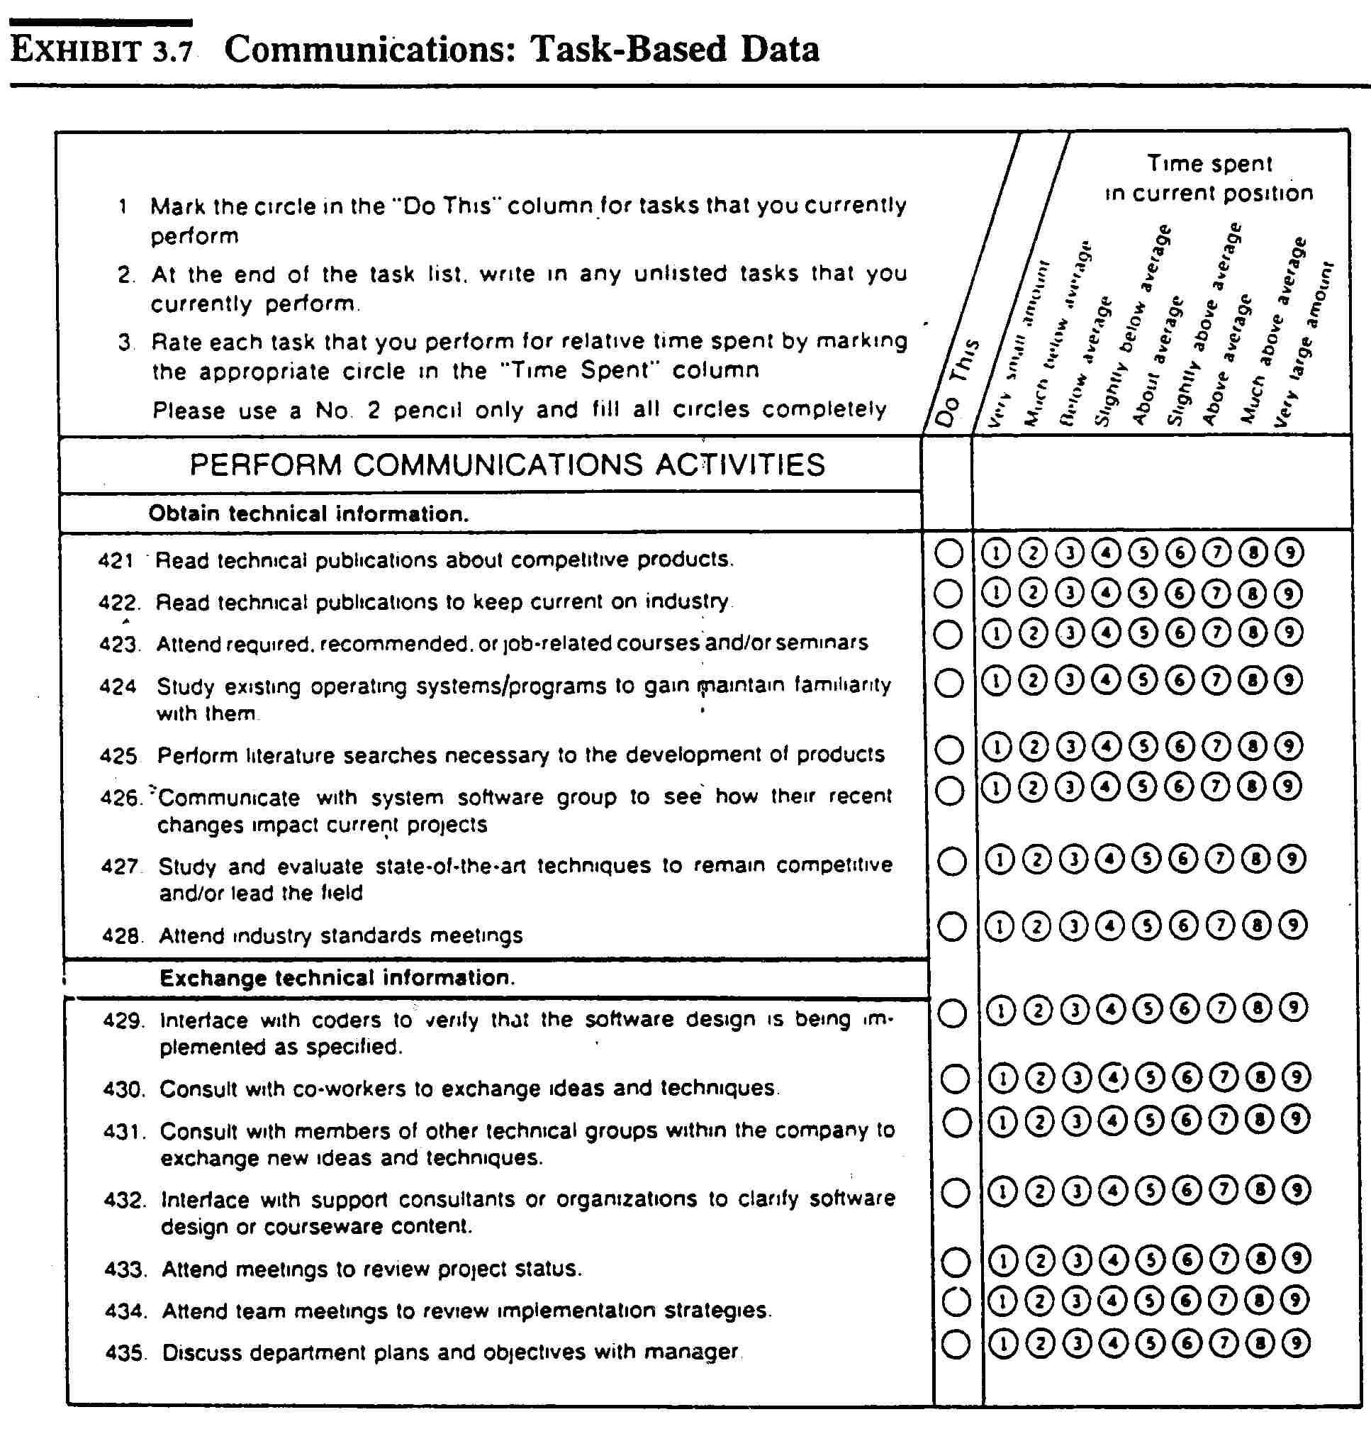
Job Analysis Systems
Job or Task-oriented Methods
  End-results focus
  “What gets done”
  Specific functional analysis for detailing work
  Less generalizable data
    Often developed in-house

Slide 5
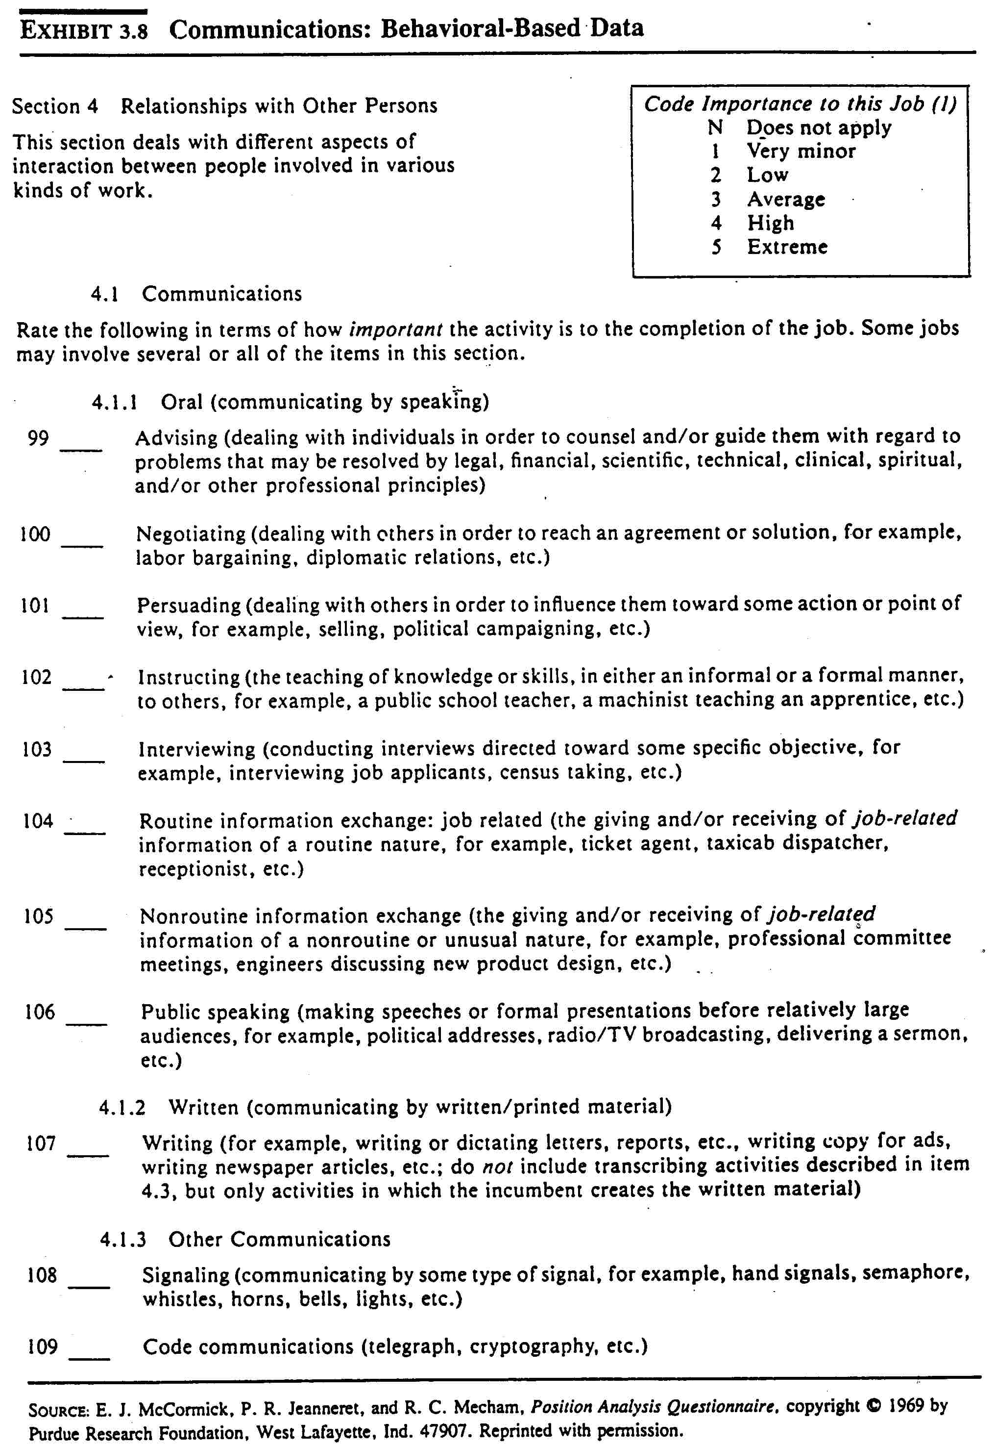
Job Analysis Systems
Worker or behavior-oriented Methods
  Process focus
  “How things get done”
  Less Specific functional analysis
  More generalizable data for comparing jobs
    Often off-the-shelf like the PAQ

Slide 6
Critical Incident Technique a procedure for systematically identifying behaviors that contribute to success or failure of individuals or organizations in specific situations
The CIT describes behavior in its natural setting by people directly performing job-relevant behavior
Typically consists of 3 core components
  Antecedent (what conditions prevailed at the time of the event?)
  Behavior (what behavior was performed?)
  Consequence (what resulted from the behavior?)
    Dimension of performance it is characteristic of (quality? service?)
    Event frequency (daily, weekly, monthly?)
    Behavioral effect (degree of success or failure)
Applicable to all work situations

Slide 7
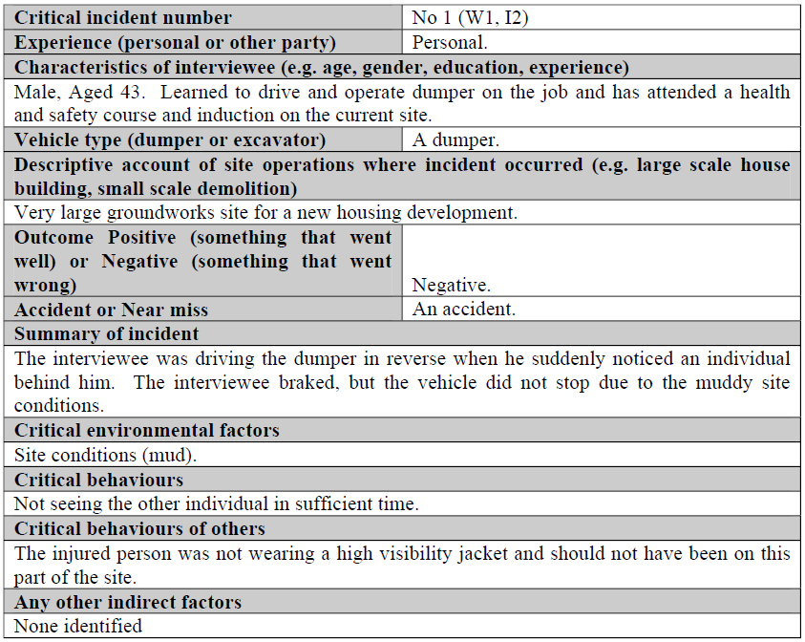
Example CIT at a construction site
Unsafe work practices dimension

Slide 8
Front-end Grocery Store Critical Incident
A. It’s a busy first Friday of the month and shoppers are lined up 5 deep at the check stands.
B. This cross-trained front-end employee:
  Collected shopping carts from the parking lot.
  Bagged groceries at busy check-out counters.
  Opened a previously closed check stand.
C. This resulted in a consequence.
  These responses can be scaled in terms of effectiveness and used as a behavioral measure of employee job performance.

Slide 9
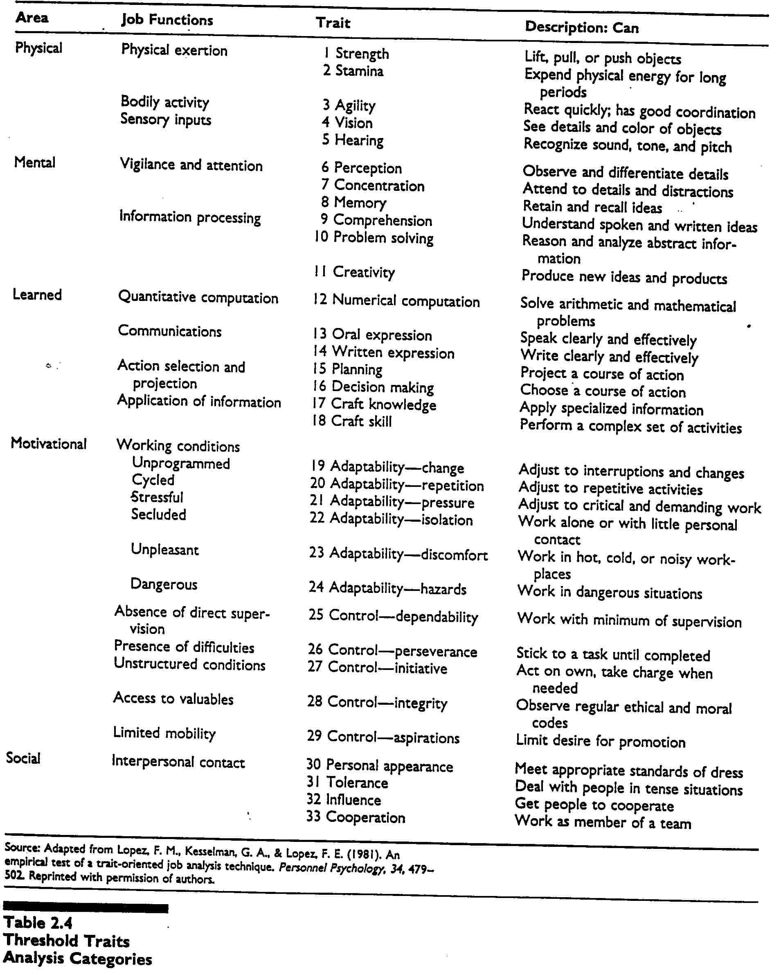
Job Analysis Systems
Trait-oriented
  KSAO focus
  “Who gets it done”
  Selection-based
  Task x Trait matrix with relevance & importance ratings

Slide 10
Task x Trait Matrix
TASK | TRAIT
 | Verbal skills | Math skills | CSR skills
Solicits new subscriptions | 2 | 1 | 1
Resolves customer service complaints | 3 | 2 | 3
Resolves customer billing questions | 3 | 3 | 1
Level of critical skill ratings: 1=low, 2=medium, 3=high

Slide 11
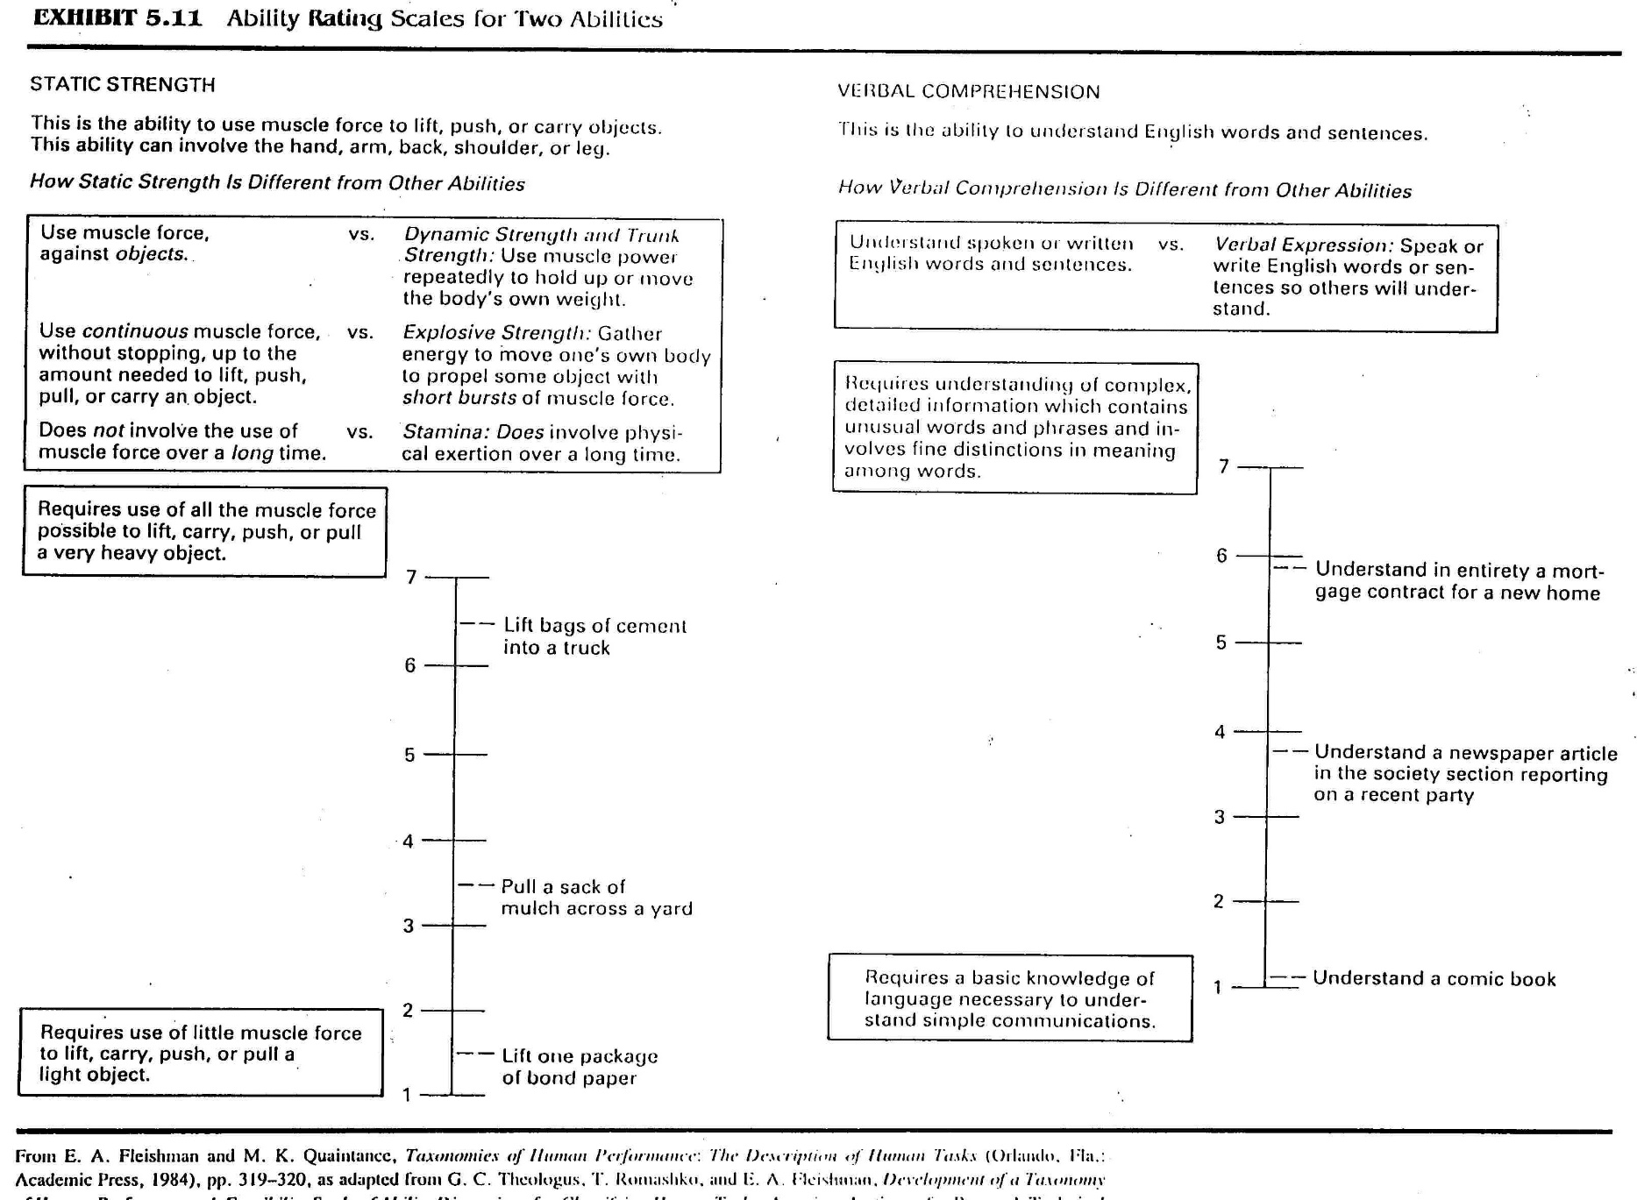
An Ability BARS

Slide 12
Job Analysis Prescriptions
JA methods should have as their goal the description of observables
    Coordinates, leads, inspires
      Ask yourself ‘how’ are these made evident?
JA involves description of work behavior independent of personal characteristics of incumbents
JA results must be valid and must be replicable in order to be valid
Focus on Essential Job Functions
  Those necessary for meeting job requirements

Slide 13
Working and the Swordsman Executioner Job
5.0 out of 5 stars Few books changed my life as much as this one has, January 8, 2012
By
W. P. Gardner (Palo Alto, CA, United States) - See all my reviews
(REAL NAME)
This review is from: Working: People Talk About What They Do All Day and How They Feel About What They Do (Paperback)
I pay attention to waiters in restaurants. I am aware of the people working around them in retail stores. Recently I had a long stay in the hospital and I talked a lot to the doctors and nurses about what they do.
Most people don't do this: most people block all that out. Most people don't "look backstage", so to speak; they only look at what's in the spotlight.
Recently I tried to figure out where I learned to look backstage, and to take an interest in ordinary people doing their jobs: it was because I read Working in the 1970s. It really changed the way I see these things. And strangely, I really am interested in what people do in their jobs. I got that from Studs Terkel.
Thanks, Studs.
A most dangerous job

Slide 14
Jobs, Roles, Work
Two systematic ways of looking at human
organizational systems
  Task/functional
    Functions necessary to fulfill organizational aims structure the organization
    Reinforced thru legitimate power/authority
      ASU Housekeeper duties
  Social system
    Patterned social interactions between social groups structure the organization
    Reinforced by the desire to maintain predictable role relations between members
      Dad duties
Notes:
Read Studs Terkel Introduction and introduce notion that WORK is LARGER than a JOB
Task Functional – Organizational Chart/ Job descriptions
Social – patterned by time, cycled interactions; repetitive & predictable
Individuals seek predictable social relations & events

Slide 15
What are Jobs?
Created by prime beneficiaries (principals) or their agents
Objective; social consensus about tasks is what defines them
Bureaucratic; exist independently of the person occupying the position
Quasi-static; do not change rapidly or frequently
  Consist of established task elements
Notes:
JOB – Set of tasks grouped together under one job title

Slide 16
The Job Context
Subjective, personal, and dynamic job environment with multiple interests
  Complexity/changes in work demands
  Remoteness of prime beneficiaries
  Supervisor expectations
  Coworker expectations
  Subordinate expectations
  Self-originated expectations & changes
    All contribute to Emergent Task Elements
Notes:
The multiple interests may conflict
Sometimes emergent task elements are thrust upon a person
Computer technology and clerical work in 1980’s

Slide 17
What are Roles?
Formed by constituencies other than the prime beneficiaries
Subjective; less common perceptions of what set of tasks constitute the role
Personal; role is not independent of person
Dynamic; what a person does changes and the rate of change varies by role occupant
  Established + Emergent Tasks = ROLE
Notes:
Reggie as example
Can we hire another Reggie?

Slide 18
Job-Role Prototypes
Bureaucratic Prototype
Loose Cannon Prototype
Established
Task
Elements
Established
Task
Elements
Emergent Task Elements
Emergent Task Elements
Notes:
Bureaucratic
Common among low status – low scope jobs
Narrow mandates
Factory workers; hand packager; assembler
Loose cannon
Oliver North and national security council
Ross Perot
Professors
High autonomy jobs with multiple criteria
Not real estate sales as there is single criterion

Slide 19
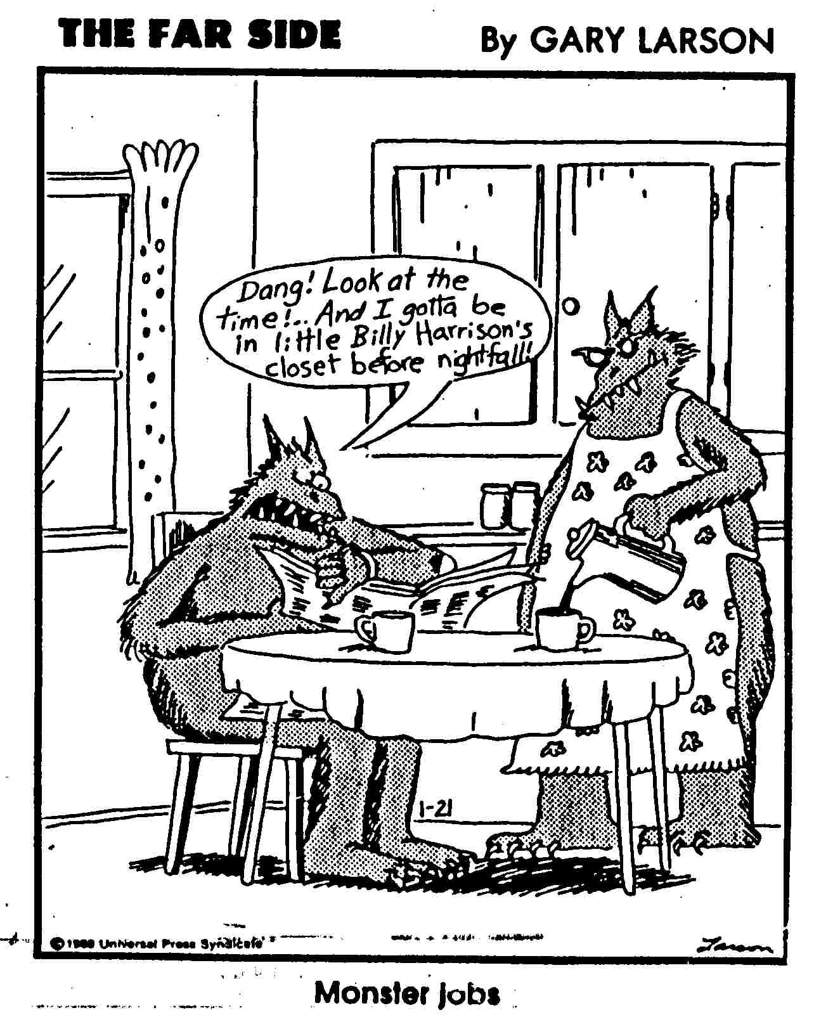
Summary
JA is a descriptive process
  Bureaucratic
  Technical
  Project management
No one best method for all situations
  JA Orientations serve different purposes

Slide 20
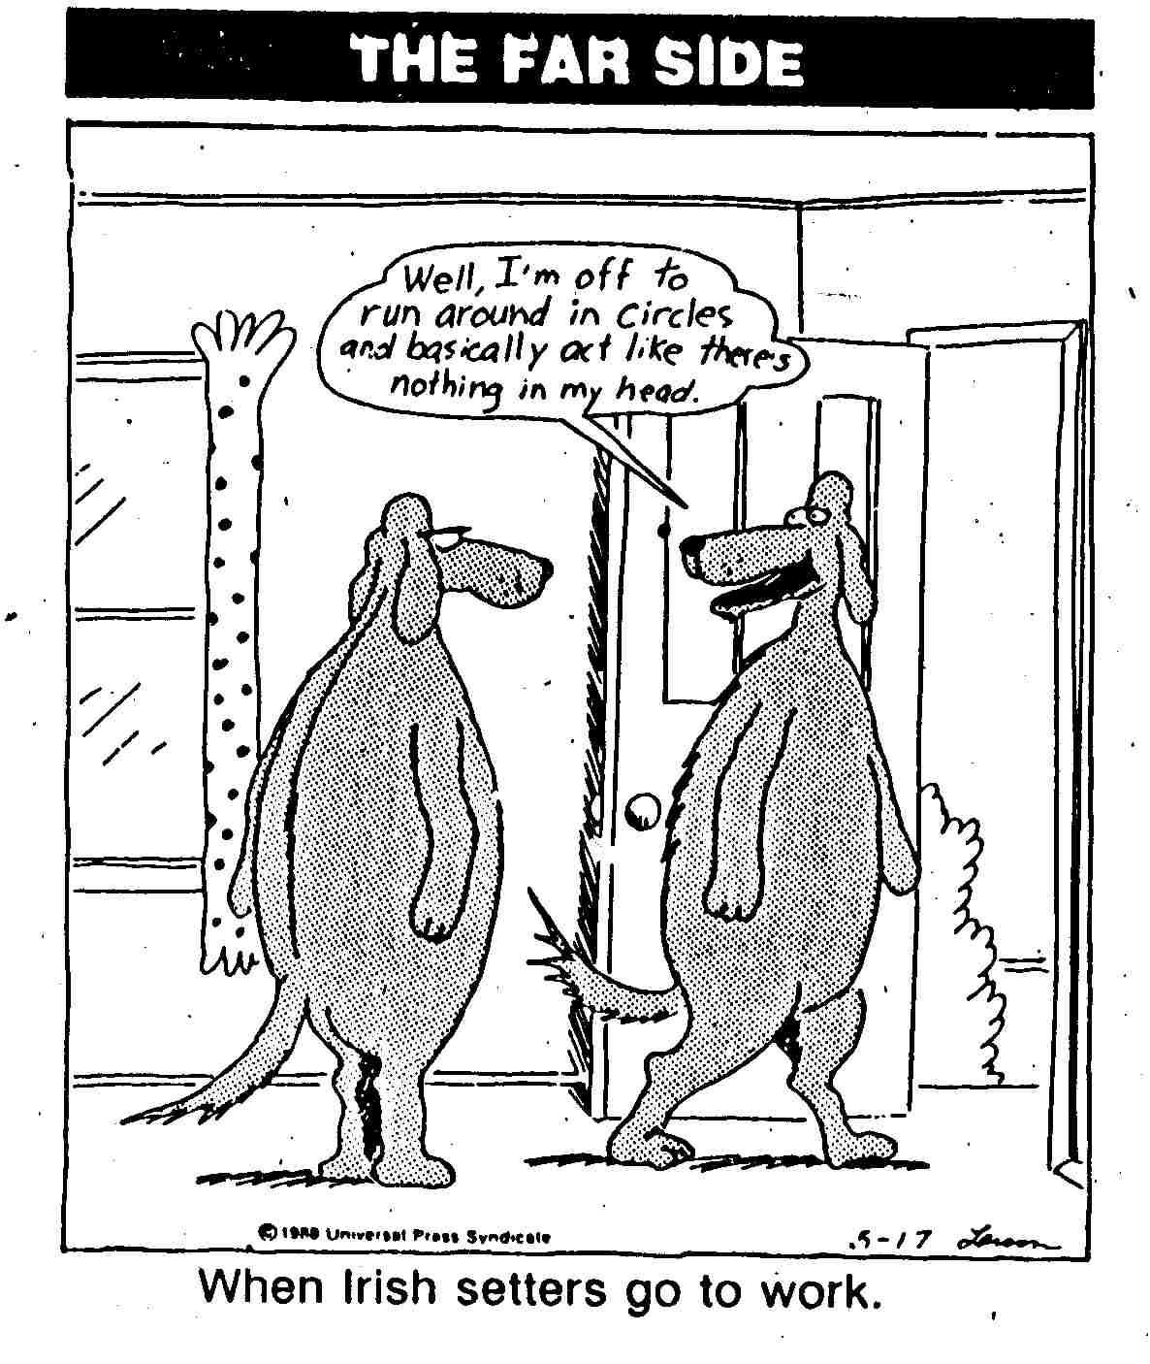
Summary
JA is viewed as potentially intrusive
JA data is inherently subjective
  Extra effort is required to control bias & error
Roles complicate the bureaucratic description of jobs

