Slide 1
DELTA forces of change in HR
Demographics and Diversity
Economics and Employment
Legal and Labor Relations Issues
Technology and Team Competencies
Attitudes and Values

Slide 2
Demographics and Diversity
  Women’s labor force participation rate
    Comparable to men (62% vs. 73%; recent declines for both)
    3/5 of college graduates are women
  Greater proportion of minority workers
  Better educated population
    Higher expectations moderated by competitive employment environment
  Increasingly older (workforce) population
    10,000 retirees per day for 20 years
    Yet many must delay retirement
      Young have fewer opportunities and stay in school longer

Slide 3
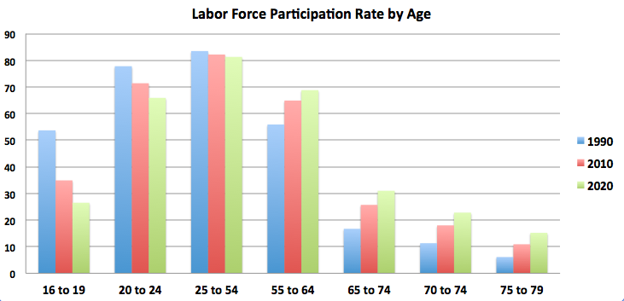
Trend Reversal in Historical Labor Force Participation Rates
-17%
-3%
+21%
-50%
+88%
+110%
+150%

Slide 4
Economics and Employment
  Global competition
    Off-shoring to save on labor costs
      China is not immune viz-a-viz regional competitors
  Stagnant or low growth economy
  Two-tiered workforce
    Core and periphery
  Rise in career debt delays consumption
  Small business challenges
    Decline of entrepreneurship & advent of COVID

Slide 5
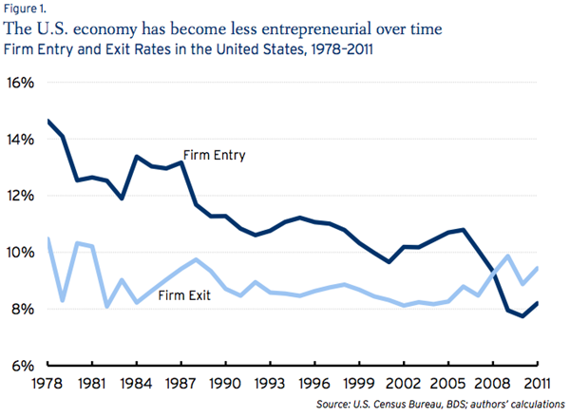
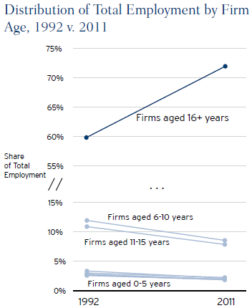
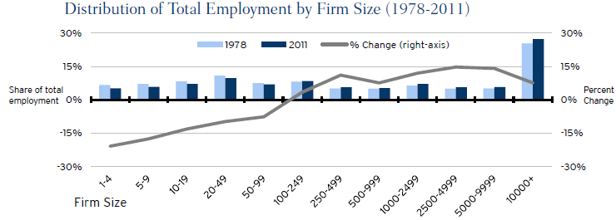
  Declining entrepreneurship
SOURCE: Brookings Institution 2014

Slide 6
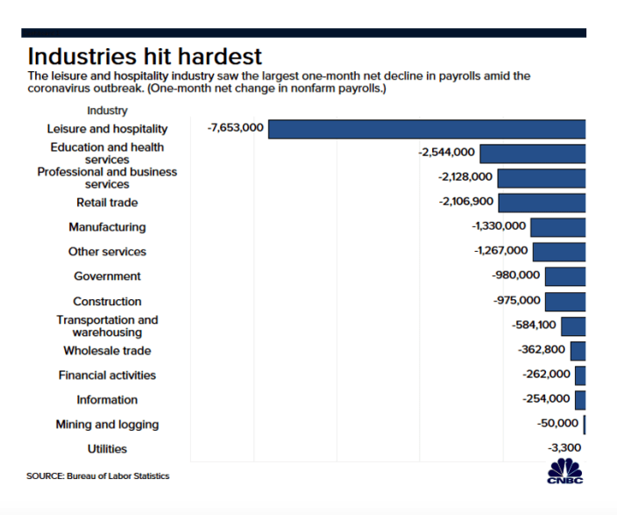
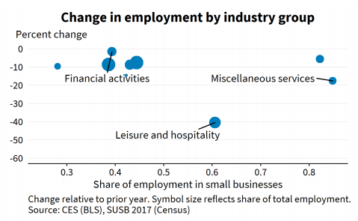
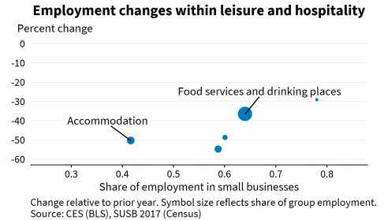
Advent of COVID and harm to industry employment
Small businesses accounted for 42% of employment in accommodation and 64% of employment in food services and drinking places.

Slide 7
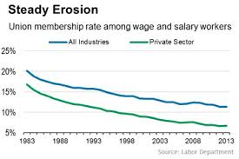
Legal and Labor Relations Issues
  1964 & 1991 CRA, ADA and ADEA
    Potential for litigation requires vigilance
  Declining labor movement
    Defined benefit versus Defined contribution plans
      13% DC plan in 1975 and now >80%
        Portability & asset allocation versus certainty
    Lower job security
Public sector union employment alone slows the decline

Slide 8
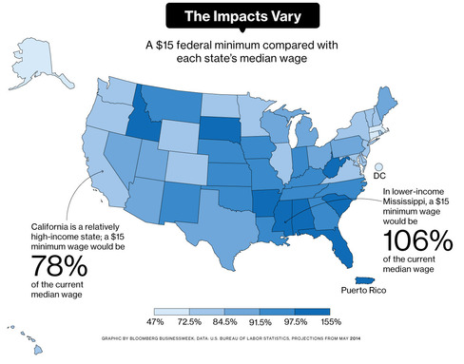
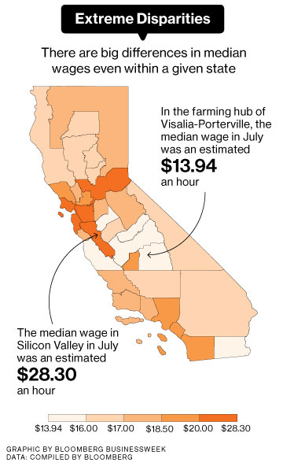
  Debates about utility of regulations
    Do they provide adequate protections or reduce opportunity and contribute to slowing growth?
      Affordable Care Act and COVID shutdowns as recent examples
      Controversy over minimum wage increases
$15
Minimum wage vs state and county medians
Bloomberg Business Week, August 2015 issue; see also Dan Price Gravity Payments and $70k minimum wage

Slide 9





Technology and Team Competencies
Preference Mandate for IT competencies
  Robotics and automated manufacturing
  Half of the jobs paying in top quartile (>$60k) require some IT competency
  Accelerated with COVID
  Continuous learning requirement
    e.g.
  The ascent of Teams
    By technology & dawn of ‘team competencies’

Slide 10
Attitudes and Values
Higher educated workforce
  Higher expectations & more career debt
Less employment security
  Lower organizational commitment/loyalty
Value perspectives toward ‘work’
  Work as an instrumentality
Lower job satisfaction (~50%)
  Pessimism, envy, and narcissism
    Have we had it so good that we expect things to come easy?

Slide 11
Changing Assumptions
ORGANIZATIONS
INDIVIDUALS
Fluid not static skills
Core employees
Lower employee loyalty
Weaker labor movement
Technology rules
Remote working
Team orientations
Fewer employer commitments
Continuous learning to remain competitive; especially with IT skills
Portfolio orientation

