Slide 1
Good Samaritan Experiment
Student (experimental subjects) from the Princeton Theological Seminary were six times more likely to help an “unfortunate who appeared to be in significant distress” when they were not in a hurry, compared to when they were in a hurry. There was almost no relationship between religiousness (a personality variable) and helping behavior.
This suggests that in the Bible story, the priest and Levite were in a hurry, whereas the Good Samaritan was not in such a hurry. The experiment supports “situationism” (i.e. blame the situation, not the person)

Slide 2
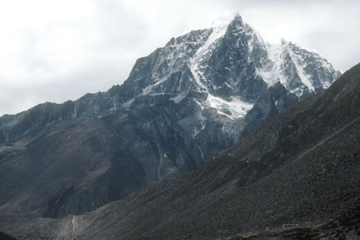

Slide 3
According to a Nepalese friend, Sadhu’s do aim to achieve a state of neutrality towards their environment, a sense of detachment from reality so that that “nothing matters”.
This indicates that he would be content to be left alone. The idea that one has to save life is thereby challenged. How strongly do we hold to that imperative?

