Slide 1
be the change ….to what???
blaze the trail …..to where???
Before you start ‘changing’ and ‘blazing’, you should:
(i) understand what your trying to achieve, the really important things, and
(ii) know the “situation and circumstances” (Sun Tzu).
e.g. don’t try to blaze a trail straight up a 2000’ ice cliff….
Notes:
Strategy = ethics. I have written books on this. Strategy as moral philosophy. Show you a picture of me demonstarting great leadership in NZ.

Slide 2
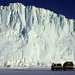
Good
leader
S--- !! How ‘we all gonna get up there??
Forget it dude, time to bail
Typical
follower
Notes:
Heres a picture of me showing leadership in New Zealand. A good leader knows the situation, the circumstances; when its time to restore balance, be moderate, compromise (ok we need another trail, another route)

Slide 3
 | LEADING TO A GOOD PLACE | LEADING TO A BAD PLACE
GETTING MANY FOLLOWERS | hero | villain
NOT GETTING FOLLOWERS | Unappreciated loner | pathetic
 | LEADING TO A GOOD PLACE* | LEADING TO A BAD PLACE*
GETTING MANY FOLLOWERS | RR? Bernie? | Hitler, Stalin
NOT GETTING FOLLOWERS | Me | Cheney
*Everyone’s “Good vs bad” descriptions are influenced by their emotions
and value-priorities, red vs blue (see chapter list) which
includes the motives to benefit Self vs others or I vs we.

Slide 4
FORMS (TYPES) OF LEADERSHIP
(i) good / bad place x many / few followers (4 categories)
(ii) Skill based: people follow you because you are obviously good at some activity that is important to them and they want to learn how to do it. E.g. in any sport, any profession (e.g. military, or the coastguard in “Guardian” movie), finance & investment (including real-estate), software, music, detailing cars & bikes, cleaning windows, etc. This is like the alpha-male form of leadership by wolves. For many people this is the only type of leadership that counts; “Don’t order people to do things that you couldn’t do, or wouldn’t do, yourself” but assign tasks to followers that you know can do it, perhaps better than you.
(iii) Knowledge-of-system or wisdom based: the leader understands the entire situation and circumstances (e.g. the details of the operation, industry or system)
(iv) Transactional vs transformational (stick & carrot; reward power* vs changing the followers’ motivation, cognition, attitude, character and sense of identity)
(v) Task-oriented vs relationship-oriented (focus on the task for leader & followers, vs improving relationships amongst all involved)
(vi) Charismatic leadership (the transformations of followers and relationship-building are achieved in part by the mysterious force (or cult) of the leader’s personality.*
(vii) Servant leadership (leader tries to serve followers, does the grunt work; Sun Tsu quote about “in their tents” . Seeking benefits for followers (or others) vs seeking power for self. Any others? [*power: reward-power, charismatic, positional]

Slide 5
human-lives
meta-goods
balance, optimality, rationality, understanding, wisdom
traits
sociality
nobility
respect
charity
care
circumstances
wealth
justice
freedoms
friendship
psych-states happiness
health
pleasure
aesthetics
complex inter-relationships

Slide 6
Global Capitalism
justice (D & Res)
negative-freedom
(from private regimes)
friendship, sociality
care, nobility
positive-
freedom
happiness
charity
health
wealth,
negative-freedom
(from state regimes)
pleasure, aesthetics
justice (ret)
A more-obviously-moral approach

Slide 7
 | Transformational | Transactional
Task- oriented
Relationship- oriented

Slide 8
 | Transformational | Transactional
Task- oriented | Change the follower’s (performance) by structuring the task well, optimize the challenge*. Also perhaps change values by choosing the task, e.g. get a bad guy to design a CSR program. | Link stick and carrot to a task e.g. “get this software working properly by 5pm and you all get a $500 bonus” (or promotion, etc). If its still not working by Friday 7pm you are all fired.”
Relationship- oriented | Change the follower (values/goals; performance; character) by persuading, heart-to heart, inspiring, showing charisma,. By inspiring loyalty, “I’ll do anything for this person” | Link friendship or sociality to the task. Eg, get this software working properly by 5pm and you can come to my apartment tonight for dinner…”
*this is motivational qualities of the task itself, intrinsic-to-the-task type of motivation
Another similar type is motivation comes from within the person, expressive, regardless of stick and carrot. Also called “intrinsic-to-the-person”. Carrot & stick provide “extrinsic motivation”
It’s all overlapping, for example you might become loyal to a boss (relationship-oriented) because you are sure he has integrity and will eventually promote you for good performance (task-oriented).

Slide 9
IDEOLOGY
A framework of ideas that can be used to explain a set of value-priorities (like blue or red in the overlapping circle diagram).
The ideas do not have to be true like “1 +1 =2” they just have to be reasonably coherent (fit together with each other).
Leaders can advocate and propagate an ideology (whether true or false).
Followers will “believe” the ideology (learn it, re-state it, write in favor of it, act in accordance with it) in part because they want (for various conscious and unconscious reasons) to remain loyal to the leader or the party; not because the ideas might be true. “2+2=5 if the party says it is”
They “want” to remain loyal partly because of the leader’s power. (reward & punishment power, positional-power, charismatic-power based on persona and skill)
This aspect of human social psychology is “truly” dangerous, life threatening. Eg “upper class bourgeoisie is the enemy” (Stalin)” “Jews (or other ethnic or religious or national group) are the enemy” (Hitler et al) etc. “government per se is the enemy” “environmentalists (or the Alt-Right etc.) are the enemy” .
The idea of leadership is loosely associated with tribalism (like the alpha-male wolf that leads the pack [1960s song?]). Hence we might refer to “moral tribes”

Slide 10
“Relationship-oriented” can also refer to “bringing people together” which some consider to be “the true definition of leadership”. However this depends on which people, which tribe.
If it refers to all people in USA and the Red-Blue “divide” then one approach might be to teach the “Table of blue & red components” so that everyone can try to think about both sides.
More on this soon

Slide 11
COMPONENT | LEFT-POLE | RIGHT-POLE | Comments
KLMBS | Compensate, refrain | exploit | Exploiting KLMBS yields market-power and generates “above normal” returns to s/h.
Value-priority | justice | efficiency | Econ.-efficiency implies aggregate wealth, so these values are like HG’s
Variants | stakeholder | shareholder | Variants of capitalism (legal, cultural) or models of strategic management (conceptual)
Capitals | multi-forms | financial forms | Human, social, ecological, cultural, moral, political, economic; Classes of equity and debt
Politics | econ-left | econ-right | Strong positions often reflect partial-knowledge, sense of identity, vague emotions
Timing | ethics now | ethics later | First get rich, then maybe give it to charity when you get old (but you won’t give enough)
Co-opetition | co-operation C | competition D | Dynamic prisoners’ dilemma games explain a lot about strategy and ethics. E.g. Tit-for-Tat
Language | values-based | value-based | There are separate (political) discourses, e.g. “Value-Based-Mgmnt” means s/h wealth-max^{n}.
Agency (resp) | corporate | individual | Pol-left endorses CM-Resp concept (like stakeholder mod^{l}.), right emphasizes indiv resp.
Agency (rights) | individual | corporate | Pol-right endorses CM-Ri like right to political speech and funding. Left wants equal voices.
Trust | in governments | in markets | Right tends to trust markets more than governments to deliver a satisfying HG mix.
Hopes | enlightenment for all | prosperity for self | Left wants to elevate peoples’ consciousness, Right seeks personal salvation or prosperity.
Passions | isothymic | megalothymic | Passion for justice or for power? Plato noted the two types of character (cf. virtue ethics).
Leader-style | transformational | transactional | t-form^{l} leader inspires and changes others’ abilities; t-act^{l} uses +/- incentives (exchanges)
Focus | We/the other | I/the self | Several psychological theories focus on this fundamental distinction (Etzioni, Piaget, Wu)
Yin/Yang | yin | yang | Female and male aspects in balance. L-R alignment is partial; yang includes “the light”
Science | Ecology | Engineering | Broadly, the right has an engineering view of economics; left has ecological-understanding
Rate of innov^{n} | Gradual, evolving | Rapid, driven | Weber noted that many do not want innovation, but just want to live in their “accustomed way”
Ethics theories* | MOMA | MFoC | The partitioned ethics-set identifies and locates forms of (pol-) moral-reasoning on both sides.

Slide 12
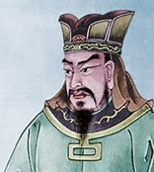
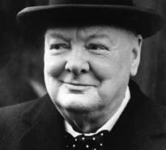
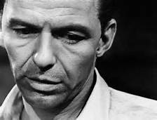
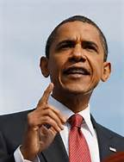
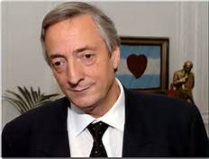
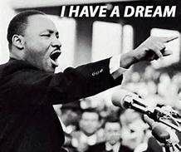
I’m going to quote from several leaders: Sun Tzu, Frank Sinatra, Winston Churchill, Barak Obama. Martin Luther King, Nestor Kirchner,
Notes:
Apologize no ladies selected, just worked out that way, not deliberate. Could quote from margaret thatcher “theres no such thing as society” but I’d rather not.

Slide 13
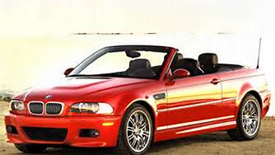
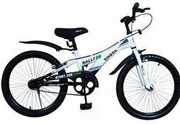
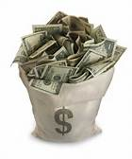
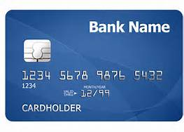
1
2
Notes:
Don’t need can still get a boyfrind or girlfriend if I ride a bike. That’s a fact. I can d better if I resist credit purchases and end up paying much more.

Slide 14
That's life, that's what all the people say; You're ridin' high in April, shot down in May ; But I know I'm gonna change that tune When I'm back on top, back on top in June
I said that's life, and as funny as it may seem, some people get their kicks stompin' on a dream. But I don't let it get me down 'cause this fine old world, it keeps spinnin' around
I've been a puppet, a pauper, a pirate, a poet, a pawn and a king
I've been up and down and over and out and I know one thing
EACH TIME I FIND MYSELF FLAT ON MY FACE I PICK MYSELF UP AND GET BACK IN THE RACE.
That's life, I tell you I can't deny it. I thought of quitting, baby, but my heart just ain't gonna buy it. And if I didn't think it was worth one single try, I'd jump right on a big bird and then I'd fly
That's life (that's life), that's life and I can't deny it. Many times I thought of cuttin' out but my heart won't buy it. But if there's nothin' shakin' come this July , I'm gonna roll LIFT myself up in a big ball a-and die. AND STAND TALL AND STILL TRY.
Notes:
Song about resilience, they read it then I sing

