Slide 1
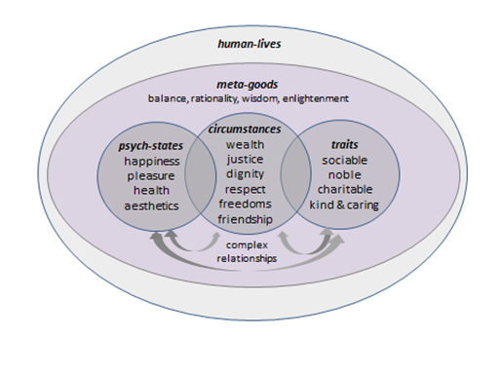

Slide 2
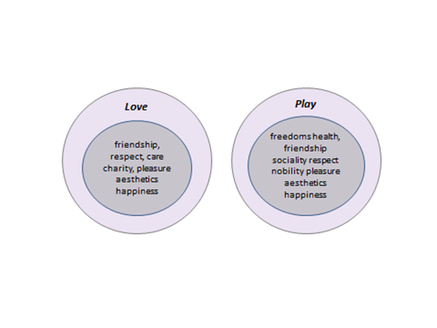

Slide 3
Frequent HGs losses at real work
health, pleasure
respect & dignity
negative-freedom
Frequent HGs gains from idealized work
wealth, charity
respect & dignity
sociality
positive-freedom

Slide 4
justice & fairness
dignity & respect
care & kindness
negative-freedom
(from private regimes)
health
aesthetics
friendship
charity & nobility
positive-freedom
wealth
happiness
pleasure
negative-freedom
(from state regimes)

Slide 5
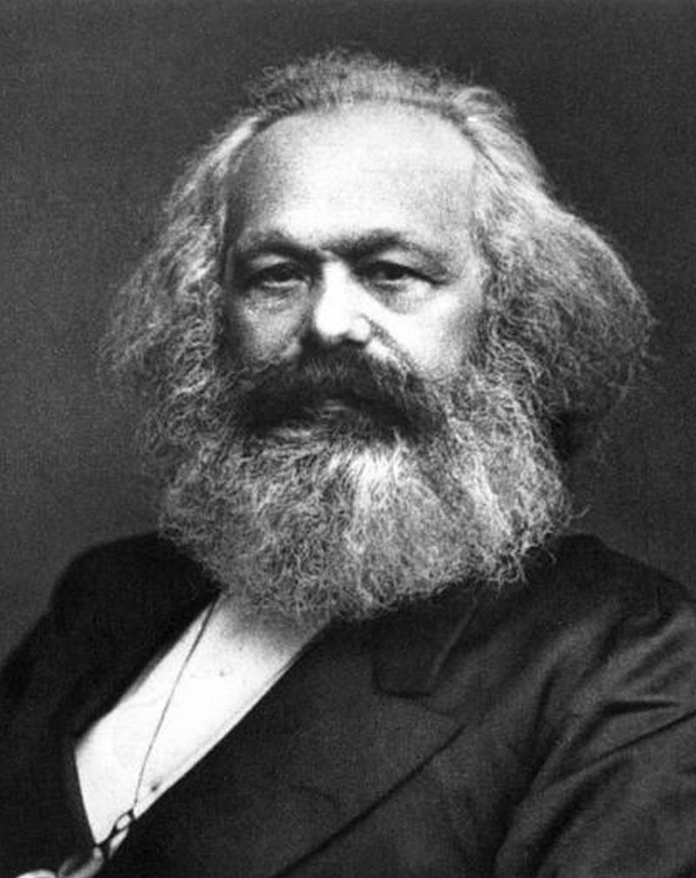
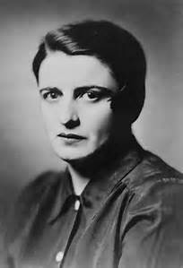
Freedom is a
very important human good

Slide 6
Human life
Improves and protects
Understanding, wisdom, balance
Meta-Goods
produces
Sociality, respect
Human Goods
produces
Attending to the arguments from and considering the HG priorities of
Left AND Right

