Slide 1
c
a
b

Slide 2
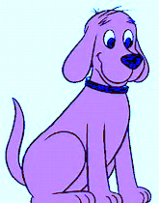

Slide 3
Child
Horus
Father
Osiris
Mother Isis

Slide 4
