Slide 1
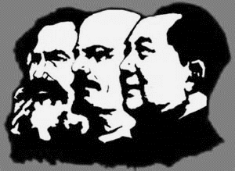
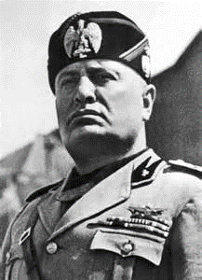
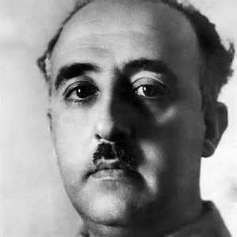
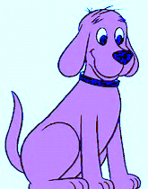
Authoritarian =
Authoritarian =

Slide 2
LEFT-AUTHORITARIAN
Authentic workers
Tough Love
RIGHT-AUTHORITARIAN
Freedom for the strong & for dominant groups
Loyalty enforced
LEFT-leaning
LEADERSHIP STYLE
RIGHT-leaning
LEADERSHIP STYLE
Authenticity
Relationships
Transformations
Wealth
Tasks
Transactions

Slide 3
AUTHORITARIAN
Big government
State-owned economy & controlled society
Communism
State-imposed order allied with corporations
Fascism
Epistocratic Capitalism
LEFT
‘good’ government
RIGHT
‘good’ government
Community autonomy moderate regulation Left-Libertarian, communitarian
Individual autonomy minimal regulation
Right-Libertarian anarchist
LIBERTARIAN
Small government

Slide 4
Votes for ‘authoritarian- populist parties’ as % of votes cast
12%
RIGHT-leaning voters
7%
LEFT-leaning voters
6%
5%
4%
financial crisis
1995
2008
2016
Adapted from a graph in The Economist reporting Timbro’s analysis of data from 33 European countries

