Slide 1
LEFT-leaning
LEADERSHIP STYLE
RIGHT-leaning
LEADERSHIP STYLE
Authenticity
Relationships
Transformations
Wealth
Tasks
Transactions

Slide 2
LEFT-leaning
objectives
Leader vs follower as the intended beneficiary
Transform towards social concerns
Incentivize social contributions
LEFT-leaning
LEADERSHIP STYLE
RIGHT-leaning
LEADERSHIP STYLE
Transform towards profit-seeking
Incentivize profit-seeking
RIGHT-leaning
objectives

Slide 3
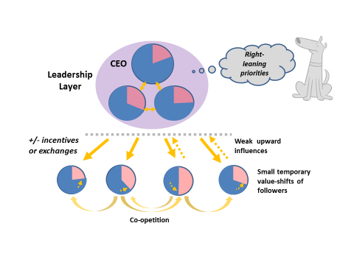

Slide 4
