Slide 1
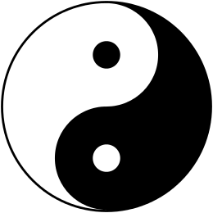
Yin
femininity
passivity
earth & moon Left-leaning
Yang
masculinity
activity
sky & sun
Right-leaning

