Slide 1
nous
super-ego
reason & desire
epithymia
ego
thymos
passion
ID
Plato’s ‘Soul’
Freud’s Psyche

Slide 2
I want my passions to be recognized as superior, more important that the others
>
>
>

Slide 3
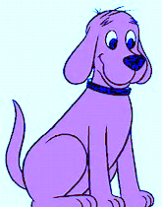
We are all equally entitled to pursue our personal passions. I want to be treated that way, too.
=

Slide 4
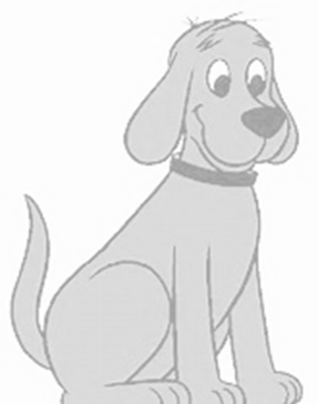
Megalothymia
Authoritarian-Left
Authoritarian-Right
passions of a Megalothymic leader dominate the process
LEFT
RIGHT
Democratic Socialism. Justice is done when everyone is helped to pursue their own passions. e.g. as artists
Classical Liberalism
Negative-Freedom from the state to pursue your own passions, e.g. as an entrepreneur
Isothymia

Slide 5
Blocks recognition & fosters megalothymia
Narrows attention & suppresses reason
Sustained poverty & inequality
Stimulates Atavistic passions
Behavior based on emotions catharsis & identity
Continues & worsens

