Slide 1
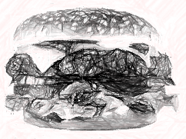
Meta-
preference
<
Revealed preference
Reflective preference
>
<

