Slide 1
According to publically available US Inland Revenue service (IRS) tables, the 400 highest-income individuals in the US reported an adjusted net income before tax of about $1,000,000 per day, so it’s no surprise that they pay a significant amount of tax even when their average tax rate is quite low. Let’s now suppose that any such income above, say, $10 million per annum were taxed in at a (1950’s style) top marginal rate of 90% (instead of the typical relevant current rate of around 20%). The extra revenue to the government could cover about 40% of all public college costs in the USA (i.e. everyone’s out of pocket costs). This amount of potential extra revenue is from only these 400 highest-income taxpayers. To make it real, they would have to agree to manage on just $100,000 per day whilst doing whatever they do, but also agree (or be required) to remain as a US tax resident. In the USA there are about 140,000,000 individual taxpayers, so even the ‘top 0.1%’ contains roughly an additional 140,000 high-income individuals. The potential for deficit reduction and public-goods delivery is thus apparent.

Slide 2
Table 1. Summary of reasons for high and low income tax rates
LEFT LIKES HIGH BECAUSE… | RIGHT LIKES LOW BECAUSE…
30:1 pay ratios seem reasonable | Pay ratios should be set by the market
Inequality is too high & increasing | Inequality does not matter. Envy is bad.
Wealth gushes up, poverty trickles down | Wealth trickles down
WTMMs distorted the ratio, ‘Federer effect’ | Technology, talent, evolution creates losers
Complex motives, Inverted–U, greed | Psycho-babble, be free to acquire $ billions
Others’ labor, unearned, exploitation, luck | Appropriate fruits of one’s labor.
Classroom rewards for performance | No classroom, only supply!
Some pie is tax-funded, strategies shrink pie | No fixed pie, maximize incentives to produce
Rigged or unearned high incomes, lotteries | The market is fair and sets top pay
Many poor people have several jobs | Many poor people are lazy
Close loopholes using NSA-tech | Rich will find loopholes
Few productive rich emigrate | Productive rich might emigrate
Increase tax to increase revenue (Laffer) | Reduce tax to increase revenue (Laffer)
More $ for needy citizens & public goods | More $ for me & my family
$-to-poor lifts spending, creates growth | $-to-rich lifts production, lowers inflation
Government programs effective, reduce poverty | Charity is effective, low taxes reduce poverty
‘The rich want out’ | ‘Noblesse Oblige’
‘No taxation without representation’ | Flat-tax gives everyone ‘skin in the game’

Slide 4
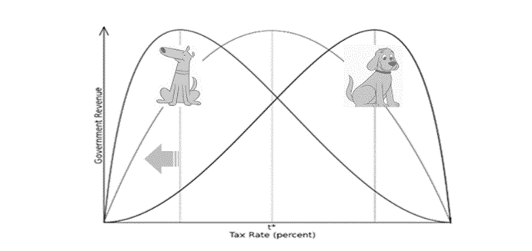

Slide 5
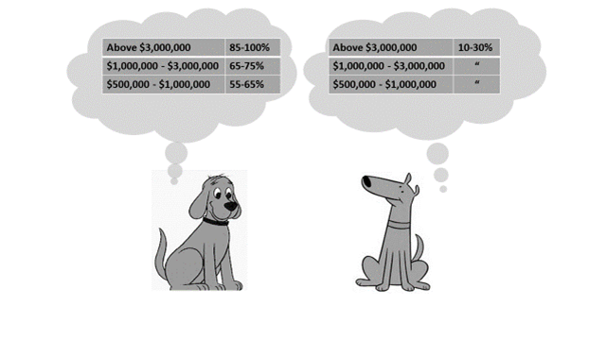

Slide 6
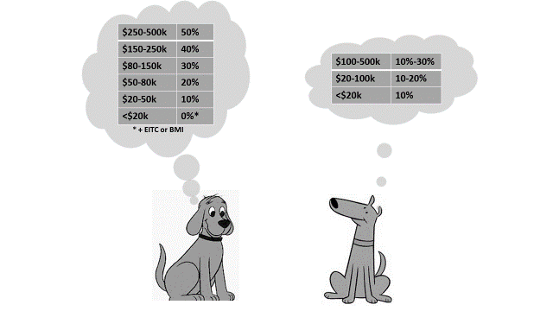

Slide 7
INCOME BRACKET | MID-RANGE % | MID POINT %
>3mill | 47.5 – 65* | 56
1-3mill | 38-53 | 45
500K-1mill | 32-47 | 40
250-500K | 30-40 | 35
150-250K | 25-35 | 30

Slide 8
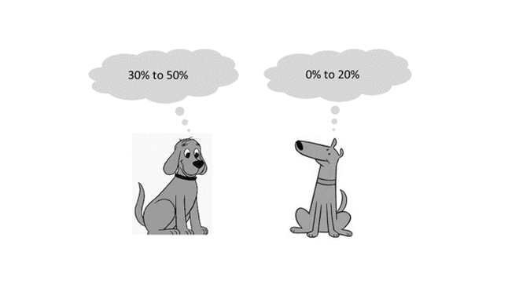
Preferred capital gains tax rates.

Slide 9
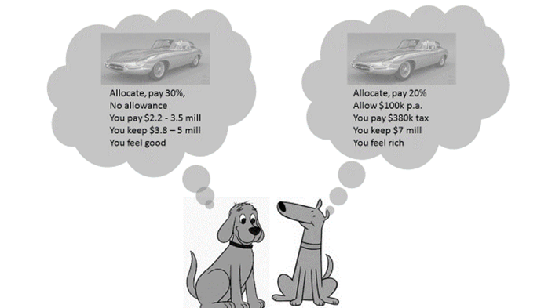

Slide 10
Two Dogs debating Corporation Taxes

Slide 11
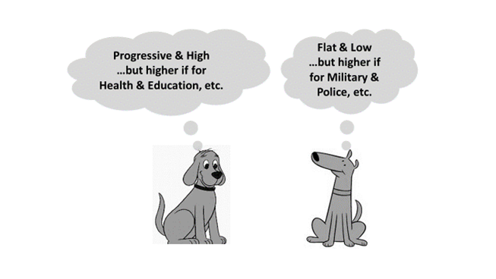
Preferred tax regimes depend on expected expenditure categories

