Slide 1
Legal-political
Macro-environment
Shareholder
-oriented
business
Regulations that constrain & compensate for exploitation of the KLMBS

Slide 2
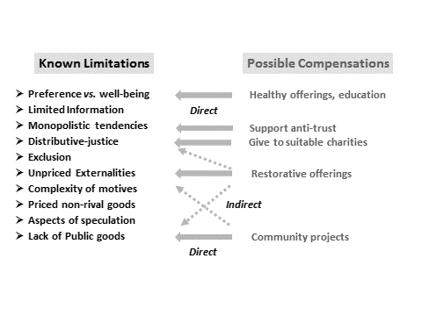

Slide 3
Legal-political
Macro-environment
Stakeholder
-oriented
business
Less regulation

