Slide 1
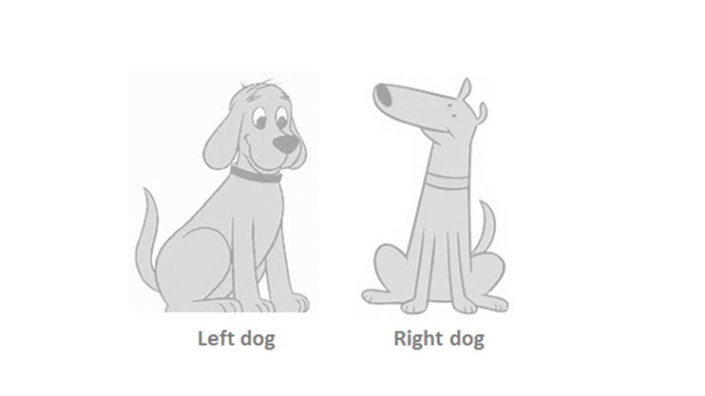

Slide 2
Revenue captured
Creativity & innovation incentivized.
‘Fruits of labour’ received
Trade-secrets reduced
Employees freed
Community & self-expression
Complex motives
Employees do not receive the ‘fruits’
Public-goods privatized
Color these grey areas in
blue or pink

Slide 3
TESTS
My chapters
goods
In-class
Case justifications
Your CASE presentation and 4+page write-up
limits
Essays based on
Chapter-extracts
understandings
Analysis of Lyrics etc.
Likes etc.
You Integrate your selected points into the CASE discussion

Slide 4
BUSINESS ETHICS
POLITICS
ECONOMICS
PHILOSOPHY

