Slide 1
International Management: Organizational Design
Angers, France
Summer 2019

Slide 2
HQ
CEO/GM
Vice President Production
Vice President
Engineering
Vice President Marketing and Sales
Vice President
Accounting
Quality Control
R & D
The Functional Structure

Slide 3
HQ
CEO/GM
Product/Division B (headed by a VP)
Product/Division A (headed by a VP)
Product/Division C (headed by a VP)
Production
HR
Marketing and Sales
Accounting
Production
HR
Marketing and Sales
Accounting
Production
HR
Marketing and Sales
Accounting
The Product/Divisional Structure

Slide 4
The Hybrid Structure
CEO/General Manager
Research and Development
Legal Counsel
Public Relations
Product/Division A
Product/Division A
Product/Division C
Production
HR
Marketing and Sales
Production
HR
Distribution
Accounting
Production
HR
Contract Management
Accounting

Slide 5
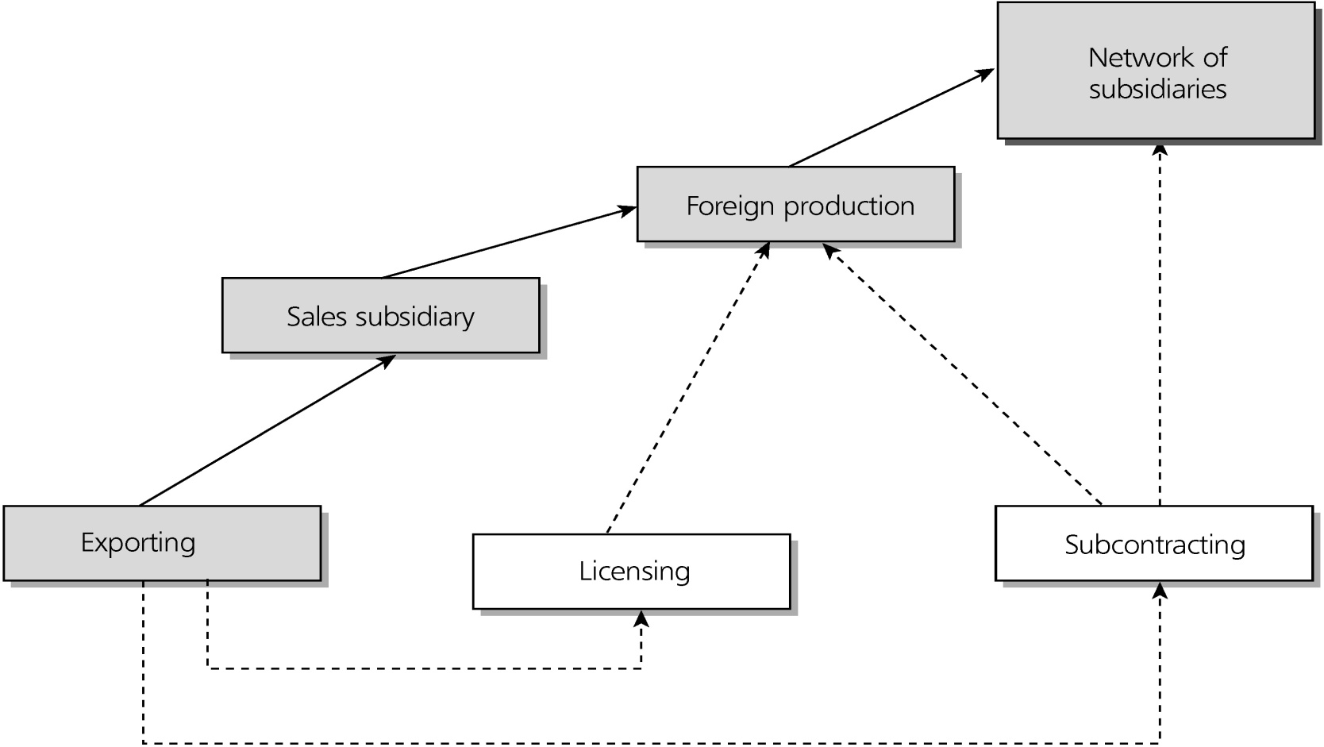
Internationalization & Structural Change
How does organizational structure adapt when a company internationalizes?

Slide 6
HQ
CEO/GM
Vice President Production
Vice President
Engineering
Vice President Marketing and Sales
Vice President
Accounting
Quality Control
R & D
Vice President Export Department
The Functional Structure

Slide 7
HQ
CEO/GM
Product/Division B (headed by a VP)
Product/Division A (headed by a VP)
Product/Division C (headed by a VP)
Production
Domestic & Global
HR
Marketing and Sales
Accounting
Production
Domestic & Global
HR
Marketing and Sales
Accounting
Domestic
Foreign
Domestic
Foreign
Production
Domestic & Global
HR
Marketing and Sales
Accounting
Domestic
Foreign
The Product/Division Structure

Slide 8
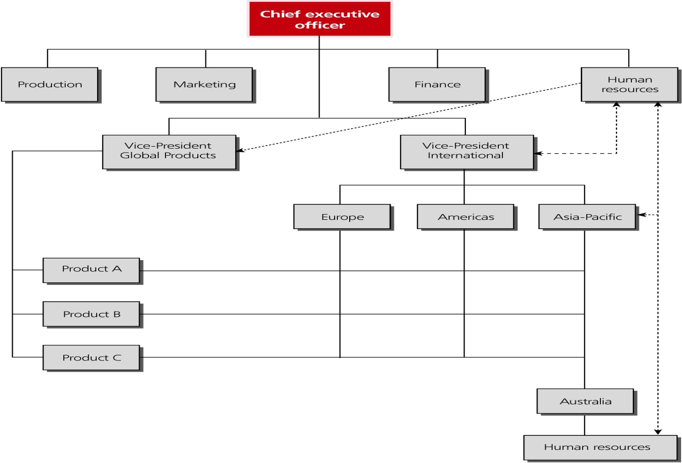
The Matrix

Slide 9
Coordination & Control
Control systems (vertical)
Measure / monitor sub-unit performance on assigned roles
Provide sub-units with feedback regarding effectiveness
How can MNCs exercise control?
Coordination systems (horizontal)
Information flow among subsidiaries
How can MNCs best coordinate their subsidiaries?

