Slide 1
International Management: Institutional Context
Angers, France
Summer 2019

Slide 2
National Context
The national context is composed of the respective (1) national cultures and (2) social institutions of a society that influence how managers make decisions regarding strategy.
Intertwined with national cultural forces are social institutions such as:
Economic system
Industrialization
Religion
Education
Level of social inequality

Slide 3
Social Institutions
Economic system: capitalism / socialism / mixed economy → impact MNCs due to
(1) government intervention levels
(2) market transitions
Level of industrialization: linked to economic development levels
Religion:
Education system
Social inequality

Slide 4
Economic System
Economic systems: Interrelated network or system of beliefs, activities, organizations and relationships that provide the goods and services of consumed by members of a society.
Capitalist/Market Economy: decentralized to private-property-rights holders who compete for profit in a competitive market
Socialist/Command Economy: state owned and centrally coordinated production resources in pursuit of collective goals (social equality & solidarity)
Mixed Economy: Certain sectors are under private ownership and others (often heath & education) are state run.
The economic system has important implications for strategic MNE management based on:
Dominant market type
Market transitions

Slide 5
Index of Economic Freedom
The extent of governmental intervention in a country.
Defines economic freedom as the absence of government coercion or constraint on the production, distribution, or consumption of goods and services beyond the extent necessary for citizens to protect and maintain liberty itself.
The index includes 10 indicators ranging from trade and taxation policies, to property rights and regulation, including government intervention in the economy.

Slide 6
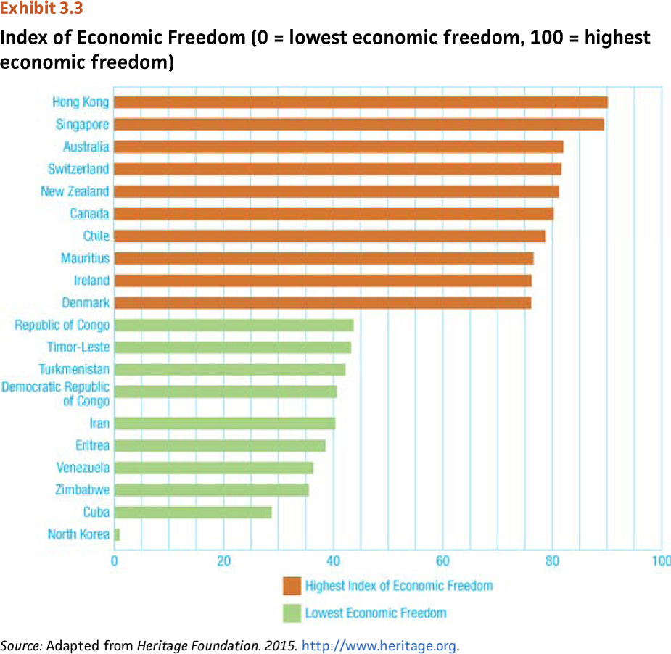
Index of Economic Freedom

Slide 7
Market Transitions
Changes that societies experience as they move from socialism to a market based economy.
Implications for Multinational managers & businesses:
Turn around inefficient formerly state-owned companies to become cost effective
Motivational issues with workers
Interpersonal trust, teams, meritocracy

Slide 8
Social Institutions
Economic system: capitalism / socialism / mixed economy → impact MNCs due to
(1) government intervention levels
(2) market transitions
Level of industrialization: linked to economic development levels
Religion:
Education system
Social inequality

Slide 9
Industrialization
Cultural and economic changes that occur because of how production is organized and distributed in society.
Stages of industrialization:
Pre-industrial society:
Agriculture dominates the economic environment
Religious norms, tradition emphasized
Industrial society:
Dominance of manufacturing or secondary sector
Technological development driving growth
Postindustrial society:
Emphasis on the service sectors
Need highly skilled workers with specialized skills

Slide 10
Managerial Implications: Industrialization
Direct correspondence between industrialization and economic development:
Pre-industrial countries provide cheap labor and untapped markets BUT
Poor infrastructure for business.
Traditional and communal values.
Industrial societies favor innovation and individualism.
Governments provide favorable environment.
Educated (and more costly) labor force.
Postindustrial societies
Dominance of service sector; knowledge based.
Almost complete demise of agricultural sector.
Significant decline in manufacturing sector rise in information-rich occupations.
Increasing emphasis on quality-of-life.
Non economic incentives favored.
Post-materialist values, individual expression, and movement toward more a humane society.

Slide 11
Social Institutions
Economic system:
Level of industrialization:
Religion: MNCs influenced by dominant religious practices
Education system: impacts human capital potential
Social inequality: implications for business ethics & choice of location

Slide 12
Religion
Shared set of beliefs, activities, and institutions based on faith.
Religion is an important aspect of most societies. Religiosity varies across nations
Together, Christianity, Islam, Hinduism and Buddhism are followed by almost 71% of the world’s population.
20% of world’s population are nonreligious.
Different religions shape how people do business in different parts of the world with implications for international business.

Slide 13
Education
Education: organized networks of socialization experiences which prepare individuals to act in society.
Central element in organization of society.
Helps construct competencies, professions, and professionals.
Implications for Multinationals:
Gives an idea of the skill level of workers in any society (human-capital potential).
Educational attainment helps determine the nature of the workforce.
May impact needed spending on training and development.
Other relevant information include Math and Science scores and R & D expenditures.

Slide 14
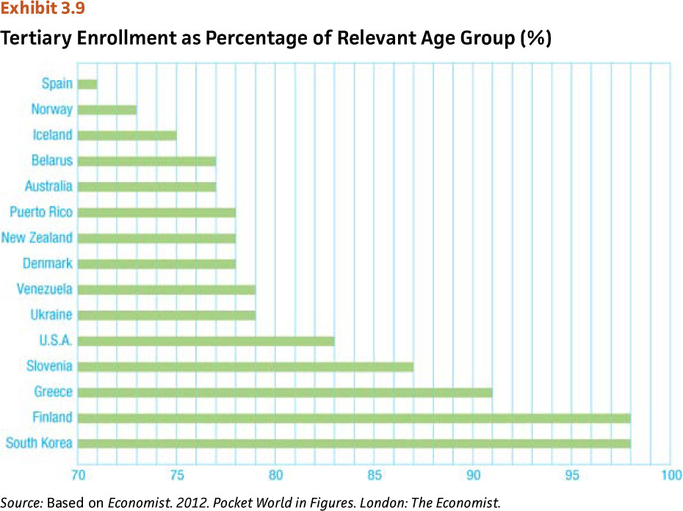
Tertiary (postsecondary) Enrollment as Percentage of Relevant Age Groups

Slide 15
Social Inequality
Refers to the degree to which people have privileged access to resources and positions within societies.
In societies with high social inequality, a few individuals have the ability to control and use important resources.
These select few use access to resources to acquire more power, thereby perpetuating inequality.
Social inequality negatively impacts the degree to which people are attached to work.

Slide 16
Social Inequality: Managerial Implications
Degree to which people in a society have privileged access to resources and/or positions.
Many MNCs are facing significant criticisms for their operations in countries with high social inequalities (ethical implications)
Criticized for paying low wages, using child labor.
Realizing social responsibility is also in their own interests.
Implications for Management:
Many key ethical issues arise in such countries.
Consider the GINI Index on the degree of social inequality.
Recognize that social inequality yields more demoralized workers, suspicious of management.

Slide 17
Summary
To understand a society, it is essential to understand both its national culture and institutional context.
Social institutions affect individuals and organizations.
Differing economic systems have major implications for multinational strategic management.
The degree of industrialization of a society is linked to its economic development.
Religion, education & social inequality also impact multinational management strategy.

