Slide 1
International Team Management: Multinationals in a Changing World
Angers, France
Summer 2019

Slide 2
Multinational Management
MNE / MNC → “Any company that engages in business functions beyond its domestic borders.”
Why should management students gain a better understanding of multinational management?
MNE Management → “Formulation of strategies and the design of management systems that successfully take advantage of international opportunities and respond to international threats.”
Where do most MNCs originate?

Slide 3
Largest Companies in the World
Rank | Company | Industry | Headquarters Country | Revenues (US$ mil)
1 | Wal-Mart Stores | Retailing | U.S.A | 476,294
2 | Royal Dutch Shell | Petroleum | The Netherlands | 459,999
3 | Sinopec Group | Petroleum | China | 457,201
4 | China National Petroleum | Petroleum | China | 432,007
5 | Exxon Mobil | Petroleum | U.S.A. | 407,666
6 | BP | Petroleum | U.K. | 396,217
7 | State Grid | Power Supply | China | 333,386
8 | Volkswagon | Automotive | Germany | 261,539
9 | Toyota Motor | Automotive | Japan | 256,454
10 | Glencore International | Manufacturing | Switzerland | 232,694
Source: Adapted from Fortune 2015. “Fortune Global 500.”

Slide 4
Newcomers to Global 500 List

Slide 5
Globalization
Changes in the density of global interactions relative to national ones” (Chase-Dunn, Kawano & Brewer, 2000).
“The expansion, concentration and acceleration of worldwide relations” (Osterhammel & Petersson, 2001).
“Trend through which the world’s economies are becoming borderless and interlinked” (Cullen & Parboteeah, 2014)

Slide 6
Forces Driving Economic Global Integration
Rise of Global Standards
New competitors
Disintegrating borders CSR & Ethics
Growing Trade & Investment (FDI)
Growing liberalization of trade (Cross-border trade agreements)
Global Products / Customers
Growing homogeneity of tastes and desires
Technological advances
Multinational Organizations

Slide 7
Regional Trade Agreements
Regional Trade Agreements are agreements among nations to reduce tariffs and develop similar technical and economic standards.
The three largest account for half the world’s trade:
The European Union (EU) (28 European nations, and growing) allows free movement of goods and services across borders of member states without customs or quotas and adopted a common currency (the Euro). http://europa.eu/about-eu/index_en.htm
The North American Free Trade Agreement (NAFTA) linking the U.S., Canada, and Mexico, allows the freer exchange of goods and services. http://www.nafta.org
The Asia-Pacific-Economic Cooperation (APEC) is a loose confederation of economies (12 Asian nations) with agreements on trade facilitation in the Pacific region, with goals for free trade by 2020. http://www.apec.org

Slide 8
Foreign Direct Investment (FDI)
Foreign Direct Investment (FDI) occurs when a multinational company from one country has an ownership position in an organizational unit located in another country.
FDI increased by more than 36% from 1996 - 2000.
Since 2001, there has been a decline in FDI, but FDI grew to its highest level in 2007.
Emerging markets will continue to attract FDI.
Developing countries provide opportunities but also risks.
MNCs should consider two types of risk when engaging in FDI:
Economic risk: includes all factors of a nation’s economic climate that may affect a foreign investor.
Political risk: anything a government might do or not do that might adversely affect a company (ex., expropriation)

Slide 9
The Internet and Information Technology
The internet and information technology facilitate communication and business operations, allowing MNEs to communicate with other companies throughout the world.
Text and graphic information can flow to any part of the world almost instantaneously.
HQ and value chain activities (e.g., R&D, manufacturing) can be located anywhere in the world.
Information technology is spurring a borderless financial market.
Worldwide communication using Voice-Over-Internet Protocol (VOIP) systems are cost-effective.
Collaborative networks can be established at reasonable cost with increasingly sophisticated technology.
Information can be obtained by search engines like Google.

Slide 10
Global Products and Global Customers
The needs of customers for many products and services are growing more similar (e.g., McDonald’s, Boeing, Toyota).
Global customers search the world for their supplies without regard for national boundaries.
70% of global e-commerce comes from business-to-business transactions BUT, with the growth of web-based stores, this will change.
These factors link economies because companies can produce one product for everyone, and anyone can buy anything from anywhere.

Slide 11
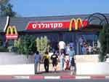
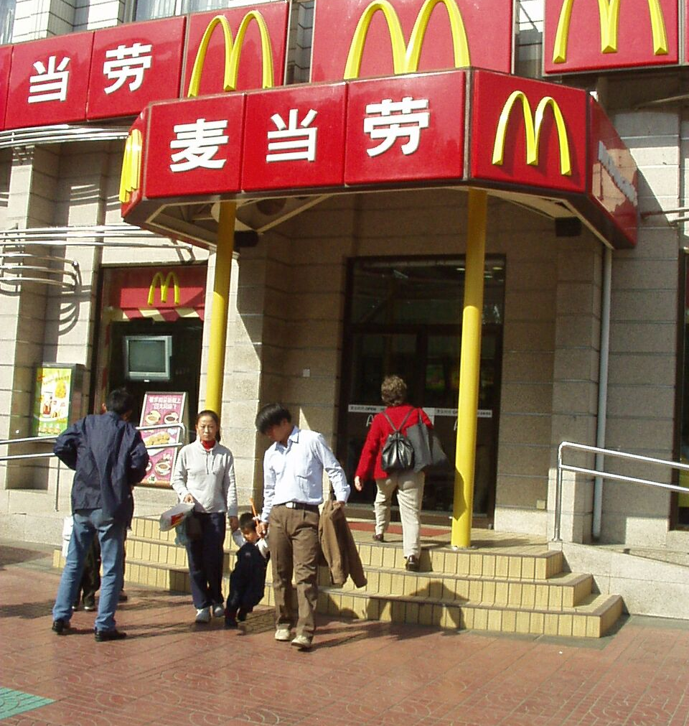
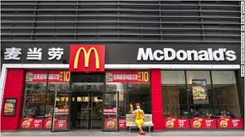
Growing Homogeneity of Tastes: McDonalds has spread all over Asia in just over two decades

Slide 12
Globalization: Challenges
Not all of the world’s economies benefit or participate equally : Terrorism, wars, and economic stagnation have limited or reversed some aspects of globalization.
Globalization produces a scarcity of natural resources, environmental pollution, negative social impacts, and increased inter-dependence of economies.
Globalization may be widening the gap between rich and poor countries.

Slide 13
Globalization: Benefits
Globalization results in lower prices in many countries, as multinationals become more efficient.
Globalization benefits many emerging markets such as India and China, as these countries enjoy greater availability of jobs and better access to technology.
Globalization is the main reason why many new companies from Mexico, Brazil, China, India, and South Korea are the new dominant competitors.

Slide 14
Making sense of globalization
Depth: How much of a country’s economic activity is taking place across national borders (compared to within the country’s borders).
Breadth: How globally a country’s international flows are distributed (for example, neighboring countries or distant countries in other regions).
Directionality: Proportion of inward to outward flow for a specific country.

Slide 15
Global Managers
“It takes more than a lot of frequent flyer miles to be come a global leader. Today’s cosmopolitan executive must know what to do when competitive advantage is fleeting, when change becomes chaos, and when home base is the globe.”
“We need global leaders at a time when markets and companies are changing faster than the ability of leaders to reinvent themselves. We have a shortage of global leaders at a time when international exposure and experience are vital to business success. And we need internationally minded, globally literate leaders at a time when leadership styles are in transition around the world.”
Cullen & Parboteeah, 2014
What makes a manager global?

Slide 16
A Strategic Approach to MNE Management
Strategy: activities used by management to sustain / increase organizational performance & accomplish its mission / vision
Strategy formulation: process of crafting a strategy (SWOT analysis in global setting)
Strategy Implementation: activities to be performed so as to achieve strategic objectives
Challenges
Blurring of industry lines
Flexibility matters more than size
Finding a niche
Hyper competition
Emphasis on innovation & learning organization

