Slide 1
International Management: Institutional Context
Angers, France
Summer 2019

Slide 2
National Context
The national context is composed of the respective (1) national cultures and (2) social institutions of a society that influence how managers make decisions regarding strategy.
Intertwined with national cultural forces are social institutions such as:
Economic system
Industrialization
Religion
Education
Level of social inequality

Slide 3
Social Institutions
Economic system: capitalism / socialism / mixed economy → impact MNCs due to
(1) government intervention levels
(2) market transitions
Level of industrialization: linked to economic development levels
Religion:
Education system
Social inequality
Notes:
National context shaped by culture but also institutions (economic system, religion, education). Similar to culture, social institutions dictate behavioral norms
ECONOMIC SYSTEM: mixed (state own education and health rest is private – France); socialism (Cuba, people in socialist system focus on building relationships rather than meritocracy system) → economic systems will dictate level of government interference in business – “index of economic freedom” (capitalist societies at the top of this list) http://www.heritage.org/index/?utm_source=google&utm_medium=ad&utm_content=062016countryrankings&utm_campaign=crcgg_2016indexeconomicfreedom
→ Market transitions (moving from one system to another) impacts workers /mgmt/ efficiencies which MNCs must work with
INDUSTRIALIZATION:
preindustrial societies (agriculture dominates, traditional, ascription) offer fewer opportunities, cheap labor, poor infrastructure & business support
Industrial societies (universalism/achievement, skilled labor) favor innovation & individualism. Significant opportunities, educated, skilled workforce, business support, stable governments
Post industrial (focus on services, educated skilled labor, highly trained/ specialized, information rich occupations-professional/technical) – increased emphasis on quality of life – implications for changing workers’ needs

Slide 4
Economic System
Economic systems: Interrelated network or system of beliefs, activities, organizations and relationships that provide the goods and services of consumed by members of a society.
Capitalist/Market Economy: decentralized to private-property-rights holders who compete for profit in a competitive market
Socialist/Command Economy: state owned and centrally coordinated production resources in pursuit of collective goals (social equality & solidarity)
Mixed Economy: Certain sectors are under private ownership and others (often heath & education) are state run.
The economic system has important implications for strategic MNE management based on:
Dominant market type
Market transitions
Notes:
The economic system shapes beliefs regarding work, property, wealth etc.
Activities production, distribution
Organizations companies, labor unions, regulator agencies, consumer groups
Capitalist/market economy: economic system in which production is decentralized to private property rights owners who act to make profits in competitive market.
Socialist/command economy: economic system in which production resources are owned by the state, and production decisions are centrally coordinated.
Mixed economy: combines aspects of capitalist and socialist economies (e.g., Sweden, France, Denmark, Italy and India).

Slide 5
Index of Economic Freedom
The extent of governmental intervention in a country.
Defines economic freedom as the absence of government coercion or constraint on the production, distribution, or consumption of goods and services beyond the extent necessary for citizens to protect and maintain liberty itself.
The index includes 10 indicators ranging from trade and taxation policies, to property rights and regulation, including government intervention in the economy.
Notes:
Government intervention also addressed in INDEX OF ECONOMC FREEDOM

Slide 6
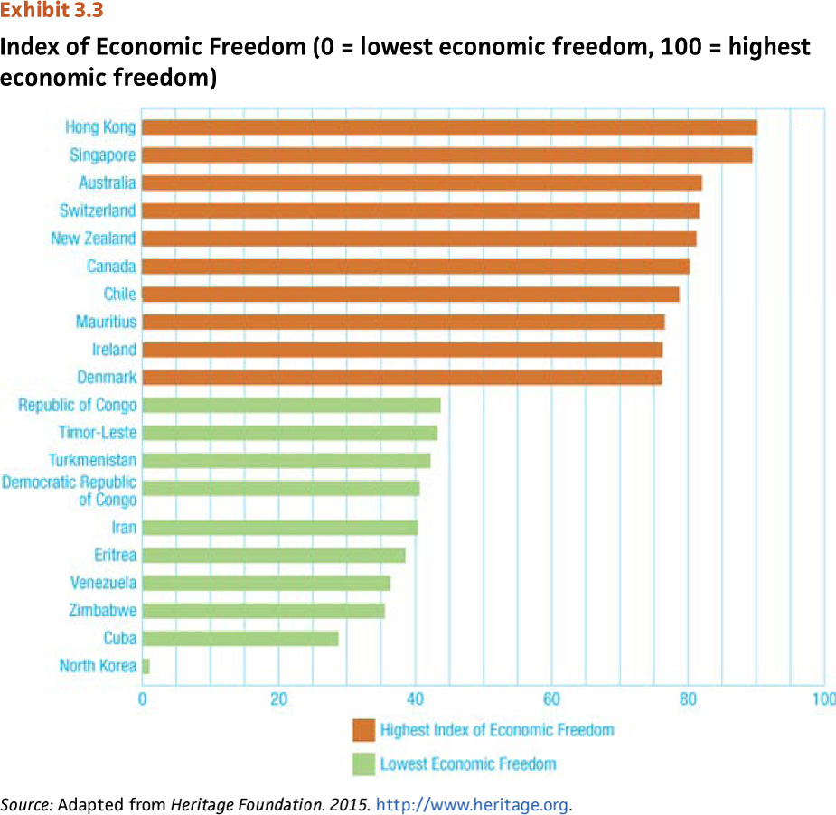
Index of Economic Freedom
Notes:
Capitalist societies are at the top of the list
Communist societies are at the bottom

Slide 7
Market Transitions
Changes that societies experience as they move from socialism to a market based economy.
Implications for Multinational managers & businesses:
Turn around inefficient formerly state-owned companies to become cost effective
Motivational issues with workers
Interpersonal trust, teams, meritocracy
Notes:
Nations in Eastern Europe and Asia (China, Vietnam) have transitioned → this represents significant opportunities for MNEs because transition economies offer access to skilled and relatively lower cost labor
Also drives increase of alliances between MNEs & local companies
IMPLICATIONS
In centrally planned economy
Most enterprises were factories with no emphasis on cost control
Little if any strategic planning, accounting or marketing
Focus on firm survival in spite of inefficiencies
Prices set by government – often not related to actual cost
Banks served central planning – loans often granted based on personal connections/relationship rather than creditworthiness
NEED TO
- Introduce idea of efficiency & introduce essential business functions
Change management mindset to being cost-effective
Prices determined by the market

Slide 8
Social Institutions
Economic system: capitalism / socialism / mixed economy → impact MNCs due to
(1) government intervention levels
(2) market transitions
Level of industrialization: linked to economic development levels
Religion:
Education system
Social inequality
Notes:
National context shaped by culture but also institutions (economic system, religion, education). Similar to culture, social institutions dictate behavioral norms
ECONOMIC SYSTEM: mixed (state own education and health rest is private – France); socialism (Cuba, people in socialist system focus on building relationships rather than meritocracy system) → economic systems will dictate level of government interference in business – “index of economic freedom” (capitalist societies at the top of this list) http://www.heritage.org/index/?utm_source=google&utm_medium=ad&utm_content=062016countryrankings&utm_campaign=crcgg_2016indexeconomicfreedom
→ Market transitions (moving from one system to another) impacts workers /mgmt/ efficiencies which MNCs must work with
INDUSTRIALIZATION:
preindustrial societies (agriculture dominates, traditional, ascription) offer fewer opportunities, cheap labor, poor infrastructure & business support
Industrial societies (universalism/achievement, skilled labor) favor innovation & individualism. Significant opportunities, educated, skilled workforce, business support, stable governments
Post industrial (focus on services, educated skilled labor, highly trained/ specialized, information rich occupations-professional/technical) – increased emphasis on quality of life – implications for changing workers’ needs

Slide 9
Industrialization
Cultural and economic changes that occur because of how production is organized and distributed in society.
Stages of industrialization:
Pre-industrial society:
Agriculture dominates the economic environment
Religious norms, tradition emphasized
Industrial society:
Dominance of manufacturing or secondary sector
Technological development driving growth
Postindustrial society:
Emphasis on the service sectors
Need highly skilled workers with specialized skills
Notes:
Pre-industrial society: ascription (vs. achievement), social mobility discouraged, social status is inherited
Industrial society: achievement (vs. ascription) broad range of skills required from workforce
Postindustrial society: emphasis on formal education because of the need for highly trained workers with specialized skills
Value of quality of life – work-life balance

Slide 10
Managerial Implications: Industrialization
Direct correspondence between industrialization and economic development:
Pre-industrial countries provide cheap labor and untapped markets BUT
Poor infrastructure for business.
Traditional and communal values.
Industrial societies favor innovation and individualism.
Governments provide favorable environment.
Educated (and more costly) labor force.
Postindustrial societies
Dominance of service sector; knowledge based.
Almost complete demise of agricultural sector.
Significant decline in manufacturing sector rise in information-rich occupations.
Increasing emphasis on quality-of-life.
Non economic incentives favored.
Post-materialist values, individual expression, and movement toward more a humane society.
Notes:
IMPLICATIONS
Economic development and industrialization go hand in hand
Pre-industrial tend to offer fewer opportunities for MNEs because they have limited market size with disposable income BUT provide low cost labor compared to industrialized societoes
Post-industrial societies: motivating employees is more challenging, need to focus on non-monetary rewards & autonomy

Slide 11
Social Institutions
Economic system:
Level of industrialization:
Religion: MNCs influenced by dominant religious practices
Education system: impacts human capital potential
Social inequality: implications for business ethics & choice of location
Notes:
RELIGION: religions continue to be pervasive & influential in people’s lives (ex. Islam during Ramadan, Christian nations during Xmas).
For Ex. Protestant work ethic as foundation of modern capitalism (Max Weber, German sociologist. Ten commandments guiding ethical conduct
For ex. Islam outlaws charging interest on loans but MNCs will be asked to share profits – find creative AND acceptable ways to manage finances. Also gender roles in Muslim countries (men work, women care for the home)
For ex. Hinduism places emphasis on duty & respect (respect for elders in family & business)
EDUCATION: impacts workers’ productivity & skill level
Variability between purely academic or academic and vocational (Germany)
+ degree to which education system encourages innovation & creativity (challenge in certain Asian societies)
SOCIAL INEQUALITY: GINI index – measures the degree to which people’s income deviates from a perfectly equal income distribution. Can have implications for less favorable work environment, see MNCs as exploiters http://data.worldbank.org/indicator/SI.POV.GINI
MNCs can put mechanisms in place to reduce inequality, for ex. Chiquita Banana in Nicaragua implemented “equal pay for equal work” for female workers, hired more female supervisors to reduce sexual harassment, created reporting mechanisms to report abuse, better maternity rights, etc.

Slide 12
Religion
Shared set of beliefs, activities, and institutions based on faith.
Religion is an important aspect of most societies. Religiosity varies across nations
Together, Christianity, Islam, Hinduism and Buddhism are followed by almost 71% of the world’s population.
20% of world’s population are nonreligious.
Different religions shape how people do business in different parts of the world with implications for international business.
Notes:
Religiosity → level of attendance in religious establishments. The higher the religiosity level in a country the more responsive a MNE should be.
Christianity
For example protestant work ethic is believed to have led to the emergence of modern capitalism in Western Europe. Protestant work ethic emphasizes hard work, creation of wealth and frugality. This world view also encourages the reinvestment of wealth - rather than spending it. This is actually common to all religions – the idea that work is an important societal obligation and important duty.
Religions also have an impact on society though important holidays such as Ramadan for Muslims or Christmas season for Christians
ISLAM
MNEs must respect / accommodate religious mandates, for example in Muslim countries, employees should be allowed to pray five times / day which is required by Shari’ya law in Muslim nations as well as accommodate unique needs during Ramadan. Charitable giving is valued, MNEs may want to take part in such activities. Islam also prohibits the charging of interest on loans, thus in Muslim nations MNEs may be required to engage in profit sharing with banks rather than interest payment. Need to also consider gender-role segregation in Muslim countries
HINDUISM
While the caste system (dividing society in to 4 hierarchical lever – priests/kings& warriors/merchants& farmers) is outlawed, it still has an impact on Indian society, putting a lower cast member in a supervisory position over higher caste members may be problematic. Also might make hiring difficult if recruits feel that the job is of low status, incompatible with their cast (ex. Of supermarket chain on pp. 74-75). Also role of family is important and adult children will still comply with parental wishes and guidance
BUDDHISM
Buddhism prescribes a strong work ethic encouraging employees to put forth their best effort. Taking initiative, persistence and hard work are respected while laziness is seen as very negative. Buddhism also emphasizes team work and high ethical standards to achieve success. Believe that companies exists for the betterment of society and other beings beyond wealth creation.

Slide 13
Education
Education: organized networks of socialization experiences which prepare individuals to act in society.
Central element in organization of society.
Helps construct competencies, professions, and professionals.
Implications for Multinationals:
Gives an idea of the skill level of workers in any society (human-capital potential).
Educational attainment helps determine the nature of the workforce.
May impact needed spending on training and development.
Other relevant information include Math and Science scores and R & D expenditures.
Notes:
Education is a critical path to economic development and progress
→ For ex. Pharmaceutical companies tend to be located around universities and other research and development in more industrialize countries because of the crucial dependence of that sector on research.,
Having a supply of ell educated individuals allows countries to facilitate the absorption of technology from developed countries.
(India for ex. Has become a center for software development because of ready access to English speaking software engineers)
Education systems will vary across countries: for ex. In France education is purely academic, in Germany there is a balance between academic and vocational components → need to look at nature of the education system beyond simply educational attainment.
For ex. Asian societies rely heavily on memorization and less on innovation and creativity. MNEs may need to supplement gaps through training.

Slide 14
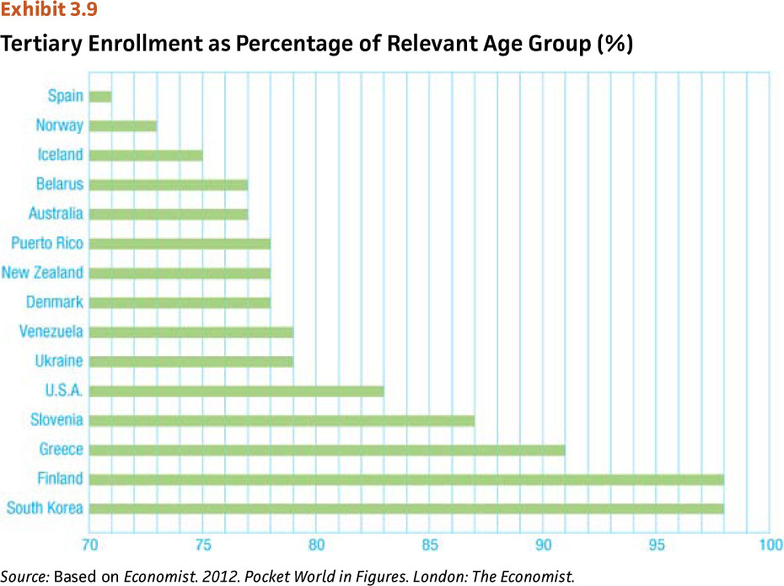
Tertiary (postsecondary) Enrollment as Percentage of Relevant Age Groups

Slide 15
Social Inequality
Refers to the degree to which people have privileged access to resources and positions within societies.
In societies with high social inequality, a few individuals have the ability to control and use important resources.
These select few use access to resources to acquire more power, thereby perpetuating inequality.
Social inequality negatively impacts the degree to which people are attached to work.

Slide 16
Social Inequality: Managerial Implications
Degree to which people in a society have privileged access to resources and/or positions.
Many MNCs are facing significant criticisms for their operations in countries with high social inequalities (ethical implications)
Criticized for paying low wages, using child labor.
Realizing social responsibility is also in their own interests.
Implications for Management:
Many key ethical issues arise in such countries.
Consider the GINI Index on the degree of social inequality.
Recognize that social inequality yields more demoralized workers, suspicious of management.
Notes:
Discuss ethics in chapter 4
Consider GINI index when doing business in other countries. GINI Index published by the world bank
GINI index measures the degree to which people’s income deviates from a perfectly equal income distribution
Some indication that high levels of social inequality negatively impact’s people’s attachment to work and leads to more demoralized workers who are distrusting of their employers who they see as exploiters

Slide 17
Summary
To understand a society, it is essential to understand both its national culture and institutional context.
Social institutions affect individuals and organizations.
Differing economic systems have major implications for multinational strategic management.
The degree of industrialization of a society is linked to its economic development.
Religion, education & social inequality also impact multinational management strategy.

