Slide 1
International Team Management: Multinationals in a Changing World
Angers, France
Summer 2019

Slide 2
Multinational Management
MNE / MNC → “Any company that engages in business functions beyond its domestic borders.”
Why should management students gain a better understanding of multinational management?
MNE Management → “Formulation of strategies and the design of management systems that successfully take advantage of international opportunities and respond to international threats.”
Where do most MNCs originate?
Notes:
Companies from developed and developing nations are increasingly looking at global rather than domestic markets
MNE - might start out with sales but usually evolves other activities (can buy raw materials in one or multiple places, manufacture in a second and sell in a third)
MNE management = “formulation of strategies and the design of management systems that successfully take advantage of international opportunities and respond to international threats”
Top MNCs most are from US & EU but growth in MNEs from emerging markets (Brazil, Russia, India, China)

Slide 3
Largest Companies in the World
Rank | Company | Industry | Headquarters Country | Revenues (US$ mil)
1 | Wal-Mart Stores | Retailing | U.S.A | 476,294
2 | Royal Dutch Shell | Petroleum | The Netherlands | 459,999
3 | Sinopec Group | Petroleum | China | 457,201
4 | China National Petroleum | Petroleum | China | 432,007
5 | Exxon Mobil | Petroleum | U.S.A. | 407,666
6 | BP | Petroleum | U.K. | 396,217
7 | State Grid | Power Supply | China | 333,386
8 | Volkswagon | Automotive | Germany | 261,539
9 | Toyota Motor | Automotive | Japan | 256,454
10 | Glencore International | Manufacturing | Switzerland | 232,694
Source: Adapted from Fortune 2015. “Fortune Global 500.”
Notes:
Largest MNCs by SALES REVENUES
MNCs not just in Western countries – also from emerging markets (BRIC – Brazil’s Embraer / India’s Tata Motors / China’s Lenovo)

Slide 4
Newcomers to Global 500 List
Notes:
The Global Environment is very dynamic, many new comers enter the playing field every year, not just from developed nations but also from developing nations

Slide 5
Globalization
Changes in the density of global interactions relative to national ones” (Chase-Dunn, Kawano & Brewer, 2000).
“The expansion, concentration and acceleration of worldwide relations” (Osterhammel & Petersson, 2001).
“Trend through which the world’s economies are becoming borderless and interlinked” (Cullen & Parboteeah, 2014)
Notes:
Globalizations is not unidirectional, some vents have slowed down or even reversed the process + not all economies benefits equally from globalization
Trade barriers are falling → goods can flow more easily across national borders
Companies can
Compete anywhere
Source raw material anywhere
Conduct R&D anywhere
Produce / assemble anywhere
Developed countries
Developing countries Hong Kong, Singapore, Taiwan
Transition economies – Czech republic, Hungary, Poland, Russia (changing from government controlled mostly communist to free market or capitalistic systems)
Emerging markets – economies that are growing rapidly BRIC, African nations
https://www.youtube.com/watch?v=u06BXgWbGvA Did you know? (6:40min)

Slide 6
Forces Driving Economic Global Integration
Rise of Global Standards
New competitors
Disintegrating borders CSR & Ethics
Growing Trade & Investment (FDI)
Growing liberalization of trade (Cross-border trade agreements)
Global Products / Customers
Growing homogeneity of tastes and desires
Technological advances
Multinational Organizations
Notes:
Rise of Global Standards → ISO-9000 (Intl. Org for Standardization), quality standards, can acquire certification http://asq.org/learn-about-quality/iso-9000/overview/overview.html
New competitors → especially in global industries & from emerging market s(ex. India’s Tata motors acquisition of British Jaguar & Land Rover; Brazil’s Embraer world’s leading makes of regional jets)
Disintegrating borders → trade agreements
CSR & Ethics → ISO-14000 (Intl. Org for Standardization), environmental protection standards + public & media scrutiny (bribery, sweatshops, pollution,)
https://ethisphere.com/ think tank that annually identifies ethical companies
Growing Trade & Investment → FDI through mergers & Acquisitions
Growing liberalization of trade → World Trade Organization: created to reduce tariffs, now focused on resolving trade disputes among nations + regional agreements such as NAFTA, EU & APEC (=Asia Pacific Economic cooperation)
Global Products / Customers → currently 70% of global trade is B-to-B but this is changing. Impact of Russian annexation of Crimea on US dairy market (when US market flooded by eastern European producers who no longer sold to Russia)
Growing homogeneity of tastes and desires → fast food, TV programs, clothing, automotive
Technological advances → ease of global communication, connect HQ, manufacturing, R&D, customers seamlessly, financial markets are becoming increasingly global, internet gives access to MNEs
Multinational Organizations →

Slide 7
Regional Trade Agreements
Regional Trade Agreements are agreements among nations to reduce tariffs and develop similar technical and economic standards.
The three largest account for half the world’s trade:
The European Union (EU) (28 European nations, and growing) allows free movement of goods and services across borders of member states without customs or quotas and adopted a common currency (the Euro). http://europa.eu/about-eu/index_en.htm
The North American Free Trade Agreement (NAFTA) linking the U.S., Canada, and Mexico, allows the freer exchange of goods and services. http://www.nafta.org
The Asia-Pacific-Economic Cooperation (APEC) is a loose confederation of economies (12 Asian nations) with agreements on trade facilitation in the Pacific region, with goals for free trade by 2020. http://www.apec.org
Notes:
Regional agreements benefit member nations – at times at the expense of other nations (for example NAFTA excludes Caribbean nations)

Slide 8
Foreign Direct Investment (FDI)
Foreign Direct Investment (FDI) occurs when a multinational company from one country has an ownership position in an organizational unit located in another country.
FDI increased by more than 36% from 1996 - 2000.
Since 2001, there has been a decline in FDI, but FDI grew to its highest level in 2007.
Emerging markets will continue to attract FDI.
Developing countries provide opportunities but also risks.
MNCs should consider two types of risk when engaging in FDI:
Economic risk: includes all factors of a nation’s economic climate that may affect a foreign investor.
Political risk: anything a government might do or not do that might adversely affect a company (ex., expropriation)
Notes:
When MNCs trade across borders – they engage in activities beyond just exports.
MNCs also build global networks that link R&D, supply, production, and sales subsidiaries around the globe. → Mergers & Acquisitions lead to FDI
MNCs can manufacture and sell anywhere!
Economic risk: when host country governments mandate an artificially high or low interest rate OR volatile exchange rates,
Political risk: Political instability will limit FDI

Slide 9
The Internet and Information Technology
The internet and information technology facilitate communication and business operations, allowing MNEs to communicate with other companies throughout the world.
Text and graphic information can flow to any part of the world almost instantaneously.
HQ and value chain activities (e.g., R&D, manufacturing) can be located anywhere in the world.
Information technology is spurring a borderless financial market.
Worldwide communication using Voice-Over-Internet Protocol (VOIP) systems are cost-effective.
Collaborative networks can be established at reasonable cost with increasingly sophisticated technology.
Information can be obtained by search engines like Google.
Notes:
E-commerce
Companies become VIRTUAL linking employees, suppliers & customers by virtual networks → even the financial market is becoming global with investors looking for the best investment opportunities worldwide
For example: Developments in computing technology mean that the manufacturing sector will no longer see hammers, lathes, drills, and stamping presses but rather more 3D printers (one of the most significant recent technologies).
The potential for the 3D printer to revolutionize multinational operations is tremendous.
Prototypes can be easily printed for approval from engineers, designers or customers For low cost!

Slide 10
Global Products and Global Customers
The needs of customers for many products and services are growing more similar (e.g., McDonald’s, Boeing, Toyota).
Global customers search the world for their supplies without regard for national boundaries.
70% of global e-commerce comes from business-to-business transactions BUT, with the growth of web-based stores, this will change.
These factors link economies because companies can produce one product for everyone, and anyone can buy anything from anywhere.
Notes:
Homogeneity of tastes

Slide 11
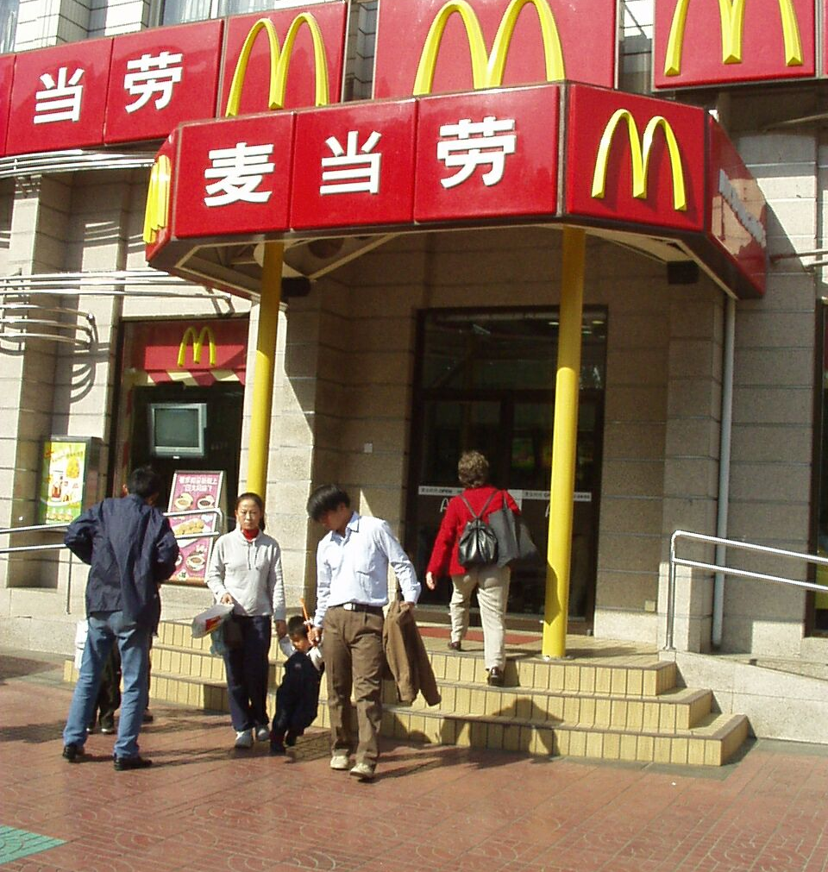
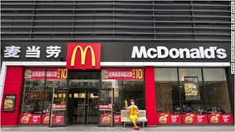
Growing Homogeneity of Tastes: McDonalds has spread all over Asia in just over two decades

Slide 12
Globalization: Challenges
Not all of the world’s economies benefit or participate equally : Terrorism, wars, and economic stagnation have limited or reversed some aspects of globalization.
Globalization produces a scarcity of natural resources, environmental pollution, negative social impacts, and increased inter-dependence of economies.
Globalization may be widening the gap between rich and poor countries.
Notes:
BUT Globalization also
Contributes to scarcity of natural resources
Environmental pollution
Negative social impacts
Higher interdependence among world’s economies
Some argue also a widening gap between rich and poor countries

Slide 13
Globalization: Benefits
Globalization results in lower prices in many countries, as multinationals become more efficient.
Globalization benefits many emerging markets such as India and China, as these countries enjoy greater availability of jobs and better access to technology.
Globalization is the main reason why many new companies from Mexico, Brazil, China, India, and South Korea are the new dominant competitors.
Notes:
The benefits of globalization
Lower prices – more buying power for consumers
Higher efficiency driving local productivity through competition
Opportunities for emerging markets to grow, create better jobs and have access to technology

Slide 14
Making sense of globalization
Depth: How much of a country’s economic activity is taking place across national borders (compared to within the country’s borders).
Breadth: How globally a country’s international flows are distributed (for example, neighboring countries or distant countries in other regions).
Directionality: Proportion of inward to outward flow for a specific country.

Slide 15
Global Managers
“It takes more than a lot of frequent flyer miles to be come a global leader. Today’s cosmopolitan executive must know what to do when competitive advantage is fleeting, when change becomes chaos, and when home base is the globe.”
“We need global leaders at a time when markets and companies are changing faster than the ability of leaders to reinvent themselves. We have a shortage of global leaders at a time when international exposure and experience are vital to business success. And we need internationally minded, globally literate leaders at a time when leadership styles are in transition around the world.”
Cullen & Parboteeah, 2014
What makes a manager global?
Notes:
Global mindset: think globally but act locally – see similarities in global markets while at the same time being able to adapt to local conditions
Emotional Intelligence: better ability to adjust and effectively interact with people from other cultures. Cultural sensitivity even if communicating in English
Long range perspective:
Talent to motivate all employees: motivational strategies that transcend cultures, getting employees to identify/be loyal to the organization not their nation
Negotiation skills: negotiating across cultures, decision making styles differ
Seek international assignments: international experience, ability to demonstrate success in more than one cultural context
Understand cultures: in spite of globalization, national differences persist. Cross cultural intelligence + language skills
« vérité en deçà des Pyrénées, erreur au-delà » de Pascal.

Slide 16
A Strategic Approach to MNE Management
Strategy: activities used by management to sustain / increase organizational performance & accomplish its mission / vision
Strategy formulation: process of crafting a strategy (SWOT analysis in global setting)
Strategy Implementation: activities to be performed so as to achieve strategic objectives
Challenges
Blurring of industry lines
Flexibility matters more than size
Finding a niche
Hyper competition
Emphasis on innovation & learning organization
Notes:
Strategy: activities used by management to sustain / increase organizational performance
Strategy formulation: process of crafting a strategy (SWOT analysis in global setting) identify opportunities & threats globally and identify systems to carry out strategy in multiple contexts
Strategy Implementation: activities to be performance so as to achieve strategic objectives
Blurring of industry lines: for ex. Samsung manufactures TVs, cellphones, microprocessors
Flexibility matters more than size: size can be liability with growth in outsourcing / alliances (can convert fixed cost to variable cost)
Finding a niche: finding a niche market and satisfying its needs
Hyper competition: intense competition that is global (Haier, Chinese company entered US in 1999, now leader in selling small dorm refrigerators & wine coolers)
Emphasis on innovation & learning organization: integrate local knowledge to create value R&D

