Slide 1
International Management: Cultural Context
Angers, France
Summer 2018

Slide 2
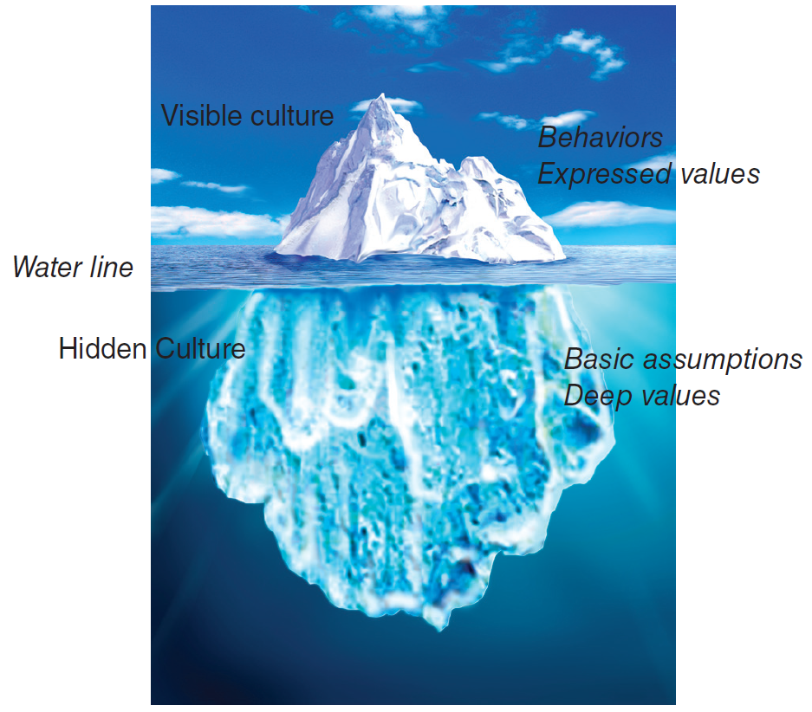
Societal Culture
Culture = set of values, beliefs and learned behaviors, shared with others in a particular society; gives a sense of belongingness and identity. Culture shapes behavior and cognition of individuals; transmitted across generation.

Slide 3
Interpreting Behavior
A Chinese manager ignores the clock he received as a gift from his European business partner.
An Asian executive for a multinational company, transferred from Taiwan to the Midwest, appears aloof and autocratic to his peers.
A West Coast bank embarks on a “friendly teller” campaign, but its Filipino female tellers won’t cooperate.
The visiting scholar from Argentina made a comment about a colleagues weight.
A business man from India, while hosted for dinner at his Kenyan counterpart’s home, leaves some of his food on his plate during dinner time.

Slide 4
Culture and Stereotyping
How the Americans
see the French:
arrogant
flamboyant
hierarchical
emotional
How the French see the Americans:
naive
aggressive
unprincipled
workaholic
French Culture
American Culture
Norms and Values

Slide 5
Cross Cultural Management Studies: Hofstede
Power distance (PD): degree to which power is unequally distributed in society.
Uncertainty avoidance (UA): degree to which ambiguity is tolerated, perceived threat by ambiguous / unknown situations.
Individualism / collectivism (IDV): relationship between the individual and the group.
Masculinity / femininity (MAS): expectations regarding gender roles.
Long-term Orientation (LTO): orientation toward time.

Slide 6
France, U.S., Spain & China
Source: www.geert-hofstede.com

Slide 7
Cross Cultural Management Studies: GLOBE
In-group & Institutional Collectivism
Future Orientation
Uncertainty avoidance
Power distance
Gender egalitarianism & Assertiveness
Performance orientation – degree to which a society encourages innovation, performance, assertiveness, excellence.
Humane orientation – degree to which a society encourages fairness, altruism, caring, generosity.

Slide 8
Cross Cultural Management Studies: 7d cultural model
Universalism Particularism | The choice of dealing with other people based on rules or based on personal relationships
Communitarianism Individualism | Focus on group membership versus individual characteristics
Neutral Affective | The range of feelings outwardly expressed in a society, little emotional display (objective and functional focus in business) emotions are part of life and business
Diffuse Specific | Type of involvement people have with each other ranging from all aspects of life to specific components
Achievement Ascription | Assignment of status in the society based on performance vs. assignments based on heritage
Sequential / Synchronic concept of time | Orientation of society to time, history (past), future, or present
Internal / External Control | Nature viewed as something to be controlled and altered or something to be accepted

Slide 9
Cross-Cultural Communication
Context (high vs. low)
Communication style (direct vs. indirect; formal vs. informal)
Non-verbal (facial expressions, hand gestures, eye contact)
Proxemics and touch
Interpreters
Corporate language

Slide 10
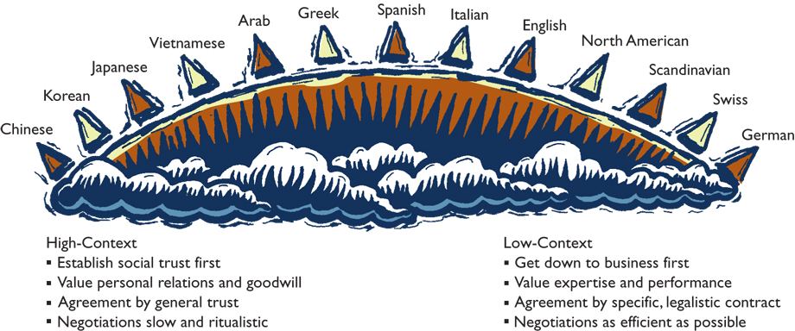
High-& Low-Context Cultures

Slide 11
Interpersonal Space for Business Conversations
Public
Social
Personal
Intimate
12.0
4.0
1.5
0
US Interpersonal Zones (distance in feet)
Arab
Asian + Latin American Cultures
North American + Northern European

Slide 12
Cross Cultural Negotiations
Preparation
Build relationship & trust
Information exchange / offer
Persuasion
Concession / agreement
Post-agreement

Slide 13
Chinese Cultural Values
Guanxi (personal connections)
Shehui Dengji (social status)
Renji Hexie (interpersonal harmony)
Jiejian (Thrift).
Miazi (face, social capital).
Chiku Nailao (endurance, relentlessness)

Slide 14
Culture and Individuals
National / Societal Culture
Sub-national culture
Organizational Culture
Ex. The culture of Nissan and Sony versus the Japanese culture
Individual culture
Function of different affiliations, extent of socialization, learned through experience …
Stereotyping vs. CQ

