Slide 1
International Management: Organizational Design
Angers, France
Summer 2018
Notes:
Org design: how organizations structure (divide the work into) subunits and use mechanisms for coordinating and controlling (those subunits to achieve desired goals . The larger the organization, the higher the number of subunits that are specialized
No best org structure, has to fit goals/strategy. Some organizations want flexible structures to respond to local tastes (Multidomestic strategy), others want tighter control / centralization & efficiency (International Strategy)

Slide 2
HQ
CEO/GM
Vice President Production
Vice President
Engineering
Vice President Marketing and Sales
Vice President
Accounting
Quality Control
R & D
The Functional Structure
Notes:
Functional structure: most commonly used in SMEs
Grouping employees by functional specialization (requires coordination)
Appropriate for low-uncertainty environments or for SMEs that focus on control and efficiency, or MNCs with few products, few locations or few customer types
CHALLENGE: how to encourage different functional departments to interact and coordinate activities (silos), sometimes departments are too intently focused on competing for resources to achieve their own goals, slow to respond to change

Slide 3
HQ
CEO/GM
Product/Division B (headed by a VP)
Product/Division A (headed by a VP)
Product/Division C (headed by a VP)
Production
HR
Marketing and Sales
Accounting
Production
HR
Marketing and Sales
Accounting
Production
HR
Marketing and Sales
Accounting
The Product/Divisional Structure
Notes:
Product / Divisional / Regional Structure:
Groups people by the product / service they work on OR by geographic region → large companies can have a product AND region structure (ex. Pepsi)
Decentralized leadership with focus on customer satisfaction and flexibility → more responsive to customer demands
CHALLENGES: can lose sight of organizational goals because each group/division becomes like a separate company, duplication of functions within each division/region requires more managers & people, loss of economies of scale BUT reduces coordination costs across divisions.
Less effective as organization grows

Slide 4
The Hybrid Structure
CEO/General Manager
Research and Development
Legal Counsel
Public Relations
Product/Division A
Product/Division A
Product/Division C
Production
HR
Marketing and Sales
Production
HR
Distribution
Accounting
Production
HR
Contract Management
Accounting
Notes:
When companies grow, functional and product structure are not as effective, very large organizations need other structural options
Hybrid Structure has organizational HQ that provide several functions to all divisions. The divisions then specialize either by product or by region. (in line with international strategy)
Used by many MNEs → offers flexibility and greater ability to deal with an uncertain environment, responsive to customers

Slide 5
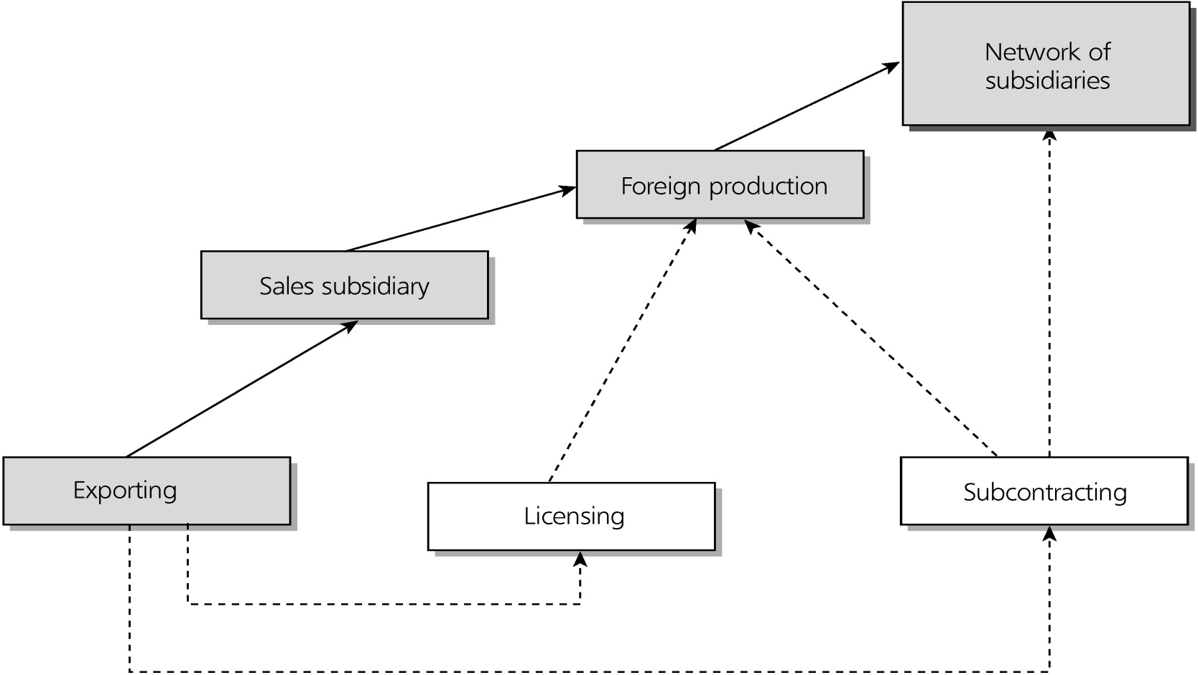
Internationalization & Structural Change
How does organizational structure adapt when a company internationalizes?
Notes:
Internationalization usually starts as:
Passive export through foreign distributor
Licensing
These require limited organizational restructuring. Once foreign operations grow in size/importance, some changes may result
Sales subsidiary (direct exporting)→ usually results in creating an export department that answers to HQ in the functional structure
Foreign production (can occur as subsidiary or outsourced)
Foreign subsidiaries: established by MNCs through FDI overseas. Can fulfill one part of value chain (compatible with the transnational strategy)OR be mini replica of parent organization (compatible with multi-domestic strategy) → typically seen as profit center but not source of R&D
An export division is created when international operations growth in staff and foreign manufacturing occurs so as to supervise a network of foreign subsidiaries (manufacturing, sales, etc)

Slide 6
HQ
CEO/GM
Vice President Production
Vice President
Engineering
Vice President Marketing and Sales
Vice President
Accounting
Quality Control
R & D
Vice President Export Department
The Functional Structure

Slide 7
HQ
CEO/GM
Product/Division B (headed by a VP)
Product/Division A (headed by a VP)
Product/Division C (headed by a VP)
Production
Domestic & Global
HR
Marketing and Sales
Accounting
Production
Domestic & Global
HR
Marketing and Sales
Accounting
Domestic
Foreign
Domestic
Foreign
Production
Domestic & Global
HR
Marketing and Sales
Accounting
Domestic
Foreign
The Product/Division Structure
Notes:
Benefit from centralizing ‘up steam’ functions at HQ BUT can lose touch with local customers
The product structure serves strategies that emphasize global products best; the geographic structure best supports strategies that emphasize local adaptation. To overcomes the limitation or either-or, MNCs try alternative/hybrid structures: Matrix, networked, transnational, metanational …

Slide 8
The Matrix
Notes:
THE MATRIX An attempt to integrate operations across more than one dimension: usually function & product or region & product (18% of MNEs). Allows MNEs to respond to environmental uncertainty & customer demands. Be more flexible, efficient + higher quality.
Integrated functional specialists with project/product specialists → cross functional teams
International/Geographical division and product division share joint authority → Violates Fayol’s principle of unity of command. Ex. Europe mgr responsible for products A B & C in all the countries that comprise his region. Product A mgr responsible for sales of product A in all areas. + dual reporting. HR mgr in specific country reports to country manager AND regional manager
BENEFITS: conflict of interest are brought into the open, each issue has an executive champion to ensure it is not neglected. Some see the matrix as the only organizational form that allows a strategy to pursue simultaneously multiple business dimensions.
CHALLENGES: expensive form that requires careful implementation and commitment from top management
Considered to bring into the management system a philosophy of matching the structure to the decision-making process. Bartlett & Ghoshal cite more challenges:
Dual reporting leads to conflict and confusion
Proliferation of communication channels which creates informational logjams
Overlapping responsibilities can create turf battles and loss of accountability
Barriers of distance, language, time and culture which make it virtually impossible to resolve conflicts and clarify confusion
In order to function well in a matrix structure: managers need good interpersonal skills, able to deal with ambiguities of responsibility and authority inherent in the matrix system + cross cultural conflict. This makes the role of HR and importance of training even more central.
Ex. Boeing used this structure to design newest airplane by teaming up managers, engineers, designers, marketers and other specialists who coordinated activities.

Slide 9
Coordination & Control
Control systems (vertical)
Measure / monitor sub-unit performance on assigned roles
Provide sub-units with feedback regarding effectiveness
How can MNCs exercise control?
Coordination systems (horizontal)
Information flow among subsidiaries
How can MNCs best coordinate their subsidiaries?
Notes:
Control systems (vertical)
Measure / monitor subunit performance on assigned roles ( roles for each subsidiary can be different: profit generation, market share, develop new technologies, supply raw materials)
Provide subunits with feedback regarding effectiveness
CONTROL MECHANISM
Bureaucratic (formal) control: budgets, statistical reports on non-financial outcomes (# of units produced, # of defective units), standard operating procedures – rules & regulations, centralized decision making.
Cultural (informal): use organizational culture, shared norms & beliefs guide behavior, can be more effective than bureaucratic mechanisms, especially in rapidly changing environments
Coordination systems (horizontal)
Information flow among subsidiaries
COORDINATION MECHANISMS
Communication: memos, reports, electronic communication
Direct contact: videoconferencing, travel
Liaison roles: certain individuals might be given the responsibility to act as liaison in certain region on top on other job duties
Full-time integrators: like liaisons but coordination is their only responsibility. for example product managers who coordinate between production and local sales units
Task forces: temporary teams created to solve specific problem, ex. Enter a new market
Teams: permanent units that coordinate efforts (new product development can consist of R&D people from different regions, sales, production, quality control, etc.) across countries, can be virtual teams. In order the be effective teams need: (1) time to build trust & relationships, (2) time for project planning and progress meetings, (3) training on communicating across cultures. Teams facilitate knowledge transfer

