Slide 1
International Management: Cultural Context
Angers, France
Summer 2018

Slide 2
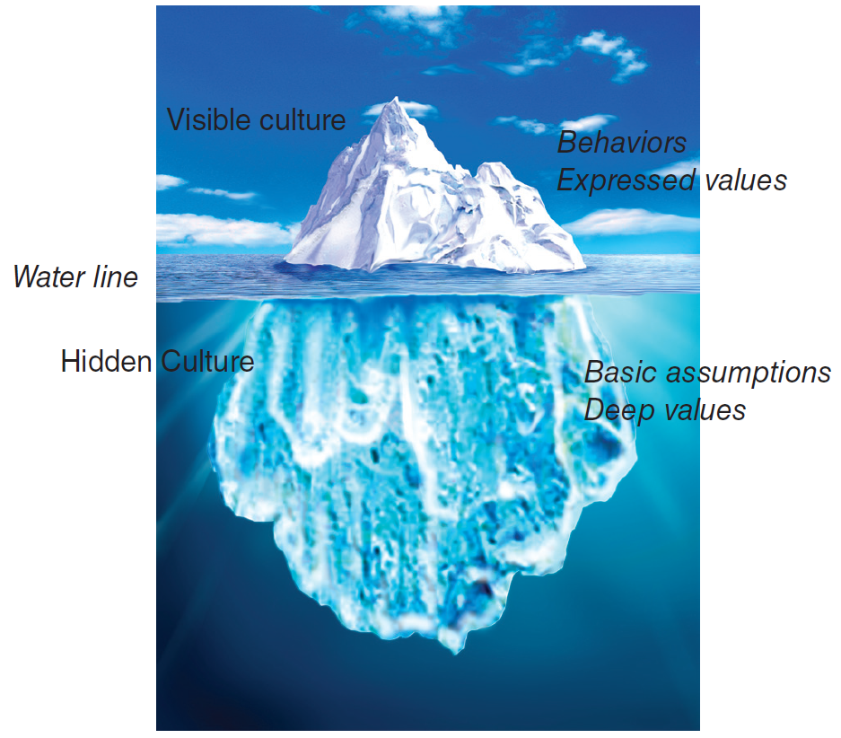
Societal Culture
Culture = set of values, beliefs and learned behaviors, shared with others in a particular society, gives a sense of belongingness and identity. Culture shapes behavior and cognition of individuals, transmitted across generation.
Notes:
Norms – what we can / cannot do (dress code, form of address)
Values – what is good / holy / legitimate
Symbols / rituals / stories : US managers large offices with desk as barrier, Japanese manager, desk in center among employees
Taken for granted pervades every part of life, not always aware of culture

Slide 3
Interpreting Behavior
A Chinese manager ignores the clock he received as a gift from his European business partner.
An Asian executive for a multinational company, transferred from Taiwan to the Midwest, appears aloof and autocratic to his peers.
A West Coast bank embarks on a “friendly teller” campaign, but its Filipino female tellers won’t cooperate.
The visiting scholar from Argentina made a comment about a colleagues weight.
A business man from India, while hosted for dinner at his Kenyan counterpart’s home, leaves some of his food on his plate during dinner time.
Notes:
Importance of local knowledge – HSBC bank https://www.youtube.com/watch?v=GOHvMz7dl2A (3 min)
2nd set
https://www.youtube.com/watch?v=ALWwK7Vz4gY&x-yt-ts=1421782837&x-yt-cl=84359240

Slide 4
Culture and Stereotyping
How the Americans
see the French:
arrogant
flamboyant
hierarchical
emotional
How the French see the Americans:
naive
aggressive
unprincipled
workaholic
French Culture
American Culture
Norms and Values
Notes:
We usually focus on what is different – starting point for understanding differences, avoid stereotyping (=ethnocentrism)
Stereotyping = mental ‘files’ used to process information based on past experience or other knowledge
Managers are ineffective in cross-cultural situations when they either deny having stereotypes or get stuck in them. Practice cultural relativism = understanding that things may work differently across cultures
Develop your CQ (through exposure to other cultures).
NOTE: Nationals of small countries tend to be the ones that have acquired most cultural sensitivity as they need to develop commercial relations with bigger nations (Ex. Denmark, Finland, Netherland, Switzerland, Singapore)

Slide 5
Qualities or Flaws?
American Qualities | Others’ Perceptions
Democracy & equality | Does not exist, impractical anyway (Asian)
Individualism | Lack of concern for others (Asian, Swedish)
Competitiveness | Aggressiveness (French)
Speedy decisions | Rushed (Japanese, Chinese)
Frank, direct | Rude (Japanese, French)
Optimism | Lack of realism (Scandinavians)
Seek change and improvement | Lack of protection for status quo (Saudi)
Results oriented | Lack in people orientation (Italian, Asian)
Self-confidence | Arrogant (South American, Arabs)
Informal, smiling | Lack of respect, insincere (German, French)
Future orientation | Disregard for past, tradition
Defends democracy & free trade | Defends American interests (Russian, Arab)
Sometimes, what we see as a quality or strength, others perceive as a major flaw, consider implications for cross-cultural negotiations and interactions.

Slide 6
Cross Cultural Management Studies: Hofstede
Power distance: degree to which power is unequally distributed in society
Uncertainty avoidance: degree to which ambiguity is tolerated, perceived threat by ambiguous / unknown situations
Individualism / collectivism: relationship between the individual and the group
Masculinity / femininity: expectations regarding gender roles,
Long-term Orientation: orientation toward time
Notes:
GENERAL TENDENCIES
PD: The degree to which people in a country accept that power is distributed unequally in society & in org
High PD: (France, Latin America): Inequality is fundamentally good -- Everyone has a place; some are high, some are low -- Most people should depend on a leader -- The powerful are entitled to privileges & should not hide their power. Brainstorming would not be effective in high PD culture
LOW PD (Denmark, Sweden, US): Hierarchy, status and power of top management is downplayed
EXAMPLE: Importance of hierarchy and role of age: and American oil company in a Pacific island hired HCNs, all newly hired foremen were assassinated → company failed to realize the link between age and status and the fact that in this nation it was unacceptable for younger men to supervise their seniors.
POWER DISTANCE → https://www.youtube.com/watch?v=sqaa42gbqhA
UA: Linked to basic assumption of control over nature: discomfort with uncertainty, desire to control and predict, avoid risk. These assumptions about control over nature are reflected in planning rituals, the importance placed on schedules, and belief in taking initiative and responsibility. (High: German speaking countries: Germany, Austria & Asian cultures: Singapore, Hong Kong)
Conflict should be avoided
Deviant people and ideas should not be tolerated
Laws are very important and should be followed
Experts and authorities are usually correct
Consensus is important
IDV: (US, Northern EU, Canada, Anglo-Saxon nations: UK, Australia) social pattern of loosely linked individuals who view themselves as independent of collectives and who are motivated by their own preferences, needs, rights, and contracts. → People in individualist cultures think of the “self” as independent of the immediate social environment and see each piece of information as independent of its context. More emphasis on rationality and rational analysis in knowledge transfer and reception.
Motivation towards achievement and power -- Conflict is seen as inevitable
Tasks valued over relationships
Management entails management of individuals
Hiring and promotion are based on skill and roles
Employer-employee relationship based on mutual advantage
Collectivism: (Asia, Latin America) social pattern of closely linked individuals who see themselves as belonging to one or more collectives—family, tribe, in-group, organization—and who are motivated by norms, duties, and obligations which are imposed by the collective. → people in collectivist cultures see the “self” as functioning inter-dependently with significant others within the immediate social environment and look for contextual cues in each piece of information. More emphasis on historical & contextual information
Motivation towards affiliation
Relationships valued over tasks
Conflict is seen as a negative force
Management entails management of groups
Hiring and promotion takes in-group into account
Employer-employee relationship is like a family connection
Taking care of business vs. taking care of people

Slide 7
France, U.S., Spain & China
Source: www.geert-hofstede.com
Notes:
PD: France relatively high, hierarchical society, company leaders usually come from prestigious universities (grande ecole)
IDV: lower than US but still individualistic, family tighter knit, more respect for elderly
MAS: France is somewhat Feminine (strong welfare programs, emphasis on quality of life)
UA: France ranks high, planning & structure are respected (possibly explain French expertise in developing complex systems such as nuclear power plants & rapid train systems)
LTO: France scores high, pragmatic society, ability to adjust traditions to current context/changed conditions. Strong propensity to save/invest, perseverance in achieving results

Slide 8
Cross Cultural Management Studies: GLOBE
In-group & Institutional Collectivism
Future Orientation
Uncertainty avoidance
Power distance
Gender egalitarianism & Assertiveness
Performance orientation – degree to which a society encourages innovation, performance, assertiveness, excellence.
Humane orientation – degree to which a society encourages fairness, altruism, caring, generosity.
Notes:
GLOBE: Global Leadership and Organizational Behavior Effectiveness. 62 countries, various organizations/industries
Clusters with unique profiles: south Asia – Latin America – North America – Anglo Cluster – Germanic & Latin EU – Sub-Saharan Africa – Eastern EU – Middle East – Confucian Asia
Institutional COL: degree to which organizational and institutional practices encourage and reward collective distribution of resources and collective action
In-group COL: degree to which individuals express pride, loyalty and cohesiveness in tier organizations and families
UA: extent to which a society, organization or group relies on social norms, rules and procedures to alleviate unpredictability of future events
PD: degree to which members of a collective expect power to be distributed equally
Gender Egalitarianism: degree to which a collective minimizes gender inequality
Assertiveness: degree to which individuals are assertive, confrontational and aggressive in relationships with others
Performance Orientation: degree to which a collective encourages and rewards group members for performance improvements and excellence. Tend to value training & development (over family / schooling background),
Humane Orientation: the degree to which a collective encourages and rewards individuals for being fair, altruistic, generous, caring and kind to others

Slide 9
Cross Cultural Management Studies: 7d cultural model
Universalism Particularism | The choice of dealing with other people based on rules or based on personal relationships
Communitarianism Individualism | Focus on group membership versus individual characteristics
Neutral Affective | The range of feelings outwardly expressed in a society, little emotional display (objective and functional focus in business) emotions are part of life and business
Diffuse Specific | Type of involvement people have with each other ranging from all aspects of life to specific components
Achievement Ascription | Assignment of status in the society based on performance vs. assignments based on heritage
Sequential / Synchronic concept of time | Orientation of society to time, history (past), future, or present
Internal / External Control | Nature viewed as something to be controlled and altered or something to be accepted
Notes:
Specific vs. diffuse www.youtube.com/watch?v=M1ImfD0GhEg
how we relate to others
Universalism / Particularism: US - Mexico
Communitarianism / Individualism: US - Japan
Neutral / Affective: Sweden – China (animated expression, touching, emotional outburst)
Diffuse / Specific: Sweden – China (segregation between life & business)
Achievement / Ascription: US- Argentina (emphasize chain of command, use titles)
Sequential / Synchronic concept of time: US future oriented (change = good)
Internal / External Control: US, Spain – Arabic cultures

Slide 10
Cross-Cultural Communication
Context (high vs. low)
Communication style (direct vs. indirect; formal vs. informal)
Non-verbals (facial expressions, hand gestures, eye contact)
Proxemics and touch
Interpreters
Corporate language
Notes:
Interpreters – translate spoken language but can also be cultural interpreters
(ex. Company translated benefits materials for employees in Latin America, employees did not understand the concept of a retirement plan, not because it was poorly translated but because it was culturally incongruent – in Latin America people have poor trust in banks and there is an expectation that children will care for aging parents)

Slide 11
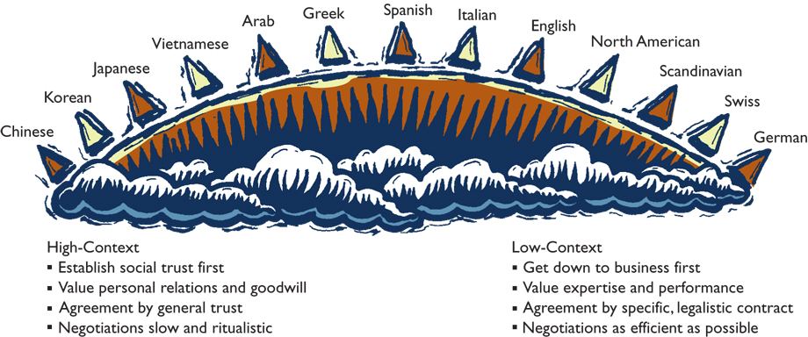
High-& Low-Context Cultures
Notes:
High context
Establish social trust first
Value personal relations & goodwill
Agreement by general trust
Negotiations slow & ritualistic
Tone of voice, speaking manner MORE important than content
Low context
Get down to business first
Value expertise & performance
Agreement by specific, legalistic contract
Negotiations as efficient as possible
High context culture will read between the lines → interpretation can be different than intent.
Low context American: “OK, we’ll accept your terms”
High context Italian: American has distaste for our terms

Slide 12
Decoding British Indirect Communication
In order to avoid direct criticism, British communicators often use understatements such as:
I will call you = I will not call you
Hmm…interesting idea = Forget it
We’ll certainly consider it = We will not do it
I agree, up to this point = I disagree
I say, that’s not bad = It is excellent
Notes:
Communicating in English
Brits use indirect communication, they attack/criticize indirectly, are very aware of social class
Americans do not emphasize social class and speak very directly BUT use many expressions
He’s on a roll → He is doing well
It bombed → it failed
He is out in left field → he is not speaking to the point
We are playing for all the marbles → this is an important deal
If you play ball → if you cooperate
Americans are also very politically correct when talking about sex, race, appearance

Slide 13
Interpersonal Space for Business Conversations
Public
Social
Personal
Intimate
12.0
4.0
1.5
0
US Interpersonal Zones (distance in feet)
Arab
Asian + Latin American Cultures
North American + Northern European
Notes:
Cultures differ in the preferred interpersonal distance. Proxemics is the term for the study of cultural expectations about interpersonal space.
High context cultures: stand close to each other
Low context cultures: greater personal space
Standing too close can be interpreted as pushy & too far as distant

Slide 14
Cross Cultural Negotiations
Preparation
Build relationship & trust
Information exchange / offer
Persuasion
Concession / agreement
Post-agreement
Notes:
Preparation: BATNA, what do I want, what does the other party want. Send right person (seniority & language), know other party’s cultural negotiation style (ex. Negotiation can be used as a way to build relationship, differences in communication style, importance of face saving, use of silence, emotional display)
Build relationship & trust: in US & Germany get down to business fast after short “small talk” in Asia, middle east more extended. In US the contract is the goal, in China it is the beginning
Information exchange / offer: first offer, be prepared to negotiate, not every culture will strive for a win-win. Integrative view
(win/win, long term relationship) vs. distributive view (win/lose, short term, dirty tricks)
Persuasion: negotiation tactics vs. dirty tricks → cultures differ to the extent that it is expected for people to play dirty tricks
Concession / agreement: In US reciprocity is the norm, in Asia negotiations viewed in holistic approach.
Post-agreement: organizational learning fur future, part of long term cultural orientation
Compromise:
Anglo-Saxons = favor it, flexibility in negotiations is seen as a virtue (others may perceive as “give-and-take tactics”)
Japan = departure from previously agreed upon consensus within the company
France = if well formulated argument stands undefeated, why compromise? Reputation for being strong negotiators
Spain/Argentina/Mexico/Panama = compromise may be perceived as loss of face – weakens = erosion of one’s position

Slide 15
Chinese Cultural Values
Guanxi (personal connections)
Shehui Dengji (social status)
Renji Hexie (interpersonal harmony)
Jiejian (Thrift).
Miazi (face, social capital).
Chiku Nailao (endurance, relentlessness)
Notes:
Chinese Cultural values:
Guanxi (personal connections) = social capital. The person with the best Guanxi wins. Personal connections are necessary to do business, can not reach people without it. (Importance of Guanxi is fading a bit given population mobility in China and Westernization of some business practices but remains important) → places importance of reciprocity which builds long terms commitment to personal connections. Ignoring reciprocity in China is not only a sign of bad manners – considered immoral, will taint future interactions.
Keiretsu in JAPAN = network of tight relationships between customers, suppliers relies on high degree of mutual trust.
Zhongjin Ren (intermediary). Trust can not be earned because business relationships can not even be formed without it. Trust must be transmitted via Guanxi → must have a Chinese intermediary to introduce you through his social connections. Intermediary also serves as cultural guide to understand subtleties of Chinese language and body langauge. For ex., in order to preserve harmony Chinese may not say “no” but change the subject, turn silent, ask a different question, give vaguely positive answers,
Shehui Dengji (social status) formality. Casualness is not welcome in China (no use of first names) given Confucian values of obedience and deference to one’s superiors. Ex. Must send the right person to negotiations, not someone too junior in rank or too young which may send a message that this negotiation is not very important to you.
Renji Hexie (interpersonal harmony) harmonious relationships. “a man without a smile should not open a shop”; “sweet temper and friendliness produce money”
Building interpersonal relationships may take days, weeks but is necessary in order to do business. Can not rush = considered rude.
Trust and harmony are more important to Chinese business people that any piece of paper, many deals rely on good faith than on tightly drafted deals.
Zhengti Guannian (holistic thinking). Chinese think of the whole while Americans think sequentially and individualistically. Negotiation for Westerns might be broken into price, quantity, warranty, delivery while Chinese see it as a whole, negotiating the package as a whole and addressing details without particular order and going back to issues repeatedly.
Jiejian (Thrift). Mainland Chinese save 4 times as much as Americans do. Chinese will look for the best deal, may frame it as a way to save face.
Miazi (face, social capital). Importance of person’s reputation and social standing, allow to save face. Face can be earned, lost, given, or taken away. In the US sometimes ‘mock tantrum’ is used in negotiations, in China this may backfire – lead to loss of face.
Chiku Nailao (endurance, relentlessness)
Americans value talent as a key to success Chinese see endurance and relentlessness as much more important. Source of Chinese industriousness. Chinese will prepare for negotiations very thoroughly and will plan to spend more time at the table.

Slide 16
Culture and Individuals
National / Societal Culture
Sub-national culture
Organizational Culture
Ex. The culture of Nissan and Sony versus the Japanese culture
Individual culture
Function of different affiliations, extent of socialization, learned through experience …
Stereotyping vs. CQ
Notes:
We tend to see our own culture as a reference point to how we evaluate other cultures. We are often unaware of our own culture until we go somewhere else and are able to identify differences. Very often we believe other see us as we see ourselves which is not always the case.
Convergence / divergence debate → research findings seem to indicate that at the organizational level (processes, technology) are converging BUT meaningful differences in employee behaviors exist and are enduring – Divergence.

