Slide 1
Trust’s Effect on Happiness
Ethan Hunter, Tanner Landolt, Hannah Perry
April 29th, 2024
Notes:
Tanner

Slide 2
To what extent does an individual’s trust in various aspects of their society impact their happiness?
Notes:
Motivate the topic; Tanner

Slide 3
Overview
European Social Survey (ESS)
Surveyed 33 countries in Europe on various social topics
Average value of answers to survey questions in 2020
Latvia’s citizens are the least happy
Denmark’s citizens are the happiest
Notes:
Tanner

Slide 4
Variables
Dependent
Subjective Happiness (ess_happy)
“Taking all things together, how happy would you say you are?”
—--------------------------------------------------------------------------------
Note: All variables are answered on a scale from 0-10, 0 indicating not trusting/happy and 10 indicating very trusting/happy
Independent
Trust in Other People (ess_trpeople)
“Generally speaking, would you say that most people can be trusted, or that you can’t be too careful in dealing with people?”
Trust in Police (ess_trpolice)
“Please tell me on a score of 0-10 how much you personally trust each of the institutions I read out” (Also asked for the following variables)
Trust in Politicians (ess_trpolit)
Trust in Legal System (ess_trlegal)
Trust in Political Parties (ess_trpart)
Trust in Parliament (ess_trparl)
Notes:
ESS: European Social Survey - 32 countries (observations)
Average survey values in 2020 (Ethan)

Slide 5
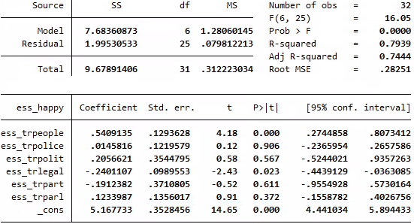
Strategy and Results
Estimation Strategy: Multiple Regression
No binary variables
Only one time period (2020)
Important Notes
R-squared is high
Trust in people and legal system are the most significant variables
Trust in police may as well not be included
Notes:
Note r-squared and p values (Ethan)

Slide 6
Insights
happiness = 5.17 + .54people + .01police + .21politicians - .24legal - .19parties + .12parliament
(0.35) (0.13) (0.12) (0.35) (0.10) (0.37) (0.14)
Insights
A higher trust in people leads to significantly higher happiness
By far the best predictor of happiness
A higher trust in the legal system typically results in lower happiness
Critiques
Multicollinearity
Omitted variable bias
Unable to suggest causality
Sampling error
Notes:
Tanner

Slide 7
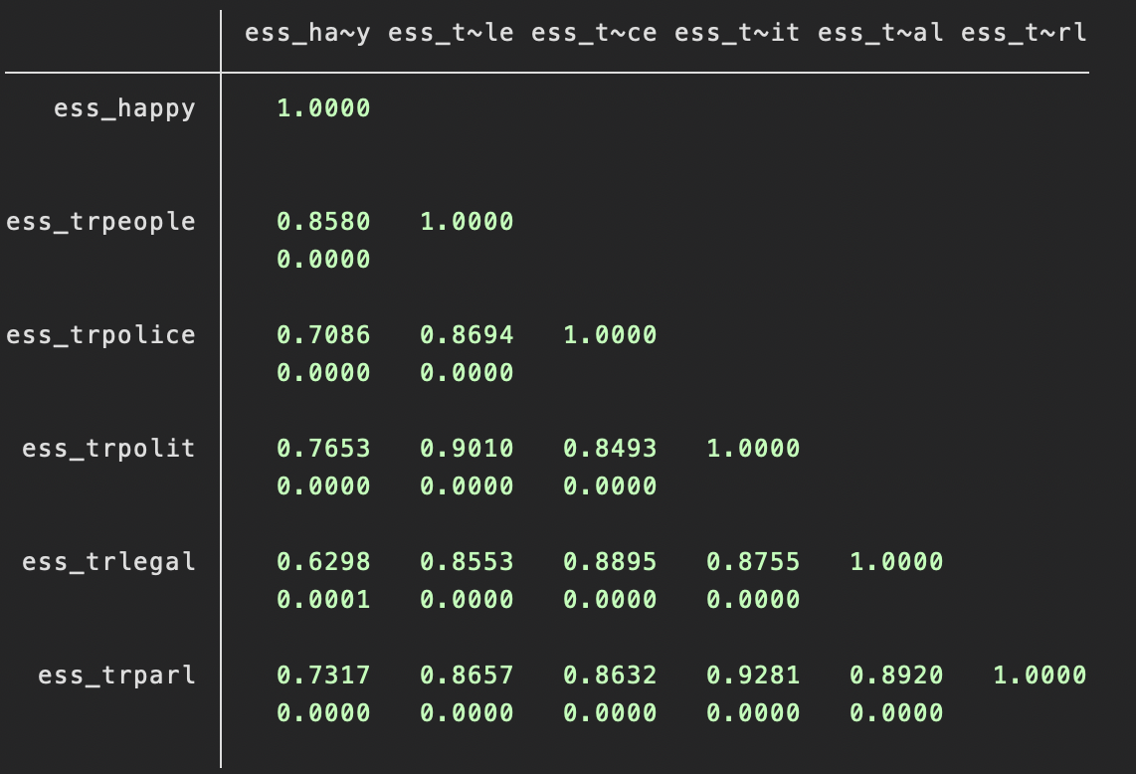
Correlation Matrix
Notes:
Tanner

Slide 8
Future Improvements
Happiness can also be affected by factors other than trust
Economic factors
GDP, job availability
demographic variables
Income, employment status, etc.
social factors
Notes:
Hannah

