Slide 1
Energy Infrastructure
By: Tristan, Roland, Giselle, and Alan
ECO5720-101_APPLIED ECONOMETRICS

Slide 2
Topic and Relevance
How do nonrenewable resources affect the use of alternative and nuclear energy sources?
Global gas demand is set to grow by 2.5% (IEA, 2024)
Coal consumption was estimated at 351.9 million (Snook, 2024)
Global oil consumption increased by more than 2 million barrels per day (EIA, 2024)
Electricity demand by 3% over the next three years (IEA, 2024)
Notes:
https://www.iea.org/news/global-gas-demand-set-for-stronger-growth-in-2024-despite-heightened-geopolitical-uncertainty
https://www.spglobal.com/commodityinsights/en/market-insights/latest-news/coal/010924-us-eia-projects-2024-coal-exports-down-9-on-year-at-91-mil-st
https://www.eia.gov/outlooks/steo/report/global_oil.php
https://www.iea.org/reports/electricity-2024/executive-summary

Slide 3
Variables Involved
Independent Variable:
Alternative & Nuclear Power (wdi_ane)
(% Of Total Energy)
Dependent Variable:
Access to electricity (wdi_acel)
(% of population)
Electricity production from gas (wdi_elprodgas)
(% Total)
Electricity production from oil (wdi_elprodoil)
(% Total)
Electricity production from coal (wdi_elprodcoal)
(% Total)

Slide 4
What is the estimation strategy? Why did you choose this approach?
MLR
OLS
wdi_ane = 𝛽₀ + 𝛽₁ wdi_acel + 𝛽₂wdi_elprodgas + 𝛽₃wdi_elprodoil + 𝛽₄wdi_elprodcoal + u

Slide 5
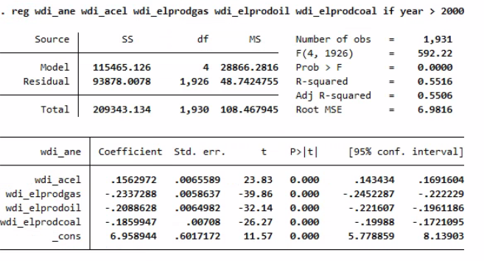

Slide 6
What conclusions can we draw from the analysis?
Non Renewable
VS
Renewable
Notes:
The production of energy through nonrenewable sources such as coal, natural gas and oil takes away the opportunity for the use of renewable energy such as solar, wind and water as well as nuclear .

Slide 7
What are some ways in which you can further improve the analysis?
Time series model
Countries
Year
Data on country infrastructure
Remove biases
Transport infrastructure

Slide 8
Sources
IEA (2024), Electricity 2024, IEA, Paris https://www.iea.org/reports/electricity-2024, Licence: CC BY 4.0
IEA.Global gas demand set for stronger growth in 2024 despite heightened geopolitical uncertainty - news.(2024, January 26). https://www.iea.org/news/global-gas-demand-set-for-stronger-growth-in-2024-despite-heightened-geopolitical-uncertainty
Snook, M. (2024, January 9). US EIA projects 2024 coal exports down 9% on year at 91 mil st. S&P Global Commodity Insights. https://www.spglobal.com/commodityinsights/en/market-insights/latest-news/coal/010924-us-eia-projects-2024-coal-exports-down-9-on-year-at-91-mil-st
U.S. Energy Information Administration - EIA - independent statistics and analysis. U.S. Energy Information Administration (EIA). (2024, April 9). https://www.eia.gov/outlooks/steo/report/global_oil.php

