Slide 1
Measuring World Happiness
Arty Vergara, Kazi Samina Afroz, Hunter Kinney, Ragan Cadd

Slide 2
Agenda
01
Topic Intro
02
Dependent
and Independent Variables
03
Estimation Strategy
04
Conclusion
and Improvements

Slide 3
What makes people happy and how do we measure happiness?
World Happiness Index
Why?
Measures and ranks the happiness of citizens in 156 countries around the world.
The World Happiness Report is a landmark survey of the state of global happiness. Initiative under the United Nations.
Uses factors such as GDP per capita, social support, life expectancy, freedom to make life choices, generosity, and perceptions of corruption.
Provides policymakers with valuable insights into the factors influencing happiness.
Helps identify areas for policy intervention and investment.
Raises awareness about the importance of subjective well-being as a measure of societal progress alongside economic indicators like GDP.

Slide 4
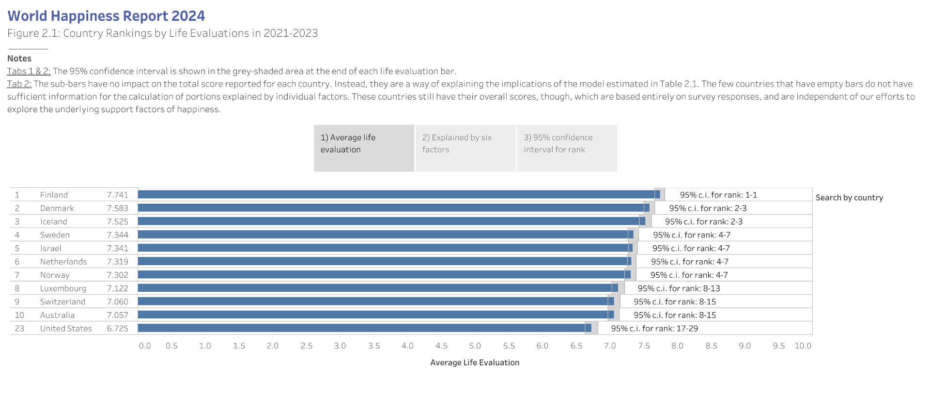

Slide 5
What are the dependent and independent variables?
Dependent Variable:
World Happiness Index: “whr_hap”
Independent Variables:
Freedom Status: “fh_status”
Economic Freedom of the World Index: “fi_index”
Global Peace Index: “gpi_gpi”
Corruption Perceptions Index: “ti_cpi”
GDP per capita (constant 2015 US dollar): “wdi_gdpcapcon2015”
Life expectancy: “wdi_lifexp”

Slide 6
Estimation strategy - Multiple Linear Regression
World Happiness Index = B₀ + B₁Freedoom Status + B₂Economic Freedom + B₃Global Peace Index + B₄Corruption Index + B₅GDP per capita + B₆Life Expectancy + u
Reasons Behind Choosing MLR:
Multiple variables and MLR can provide interpretations of their individual effects on the dependent variable.
MLR assumes independent observations, implying happiness scores in one country are not influenced by happiness scores in other countries, which may be true in many cases.
MLR can consider various independent variables, including continuous (ex. GDP) and categorical (ex. Freedom Status) ones, thereby enabling a comprehensive analysis of happiness factors.

Slide 7
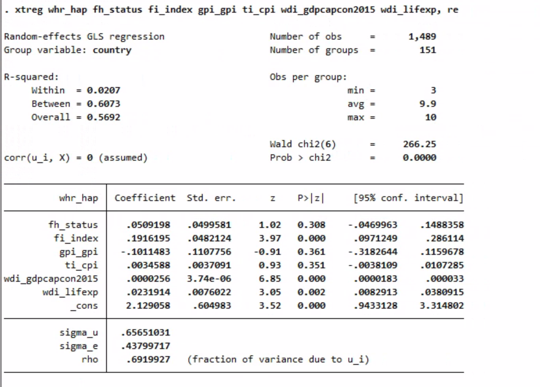
GLS Regression (Random-Effects)
STATA Output

Slide 8
Empirical Relationship Interpretations
Goodness-of-fit (Overall R-Squared) = 56.92%
Significant Variables:
Fi_index
Wdi_gdpcapcon2015
Wdi_lifeexp
Insignificant Variables:
Fh_status
Gpi_gpi
Ti_cpi

Slide 9
Empirical Relationship Interpretations
Cont.
Sigma_u = .6565 or 66%
Slightly higher variability across different levels
Sigma_e = .4379 or 44%
Model captures variability well in the dependent variable

Slide 10
Ways to Further Improve the Analysis
Gather world happiness index data for countries that did not have this information
Go through each country and the corresponding variables and gather all relevant data
Filtered out any additional countries that had missing data over 25% in a certain field of the variables that we decided to analyze
Include extra variables such as global unemployment or global terrorism index (“voh_gti”)
Incorporate interaction terms between some independent variables
Ex: Economic Freedom Index (“fi_index”) and Freedom Status (“fh_status)
Might assume economic freedom affects happiness, but we could hypothesize that the impact of economic freedom on happiness might be different depending on whether a country is free, partly free, or not free
Apply a logarithmic transformation to GDP Per Capita (Constant 2015 US dollar) (“wdi_gdpcapcon2015”)

