Slide 1
First-Year Student Involvement & Student Retention
Hannah Perry, Ethan Hunter, Tanner Landolt
April 10th, 2024
Notes:
Hannah

Slide 2
Overview
About 25% of full-time first-year students drop out in the first 12 months. (NCES, 2022)
$2.9B in grants were issued over five-years to students that stopped pursuing their degree. (Schneider, 2010)
Notes:
Hannah
According to the National Center for Education Statistics, 25% of first-year students in public 4-year universities do not return for their second year of school
$2.9B in state and federal grants issued over five-years were issued to students that dropped out of school. (Schneider, 2010)
Insert something about student involvement?

Slide 3
Empirical Relationship
Does a first-year student’s involvement in on-campus extracurricular activities increase the likelihood that they will return the second year?
Notes:
Hannah
Extracurricular activities include Clubs and organizations, research, on campus employment, university recreation, intramurals

Slide 4
Available Data
IRAP
Engage
UREC
Employment
Student Enrollment & Academic Performance
Club & Organization Involvement
Intramural Sports
Student Employment Data
Notes:
Ethan
Institutional Research, Assessment, and Planning

Slide 5
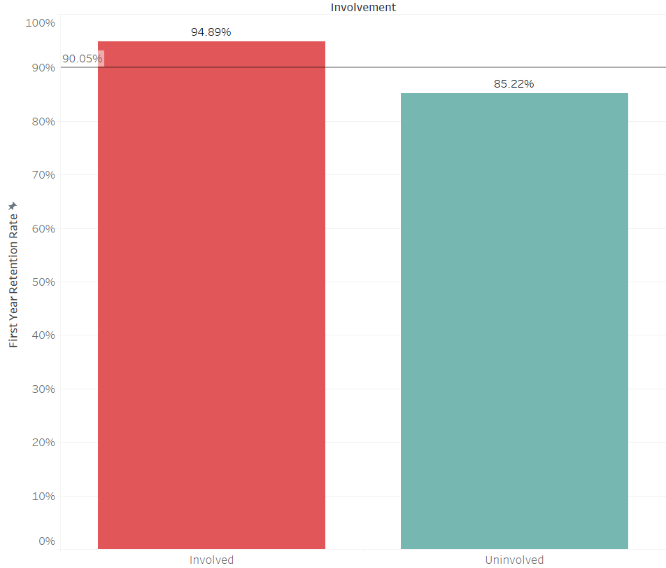
Descriptive Statistics
Since Fall 2021, 90.1% of First-Year students return to App State for classes in the following year.
94.9% retention of Involved First-Year Students
85.2% retention of Uninvolved First-Year Students
Notes:
Tanner

Slide 6
Empirical Relationship
Student is involved if they are a member of a university club or organization, a member of an intramural sports team, or an on-campus employee.
Sample: Undergraduates at App State
Use logit model to estimate the coefficients.
Notes:
Tanner

Slide 7
Additional Variables
Class Attendance
Could indicate more commitment to studies
Lack of consistent availability
Life Events (Binary Variable)
Would result in lower grades and less involvement
Data privacy concerns
Notes:
Ethan
Additional Variables that make sense to include but include in the model due to data availability concerns

Slide 8
References
Schneider, M. (2010). Finishing the first lap: The cost of first-year student attrition in America’s four-year colleges and universities. American Institutes for Research. http://www.air.org/sites/default/files/downloads/report/AIR_Schneider_Finishing_the_First_Lap_Oct101_0.pdf
U.S. Department of Education, National Center for Education Statistics, Integrated Postsecondary Education Data System (IPEDS), Fall Enrollment component final data (2006 - 2021) and provisional data (2022).

