Slide 1
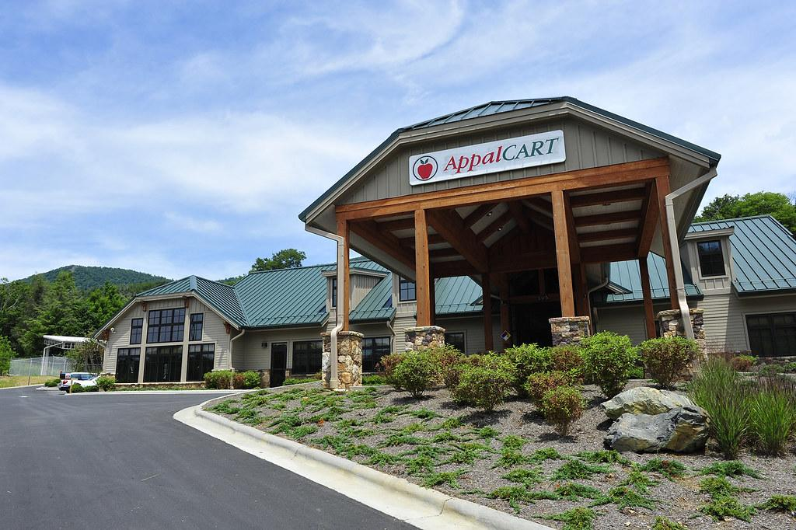
Bus Routes and their effects on Air Quality
By Arty Vergara, Hunter Kinney, Kazi Samina Afroz,
Ragan Cadd
04/10/2024

Slide 2
Agenda
01
Topic Intro and Importance
02
Data Availability
03
Empirical Relationship
04
Estimation Strategy

Slide 3
Topic Importance
Reduction in the number of individual cars on campus roads and university.
Reduction in private vehicle usage may lead to decreased emissions of pollutants.
Mitigation of Traffic Congestion
Bus routes help in managing traffic congestion on campus roads by offering an organized and efficient mode of transportation.
Integration with Sustainability Initiatives
By prioritizing environmentally friendly transportation solutions, universities demonstrate their commitment to reducing greenhouse gas emissions and fostering a campus culture that values sustainability.
Prior Research
"Does urban bus route assignment improve air quality?" by Àlex Sanz and Jordi Perdiguer
Investigates the impact of Barcelona's new bus route (NXB) design on air quality.
Concerns over air pollution, with on-road traffic being a major urban contributor.
The findings reveal that the NXB has significantly enhanced air quality in Barcelona, with notable pollution reductions near main roads where the new routes were implemented.

Slide 4
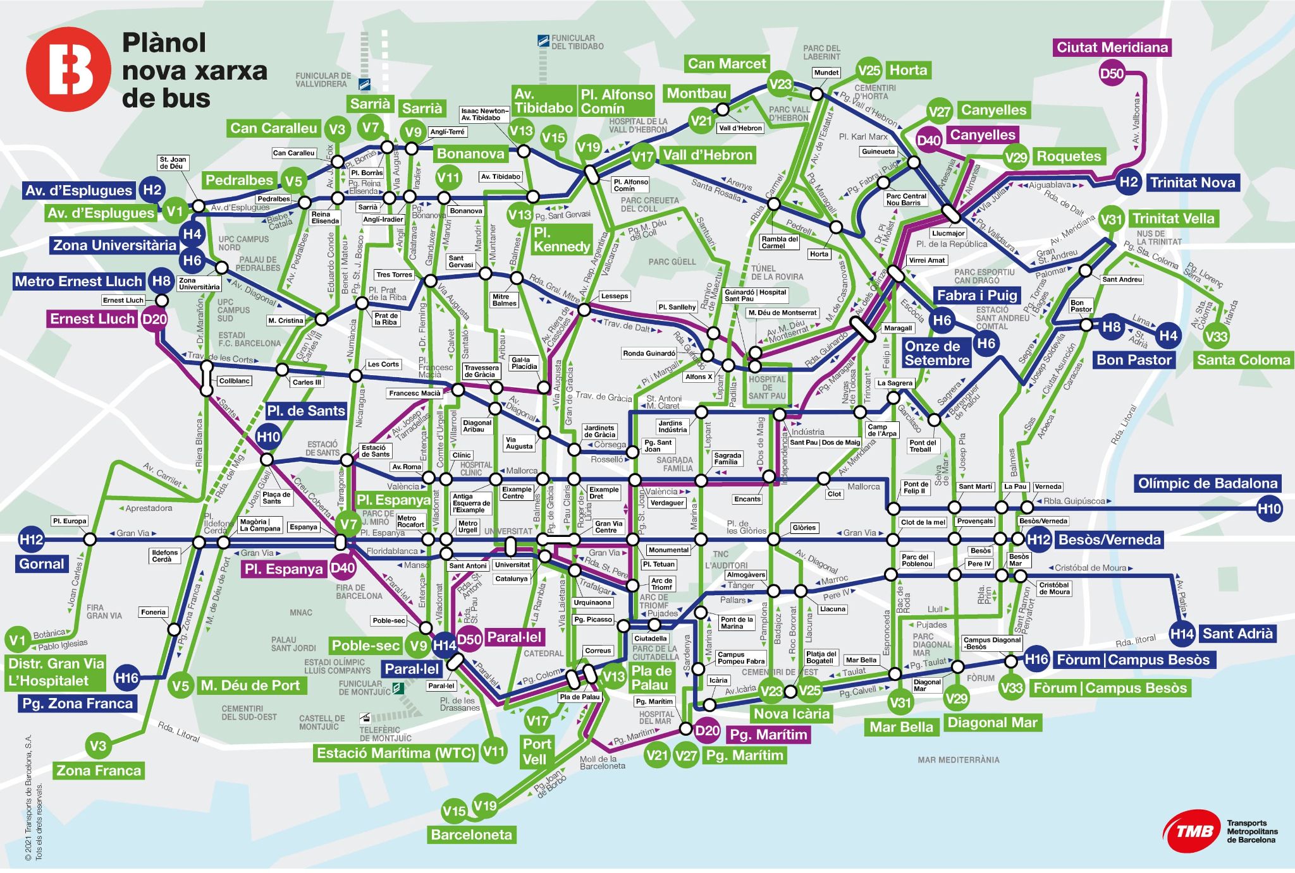

Slide 5
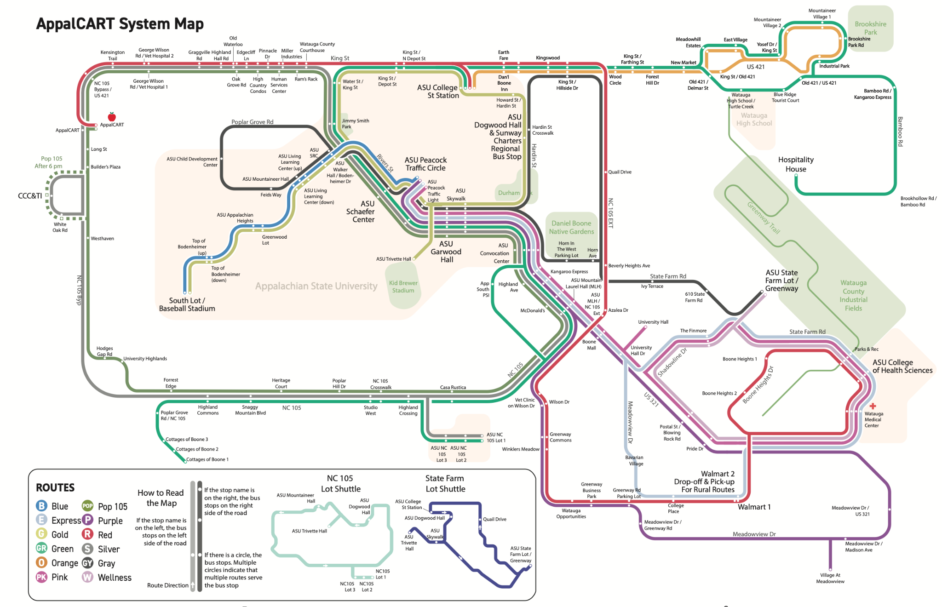

Slide 6
Data Availability
We are analyzing monthly average data for the year 2015 - 2020
Appalcart Route Data Source: Appalcart
Boone’s Temperature Data Source: North Carolina State Climate Office

Slide 7
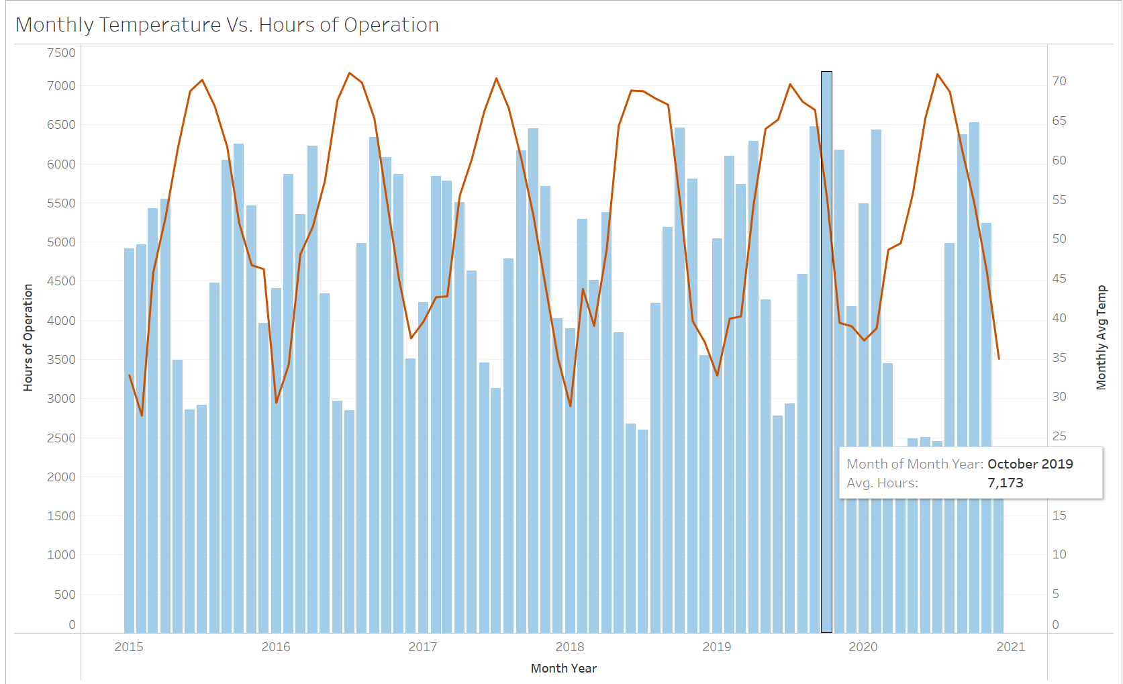
Data Visualization with Tableau

Slide 8
Data Visualization (Cont.)
June and July have the highest temperatures, even though number of passengers drops due to summer school closure.

Slide 9
Data Required
Number of buses operating each day
Bus route details during different operating hours
Average daily temperature
Air pollution data (such as ground-level ozone, particle pollution of PM2.5 and PM10, carbon monoxide, sulfur dioxide, nitrogen dioxide)
Air Quality Index for Boone for the year 2015 - 2020

Slide 10
Empirical Relationship
Bus Routes/Usage on Air Quality and/or Temperature
Variables Include:
Mileage
Hours of operation
Student Population
Number of Buses
Goal is to effectively determine the effects on air quality to help make decisions about bus usage

Slide 11
Empirical Relationship - Equation
AirQuality / Temperature =
β₀ - β₁BusOperHours - β₂BusMileage - β₃NumBusesOper - β₄StudentPop + u

Slide 12
Estimation Strategy
Multiple Linear Regression
AirQuality / Temp = B₀ - B₁BusOperHours - B₂BusMileage - B₃NumBusesOper - B₄StudentPop + u
BusOperHours: (Bus Operating Hours)
Total hours that buses are in operation
BusMileage:
Total miles traveled by the buses over a period of time
NumBusesOper: (Number of Buses Operating)
The total amount of buses that are in service
StudentPop: (Student Population)
Student population size

Slide 13
Estimation Strategy Cont’d
AirQuality / Temp = β₀ + β₁BusOperHours + β₂BusMileage + β₃NumBusesOper + β₄StudentPop + u
OLS
Estimate the coefficients for each independent variable
Interpretations:
The coefficients (β₁, β₂, β₃, β₄, β₅) will indicate the expected change in air quality given a one unit change in each predictor variable
Assumptions for unbiasedness:
Examine MLR.1 - MLR.4 to ensure that the OLS estimates are unbiased
Perform statistical significance tests:
T-test: determine whether each variable has a statistically significant relationship with air quality
F-test: determine if the variables are jointly statistically significant at the appropriate significance level
R-squared: understand the variation in air quality explained by the model

Slide 14
Any Questions

