Slide 1
Impact of AI on Student Performance
Alan Sonato- Ruiz, Giselle E. Gonzalez-Garcia,
Tristan Williamson, Roland Grant
Notes:
Other ways to rename this?
The Effects of AI Learning on Student Outcomes
The Impact of AI on Learners' Performance
The Impact of AI on Test Scores

Slide 2
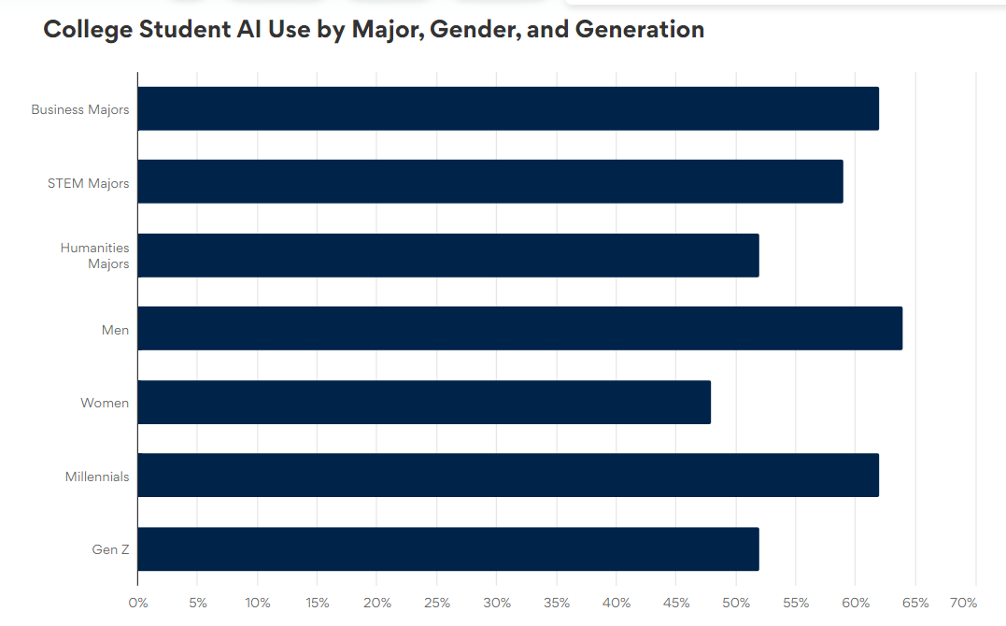
Why is the topic of AI interesting?
AI’s introduction and evolution
46% usage rate among grades 10-12
54% usage in college
56% used to complete assignments/exams
53% had coursework where it was required to be used
79% had at least one professor discuss ethics of AI in the classroom

Slide 3
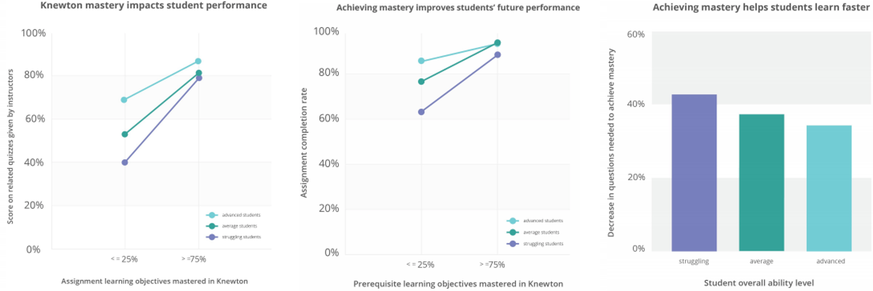
What data are available to conduct the analysis
Knewton Study
Notes:
Knewton (AI to tailor educational content to the needs of individual students) was able to show that demonstrating mastery of subjects by completing its program’s assignments was directly tied to better performance in courses overall.
In a study of more than 10k students, Knewton was able to show that demonstrating mastery of subjects by completing its program’s assignments was directly tied to better performance in courses overall. This benefit was even larger for students who were struggling, persisted over time to future assessments, and increased the pace of learning.
https://d3.harvard.edu/platform-digit/submission/knewton-personalizes-learning-with-the-power-of-ai/

Slide 4
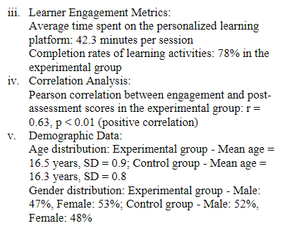
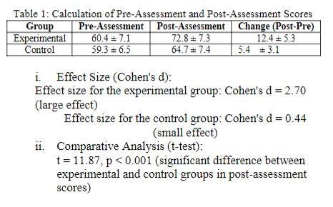
The Impact of AI-Driven Personalization on Learners' Performance Study
Notes:
https://www.researchgate.net/publication/373424876_The_Impact_of_AI-Driven_Personalization_on_Learners'_Performance
The research demonstrates a positive correlation between personalized AI-based adaptive learning and improved academic achievement, engagement, and satisfaction
There was use of quantitative and qualitative methods
This objective aims to compare the academic performance of students who experience AI-driven personalized learning with those in traditional learning environments
The study will involve a diverse group of learners from different educational settings, such as schools, colleges, or online learning platforms.
Experiment
1. Pre- and Post-Assessments: Academic performance data, such as test scores, grades, or course completion rates, will be collected from both the experimental group (exposed to AI-driven personalized learning) and the control group (non-personalized learning)
2. Learner Engagement Metrics: Data on learners' engagement levels, such as time spent on the platform, frequency of interactions, and completion rates of learning activities, will be collected
Surveys and Questionnaires
Learners will be asked to complete surveys to gather their perceptions, attitudes, and satisfaction regarding the personalized learning experience.
Interviews or Focus Groups: In-depth interviews or focus group discussions with a subset of participants will further explore their experiences, challenges, and preferences related to AI-driven personalization

Slide 5
Precise empirical relationship
Regression Model:
TScores = 𝛽₀ + 𝛽₁AI + 𝛽₂StudyHrs + 𝛽₃(StudyHrs)∙(AI) + u

Slide 6
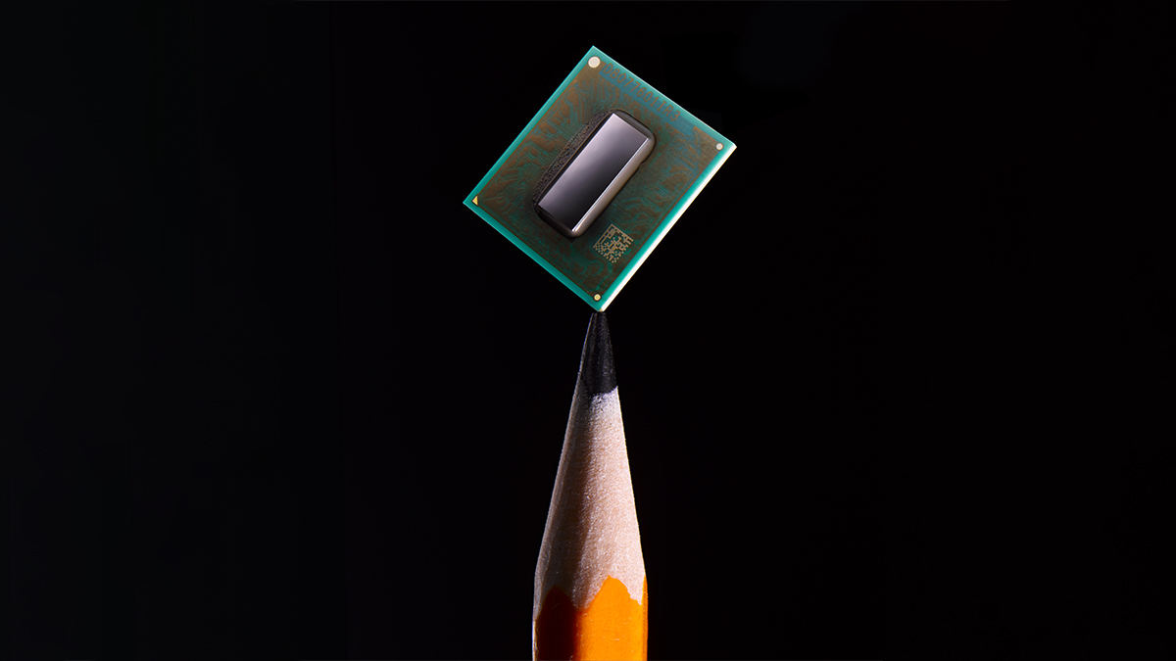
Estimation approach
MLR
OLS/MLE
E(TScores | AI, Shrs) = 𝛽₀ + 𝛽₁AI + 𝛽₂StudyHrs + 𝛽₃(StudyHrs)∙(AI) + u
AI = 0 𝛽₀ + 𝛽₂StudyHrs
AI = 1 𝛽₀ + 𝛽₁ + (𝛽₂ + 𝛽₃)StudyHrs
∆⁡Tscores /∆AI = 𝛽₁ + 𝛽₃ StudyHrs

Slide 7
Sources
ACT. (2023, December 13). Half of high school students already use AI tools. https://leadershipblog.act.org/2023/12/students-ai-research.html#:~:text=Key%20findings%3A,they%20had%20used%20AI%20tools.
Mmd. (2021, April 19). Knewton personalizes learning with the power of ai. Digital Innovation and Transformation. https://d3.harvard.edu/platform-digit/submission/knewton-personalizes-learning-with-the-power-of-ai/
Das, Amit & Malaviya, Sanjeev & Singh, Manpreet. (2023). The impact of AI-Driven personalization on learners' Performance. International Journal of Computer Sciences and Engineering. 11. 15-22. 10.26438/ijcse/v11i8.1522.
56% of college students have used AI on assignments or exams: BestColleges. BestColleges. (2023, November 22). https://www.bestcolleges.com/research/most-college-students-have-used-ai-survey/

