Slide 1
DRUNK DRIVING LEGISLATION AND TRAFFIC FATALITIES: NEW
EVIDENCE ON BAC 08 LAWS
Roland Grant, Alan Sonato, Giselle E. Gonzalez-Garcia, Tristen Williamson, David Hernandez

Slide 2
WHY IS THIS IMPORTANT?
Does legislation restricting blood alcohol concentration to a limit of .08 reduce traffic fatalities caused?

Slide 3
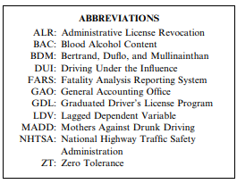
Key Questions and Considerations
Does lowering BAC limit from 0.10 to 0.08 reduce traffic fatalities?
Other legislations vs. BAC laws
Impact on creation and enforcement of laws
Role of societal attitudes and behavior changes
Costs of enforcement vs. benefits

Slide 4
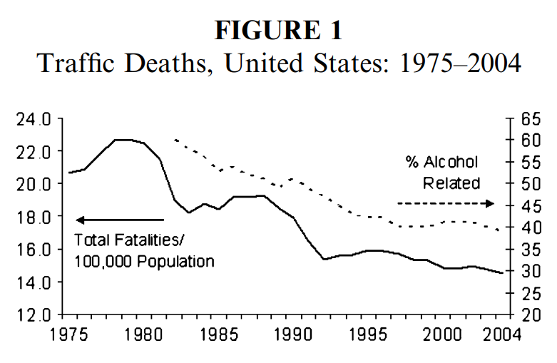
Notes:
Before getting into the actual data to measure our hyp.
The first data displays the trend of total fatalities per 100,000 population (solid line, left axis) from the year 1975 to 2004 in the United States.

Slide 5
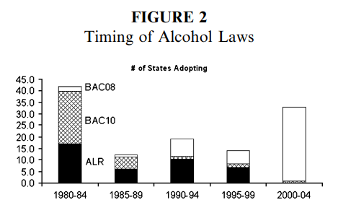
Notes:
The second data was the displays the 5-year frequencies of the adoption by the states since 1980 of two important types of alcohol control legislation laws BAC ( blood alcohol content) laws and ALR laws (Administrative License Revocation)
To read this graph, the shades areas are states who adopted ALR in that time frame. The cross hatch is BAC laws with .10 % amount of alcohol and the white is the .08 amount of alcohol.
Explain what the data lacked…
seat belt, and speed limit laws mileage traveled (accounts for traffic intensity), unemployment rates, population age 14 -24

Slide 6
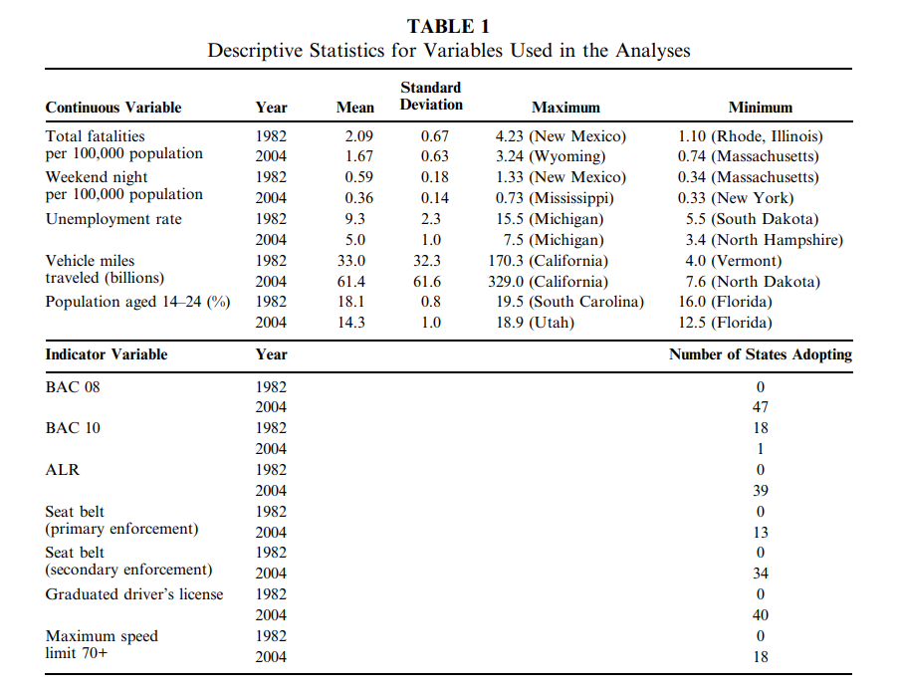
Notes:
The main data has more indep variables. Included was fatality data which is data gathered from state employees who record the data, time, days, week, road conditions, age of the victim, vehicle speed. The data used fatalities per 100,000 population in 48 states. This data also a pooled time series.
xNOTE: Fatalities in states with legislation (the treatment group), to those in contiguous states without legislation (the control group).
List independent variables
The independent variables included control legislation, BAC, ALR, GDL, seat belt, and speed limit laws. Other control variables were mileage traveled, unemployment rates, population age 14 -24 (this age bracket are twice as likely to be involved in a fatal accident). There were three tables used, one of them excluded the time series, and the everything from the year, weekend night accidents, and day time.

Slide 7
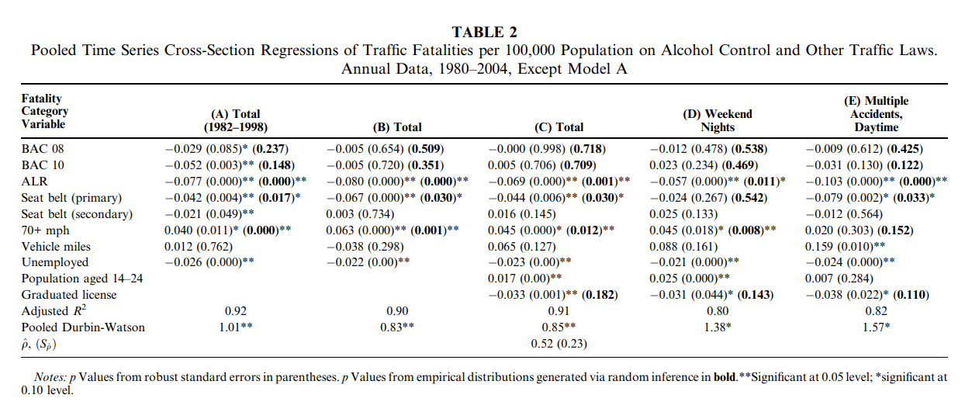

Slide 8
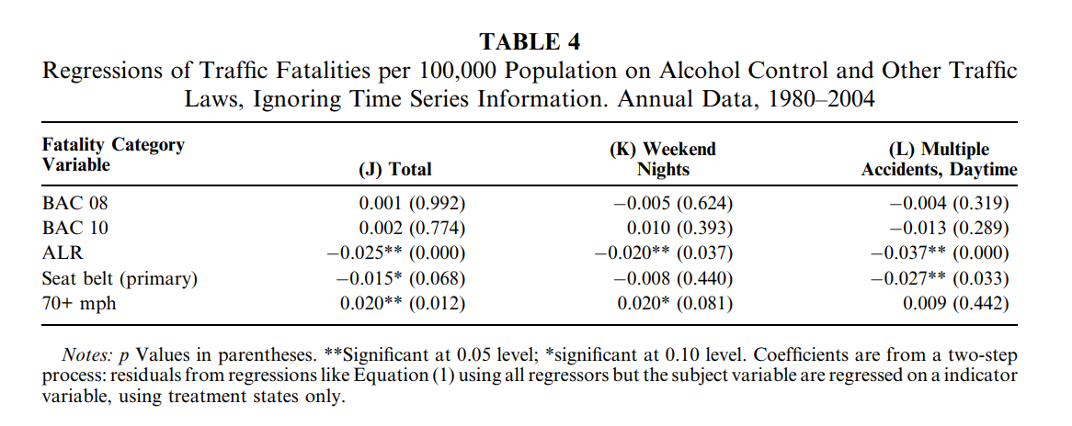

Slide 9
Analysis Performed
Using differences-in-differences approach:
Eisenberg finds evidence confirming the hypothesis that the marginal effect of BAC 08 over BAC 10 laws is statistically significant
Amounts to about an additional 2% reduction in fatalities
Evidence indicating that fatalities had begun to fall in advance of the law’s effective date, suggesting endogeneity in the passage of the BAC 08 law.

Slide 10
Concluding The Hypothesis
Final Conclusion:
BAC 08 from BAC 10 show no correlation to reduction in traffic fatalities.
More ALR laws are effective in reducing traffic deaths when BAC standards are present.
Role of societal attitudes and behavior changes:
Strong evidence of serial correlation driving and drinking behaviors.

Slide 11
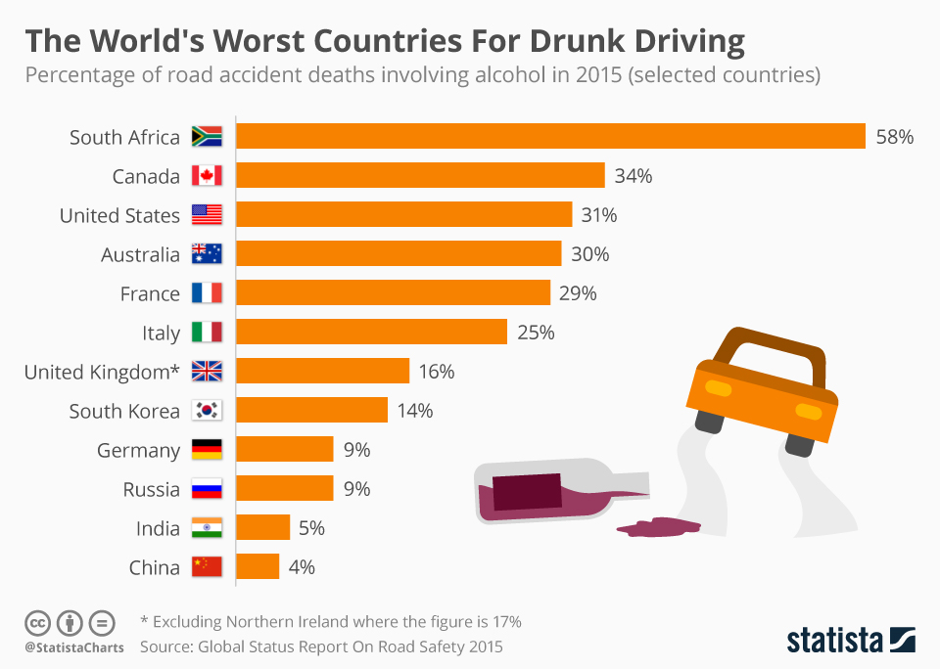
Possible Direction for future research
International comparisons:
BAC limits
Best practices
Enforcement level

Slide 12
Possible Direction for future research (cont.)
China’s approach
Strict legislation & penalty focus
India’s approach
Penalty focus

Slide 13
Citations
International Drunk Driving chart:
McCarthy, N. (August 16, 2016). The Worst Countries In The World For Drunk Driving [Digital image]. Retrieved February 28, 2024, from https://www.statista.com/chart/5504/the-worst-countries-in-the-world-for-drunk-driving/

