Slide 1
Is Trade Good or Bad for the Environment? Sorting out the Causality
Author(s): Jeffrey A. Frankel and Andrew K. Rose
February 28, 2024
Created by:
Will Carswell, Sharon Ware, Alexia Moehling, Ashton Roess, Taylor Lautz

Slide 2
Main Question
This paper seeks to answer how trade effects a country’s environment for a given level of GDP

Slide 3
Background/Overview
The most fundamental question for policy
Trade is endogenetic to pollution while geographic determinants are exogenous
there is little evidence that trade has a detrimental effect on the environment
the effect of trade on the environment is theoretically ambiguous
This paper specifically focuses on income, trade and environmental quality
Porter Hypothesis- environmental regulation stimulates productivity (impact on income and trade)

Slide 4
Topic Interests
Hypotheses
-race-to-the-bottom
-gains-from-trade
-Porter Hypothesis
-Whether the race-to- the-bottom effect in practice dominates the gains from trade effect
Understanding debate over globalization
-isolating the independent effect of openness on the environment
Where and why are environmental gains occuring?
-increase in income
-international trade and investment

Slide 5
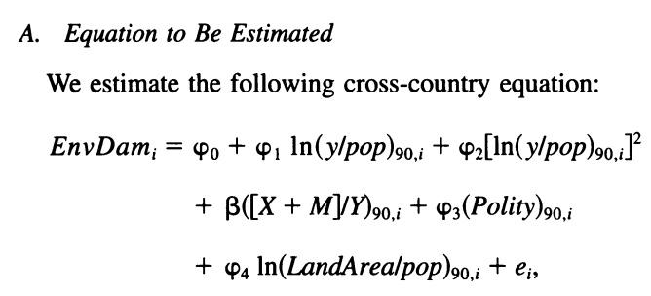
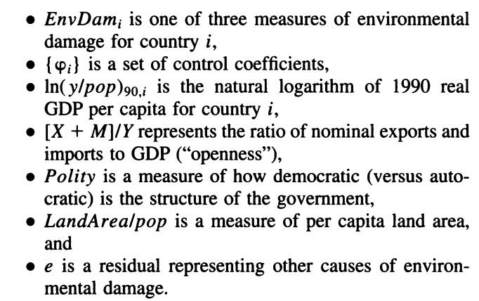
Performed Analyses
Utilized a cross-country regression analysis.
Allows analysis to occur between variables across multiple countries or continents.
Focuses on a single point in time.
Coefficient of interest is β, the partial effect of openness on environmental degradation.
Incorporate the environmental Kuznets curve (EKC)
U shape curve relationship between income per capita and pollution types to predict that the coefficient on the squared income is negative.
Employed instrumental variables to address endogeneity concerns in trade based on GDP, population and distance.
A pure cross-section approach means that we cannot control for unobservable heterogeneity and that income per capita is too endogenous.

Slide 6
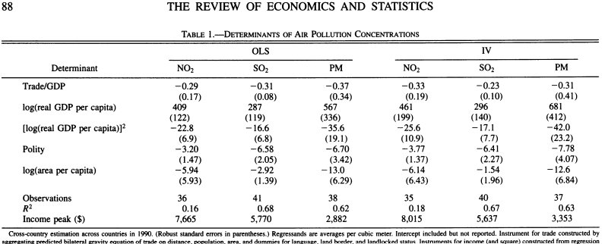
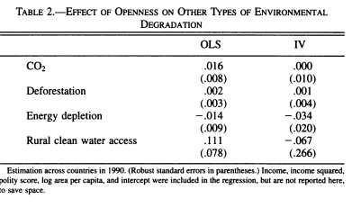
Data Used
Focused on three 1990 measures of air pollution:
SO2: mean sulfur dioxide
NO2: mean nitrogen dioxide
PM: mean total suspended solids (particulate matter)
4 measurements of environmental quality:
CO2: industrial carbon dioxide emissions per capita, in metric tons,
Deforestation: average annual percentage change, 1990-1995,
Energy depletion: "genuine savings" as a percentage of GDP,14, and
Rural clean water access: as percentage of rural population, 1990-1996.
Obtained data from diverse sources including the World Bank, Penn World Table, and the Polity IV project.
Provided GDP and the measure of openness (Penn WT)
Measurements of polarity (Polarity IV Project) and land area (CIA’s website)
Notes:
*Sharon
Takes into account the endogeneity of trade using exogenous geographic determinants of trade as their instrumental variables
Includes cross country data
OF THE USED, THE MEASURES OF AIR POLLUTION ARE THE MOST RELEVANT
Though the use of instrumental variables did not radically reverse the results of earlier OLS studies, it could have; and it did make a substantive difference to the estimates in some cases.

Slide 7
Insights
Link between Trade and Environment
Challenges prevailing notions of trade adversely affecting the environment.
Utilizes instrumental variables (ex: distance between trading partners) to address concerns regarding causal relationships.
Shows little evidence that trade worsens environmental conditions.
Wealth and Environmental Dynamics
Affirms the Environmental Kuznets Curve Hypothesis.
Recognizes the initial phase of environmental degradation followed by later improvement as income levels rise.
Emphasizes the significance of political structures in shaping environmental policies and outcomes.

Slide 8
Insights
Role of Governance
Establishes a correlation between effective governance and improved environmental conditions.
Stresses the influence of political institutions in enforcing rigorous environmental regulations.
Proposes that democratic governance fosters the adoption of environmentally friendly policies and practices.
Pollution Haven Hypothesis Examination
Examines the Pollution Haven Hypothesis and its validity.
Find limited empirical support for the theory.
Contradicts the expectation of trade leading to the creation of pollution havens in less regulated countries.
Suggests that trade dynamics do not systemically result in the exporting of pollution to regions with lax environmental regulations.

Slide 9
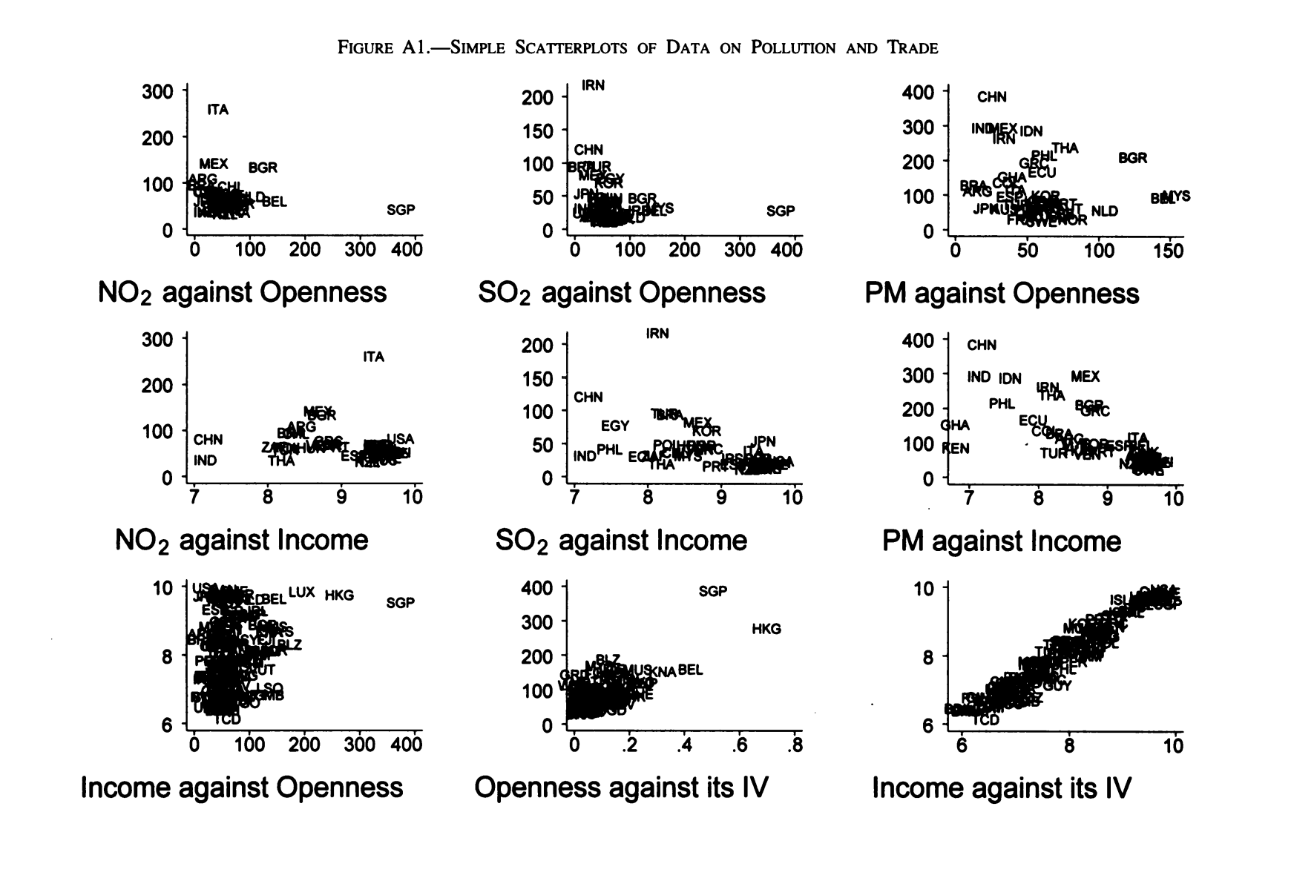

Slide 10
Future Research
Understand and investigate the impacts of trade policies on specific environmental indicators.
Examples of possible indicators include:
Soil contamination
Rising sea levels
Water pH levels
Oil spills
Dive deeper into the validity of hypotheses surrounding trade and the environment.
Race-to-the-bottom hypothesis
Countries with open economies tend to adopt weaker environmental regulations because of concerns about losing competitiveness on the global stage.
Gains-from-trade hypothesis
If trade raises income, it allows countries to attain more of what they want, which includes environmental goods as well as more conventional output.
Explore types of technological innovation and green investments that reduce environmental harm.
Renewable energy tools
Energy storage for use over time
Water conservation
Examine the effectiveness of international agreements and environmental regulations in forming trade-environmental exchanges.
Kyoto Protocol:
Agreement for developed countries to reduce gas emissions.
European Union Emissions Trading System (EU ETS)
Limiting the amount of greenhouse gases that power plants and factories can produce.
United States-Mexico-Canada Agreement (USMCA)
Replaced the North American Free Trade Agreement (NAFTA)

Slide 11
Final Thoughts
In conclusion, Trade promotes economic growth and in small parts can affect pollution but also, in larger ways, reduces it.
There is little evidence that trade negatively affects a country’s environment.
“Our examination of seven different measures of environmental quality provides little evidence that trade has a detrimental effect overall”
It was actually found that trade reduced 3 different types of air pollution.
Overall, reject the hypothesis of an international race to the bottom driven by trade
Moving forward, collective action and commitment from governments, businesses, and civil society are essential to safeguarding the environment for future generations.
The emission that causes concern is CO2 or Greenhouse gas
International agreements are going to be the only way to fix the carbon dioxide emission problems (greenhouse gas), as it is not an issue that is reliant or can be influenced by a single country’s adaptation; change requires a united effort
Notes:
*Sharon
-. “There is also no evidence for the pollution haven hypothesis, which claims that trade encourages some countries to specialize in dirtier environment”
- “The major example where trade and growth may have the detrimental effects feared by environmentalists is carbon dioxide. Greenhouse gases are global externalities, and there is no reason to expect individual countries to be able to address them in the absence of an international agreement”

