Slide 1
The impact of computer usage on academic performance: Evidence from a randomized trial at the United States Military Academy
By Hunter Kinney, Ragan Cadd, Samina Afroz, Arturo Vergara
February 28, 2024

Slide 2
Agenda
Topic Intro and Importance
Data Used in Analysis
Data Analysis Performed
Conclusion of Study
Direction for Future Research

Slide 3
Topic Intro and Importance
Study Overview: Computers in the Classroom Experiment
Investigates the impact of laptop and tablet usage on undergraduate academic achievement
Expands on previous research
Benefits and Challenges of Classroom Technology
Potential benefits include enhanced learning environment and collaboration
Addressing concerns about the potential distractions and effects of technology in classrooms

Slide 4
Data Analysis Performed
Demographic Analysis / Usage Statistics
Gender, Race, Age, Prior Military Service, Average computer usage among groups
Treatment Effect Analysis
Regression Analysis, Subgroup Analysis
Predicted Exam Scores Comparison
Investigation of harmful effects
Comparison Across Academic Semesters
Consistency of exam scores

Slide 5
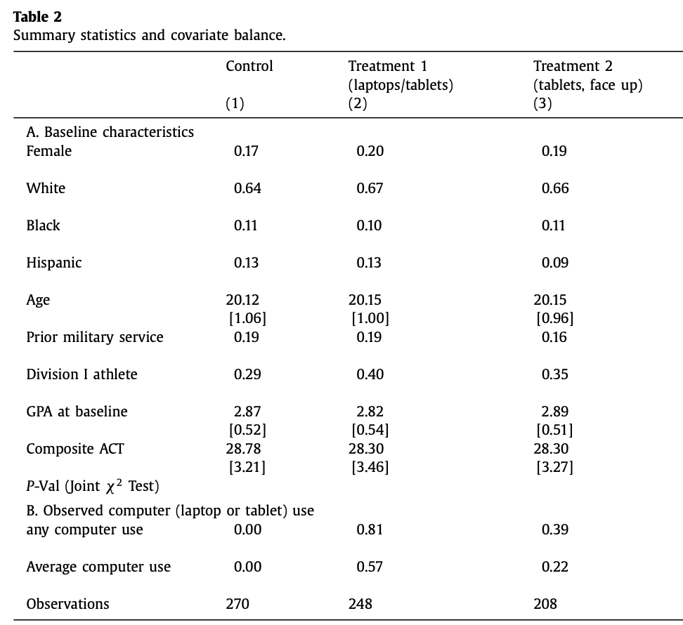
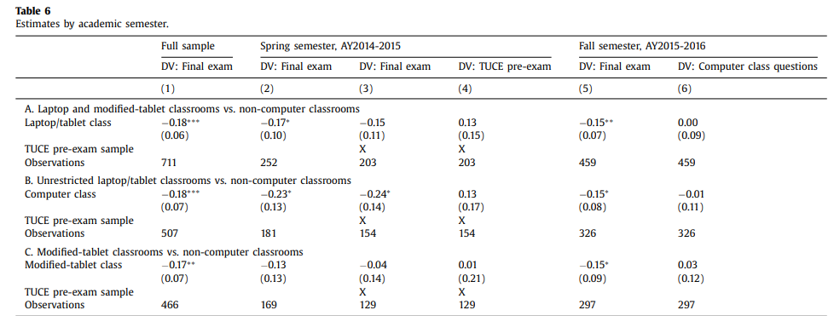
Data Analysis Performed Continued
Demographic Overview:
Regression Model:
Comparison Across Academic Semesters:

Slide 6
Data Used in Analysis
Students enrolled in Economics
50 classrooms and 726 Students
Average and observed computer usage

Slide 7
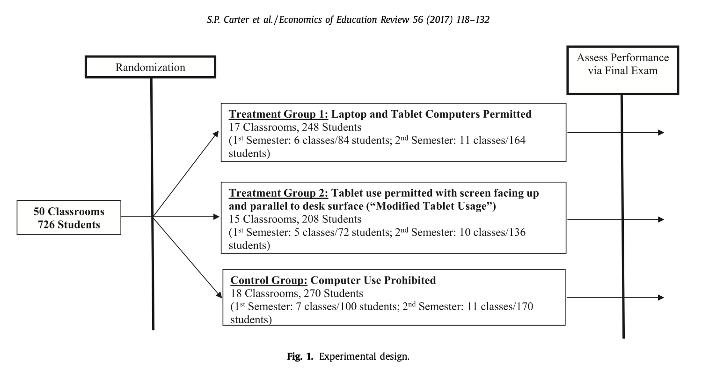
Data Used continued

Slide 8
Conclusions
This study highlights that permitting computers in the classroom, whether laptops or tablets, is associated with a statistically significant decrease in exam scores, indicating a negative impact on academic performance.
The study also suggests that traditional lecture-style classrooms could have similar or more harmful effects due to student incentivization, professor interaction, and small class sizes.

Slide 9
Direction for the Future
Differentiate between impact channels i.e. note-taking quality, distraction availability, and teaching methods.
Investigate the specific effects of these channels on student learning outcomes to provide valuable insights into the nuanced impact of technology in the classroom.
Explore impact in different educational settings and demographics.
Examine long-term effects on academic achievement and overall educational experience.

Slide 10
References
Carter, Susan Payne, et al. “The impact of computer usage on academic performance: Evidence from a randomized trial at the United States Military Academy.” Economics of Education Review, vol. 56, Feb. 2017, pp. 118–132, https://doi.org/10.1016/j.econedurev.2016.12.005.

