Slide 1
Minimum Wage Effects on Disability Insurance Claims
By: Keith Myers
Date: 01 MAY 2025
ECO 5720

Slide 2
Question
Does raising or lowering the minimum wage affect the number of Social Security Disability Insurance Claims?
Relevance
Disability Insurance is an important safety net
Policy debates often ignore indirect effects like disability claims
Minimum wage could either encourage staying in workforce or leaving for the disability benefits.

Slide 3
What are the dependent and Independent variables?
Dependent
Independent
Control
Control
(lnclaims) - log of DI claims
(lnrmw) - log of real minimum wage
(urate) - unemployment rate
(lnrstategdp_pc) - log of real state GDP

Slide 4
Estimation Strategy
Fixed Effects Model
Why fixed effects?
Control for time-invariant state differences
Ex. demographics or health profiles
Control for time-invariant year differences
Policy changes or large economic changes
lnclaimsit = B0 + B1lnrmwit + B2urateit + B3lnrstategdppcit + ai + yt + uit
Where:
i indexes states
t indexes years
ai captures state-fixed effects
yt captures year-fixed effects
uit is the error term
The dataset contains panel data from all 50 states in the U.S. from 2001 to 2017

Slide 5
Strengths and Drawbacks of this approach
Fixed Effects Model
Strengths:
Uses panel data to control for state specific unobserved factors
Fixed effects control for time-invariant omitted variables, attitudes toward disability or policies
Includes key economic controls, unemployment and GDP
Drawbacks:
Cannot control for time-varying unobserved changes within the states
The regression might miss lagged effects, wage changes might not affect DI claims immediately. I.e works delay claiming benefits
This model treats all works the same, doesn’t account for age, health status, or industry

Slide 6
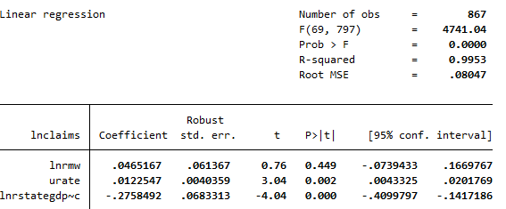
Results
Fixed Effects Model
(lnrmw) = 0.047 (p = 0.449) - Not statistically significant
(urate) = 0.012 (p = 0.002) - Positive, significant
(lnrstategdp_pc) = -0.276 (p <0.001) - Negative, significant

Slide 7
Conclusion
Fixed Effects Model
1% increase in urate causes a 1.2% increase in DI claims
A higher economic output reduces reliance on disability benefits
Minimum Wage changes do not significantly affect DI claims after controlling for economic conditions
What does affect DI claims?
Labor market overall health (unemployment, economic growth) may play a larger role than wage changes
Minimum wage is important for labor markets but doesn’t appear to drive DI claims directly

Slide 8
Questions?

