Slide 1
Assessing the Impact of North Carolina’s 2010 Back-Seat Seatbelt Law
on Traffic Fatality Rates
By Bryan Hunsinger & Parker Lawrence
ECO 5720

Slide 2
Question
“Did requiring back-seat occupants to buckle up after 2010 reduce North Carolina’s traffic fatality rate?”

Slide 3
Table of Contents
01
How We Did It
02
Results
03
Conclusion

Slide 4
01
How did we do this analysis?
Mostly Stada calculations!!

Slide 5
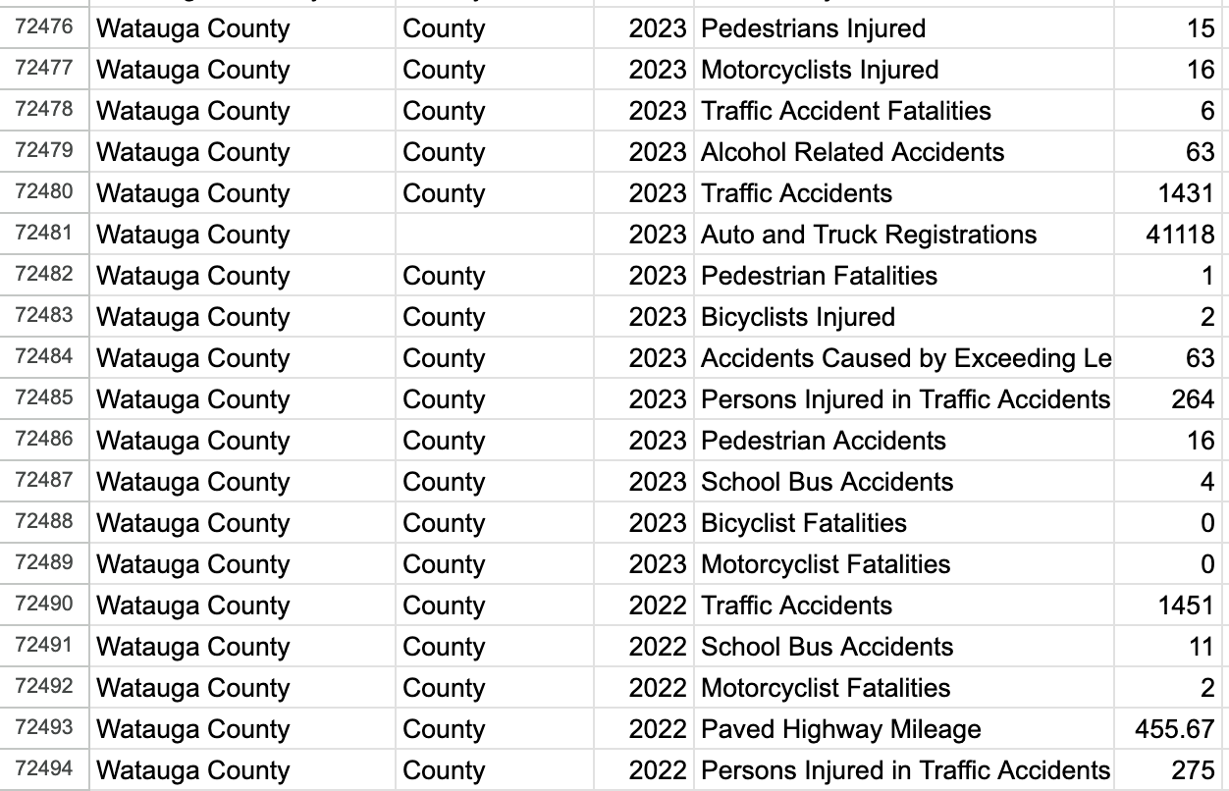
A Peek Into Our Data!
Ridiculous amount of data to parse through
Info about all of NC counties (77k rows)
Information from each county dating back to 1970
Includes many parameters with some examples below!
Traffic Accidents, Traffic Accident Fatalities, Persons Injured in Traffic Accidents, Alcohol Related Accidents, etc.

Slide 6
What about in Stata?
Import & Clean (load data)
Aggregate (sum by year)
Reshape & Compute Rate (make two columns and calculate deaths per 100 accidents)
Define Pre/Post (mark years before vs. after 2010)
T-Test (check if the rate changed)
ITS Regression (capture the trend, the 2010 jump, and the new trend)
Visualization (plot the rates and trend lines)

Slide 7
02
So, what’s the stata result?
(more stata!!)

Slide 8
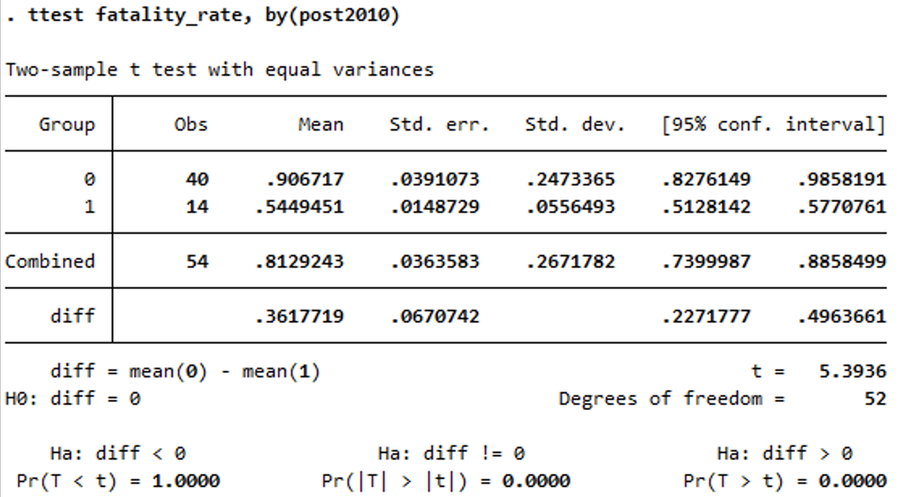
Stata ttest (fatality_rate, by(post2010)
Pre-2010 mean fatality rate: 0.907 deaths per 100 accidents
Post-2010 mean fatality rate: 0.545 deaths per 100 accidents
Difference: 0.362 fewer deaths per 100 accidents (95% CI [0.227, 0.496])
p-value: reported as 0.0000 (i.e. p < 0.0001) → Highly significant drop.

Slide 9
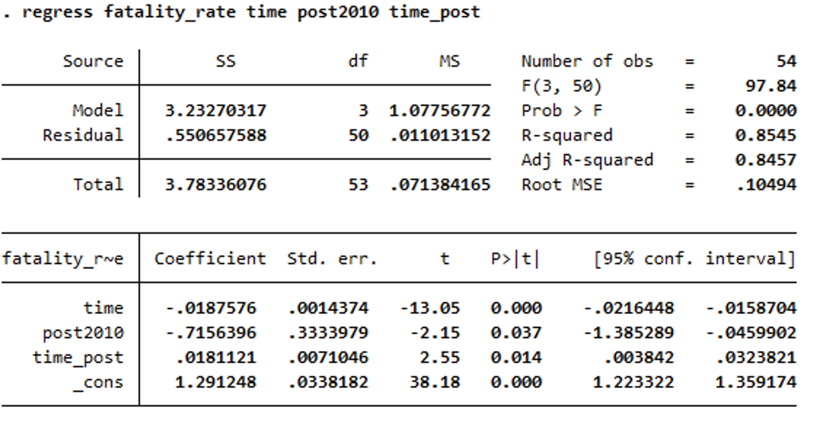
Interrupted Time-Series Regression
Model Fit: R² = 0.85 (p < 0.001)
Pre-2010 Trend (β): –0.019 per year (p < 0.001)
Level Change in 2010 (γ): –0.716 (p = 0.037)
Slope Change Post-2010 (δ): +0.018 (p = 0.014)

Slide 10
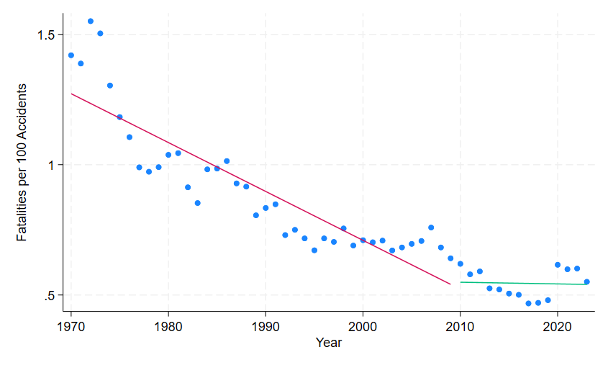
Traffic Fatality Rate: Pre- vs. Post-2010
Trend (β): –0.019 per year (pre-2010 decline)
Level change (γ): –0.716 in 2010 (immediate safety gain)
Slope change (δ): +0.018 post-2010 (flattening of decline)
R² = 0.85 → model explains 85 % of annual variation

Slide 11
(Vertical dashed line marks the 2010 back-seat seatbelt law amendment.)

Slide 12
03
Conclusion!

Slide 13
Conclusion
Absolute difference: 0.362 fewer deaths/100 accidents (~40% reduction)
Pre-law trend: –0.019 deaths per 100 accidents per year
Post-law slope change: +0.018 per year (p = 0.014), so the decline slowed but continued
95% CI for slope change: [0.004, 0.032], confirming a sustained downward trend
Potential omitted variables: enforcement intensity; vehicle-safety upgrades; driver demographics/behavior; weather; economic conditions

Slide 14
Thanks!
Do you have any questions?
Please keep this slide for attribution

Slide 15
Resources
North Carolina Office of State Budget and Management. (n.d.). Transportation. Retrieved May 4, 2025, from https://linc.osbm.nc.gov/pages/transportation/
Photos and Theme (Slidesgo)
Car being taking care of in workshop
Free photo car being taking care of in workshop
Car being taking care of in workshop

