Slide 1
The Impact of North Carolina’s Youth Bicycle Helmet Requirement
Wolfgang Enders
5/5/2025

Slide 2
Research Question: NC’s Youth Bicycle Helmet Law
Why am I interested in this topic?
Cyclist safety
My family’s interest in cycling
Why is this topic relevant?
Public safety
Analysis/review of public policies
Notes:
Alternative Considerations → honorary mentions

Slide 3
Research Question: Dependent & Independent Variables
Dependent: cylinjrte_u16 → cyclist injury rate per 100,000 under 16
Independent: helmetlaw, Accs, Auto_Truck_Regs, avrtrtime_work
Alternative Considerations: Sec_Hwy
g helmetlaw = 1 if year >= 2002 | replace helmetlaw = 0 if year < 2002
g popunder16 = Age_0_4 + Age_5 + Age_6_9 + Age_10_12 + Age_13 + Age_14 + Age_15
g cylinjrte_u16 = Cyl_Inj / popunder16 * 100000

Slide 4
Data
NC OSBM (LINC): NC Office of State Budget and Management
Transportation-related appeared rather prominent
3 Datasets:
NC Transportation
Census Transportation
Population by Age, Race, Sex
Merging Data:
merge 1:1 areaname year using “_____”
Rename variables for character limit
Reformat dataset from long to wide (reshape command)

Slide 5
Method Strengths
Fixed Effects:
Controls for county-level time-invariant unobservables
e.g., road design, biking/driving culture, infrastructure, geography, etc.
Reduces omitted variable bias
Year Fixed Effects:
Controls for larger time-varying trends on a year-by-year basis
e.g., bicycle injuries were already falling due to an increase in car safety, infrastructure, or some other factor
Together, they create a similar effect as using a differences-in-differences model

Slide 6
Estimation Method
Year Fixed Effects
Higher R² (.2396 compared to .2045 initially)
Decent sigma_u value (~40.6) is the variation due to county effects
Shows need for fixed effects
Decent sigme_e value (~32.8) is the time variation within counties
Shows need for involvement of years in the FE model
rho value shows ~60.5% of variation is due to persistent differences between counties

Slide 7
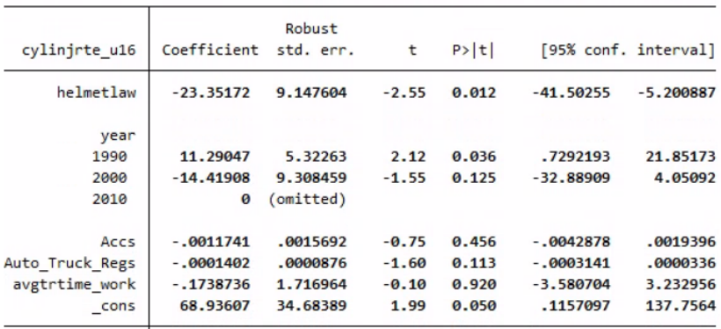
Conclusions

Slide 8
Conclusions
The youth bicycle helmet law created an estimated 23-person decrease in cyclist injuries per 100,000 people less than 16 years old
Statistically significant at the 5% level
Control Variables:
Accs: (.456) not significant
avgtrtime_work: (.920) not significant
Auto_Truck_Regs: (.113) bordering barely significant
Shows a negative effect on cylinjrte_u16, could be related to more infrastructure, or more urban/developed areas (with more infrastructure)

Slide 9
Drawbacks
Year FE’s dummy variables for each year decreased the explanatory power of the control variables in the regression (compared to the normal FE model)
Possibility of omitted variable bias in the form of time-variant county-level unobservables (e.g., enforcement, infrastructure, etc.)
Only 4 year observations per county: decreased precision, increased noise
The assumption that the helmet law was enacted nearly instantly

Slide 10
Improvements
Find and include county-level time-variant data related to the current possible omitted variables, such as:
data relating to infrastructure, cycling/driving culture, enforcement level, public awareness campaigns, etc.
Include county-specific time-varying variables to measure things such as:
the adoption/enforcement of the law, bicycling frequency, etc.
Consider using a DiD model:
e.g., explore differences between younger and older teens (those affected vs. exempt from the law)

Slide 11
Questions?

Slide 12
References
NC Office of State Budget and Management. (2023). NC Transportation (LINC). [Data set].
https://linc.osbm.nc.gov/explore/embed/dataset/nc-transportation-linc/table/?disjunctive.
area_name&disjunctive.variable
NC Office of State Budget and Management. (2022). Census Transportation (LINC). [Data set].
https://linc.osbm.nc.gov/explore/embed/dataset/census-transportation-linc/table/?disjunctiv
e.area_name&disjunctive.year&disjunctive.variable
NC Office of State Budget and Management. (2023). Population by Age, Race, Sex (LINC).
[Data set]. https://linc.osbm.nc.gov/explore/embed/dataset/population-by-age-race-sex-
linc/table/?disjunctive.year&disjunctive.area_name&disjunctive.variable&disjunctive.race&
disjunctive.sex&disjunctive.data_type&disjunctive.vintage

