Slide 1
Education and Poverty
Conner Dove and Rob Wheelock

Slide 2
Question
How does one’s education background affect their odds of being impoverished?

Slide 3
Data Source
Log into North Carolina
Employment and Income (LINC) Dataset
Education Dataset
County Census Data
Data Format:
Area (County, City, Townsend)| Year(1970-2023) | Variable | Counted Value
Poverty (Yes/No)(we are looking at Yes)(Count of Impoverished)
County Census Data(Population Count)
Education(Variable | Counted Value)

Slide 4
Dependent and Independent Variables
Dependent Variable:
Persons in Poverty
Independent Variables:
Census:
Population
Education:
College Graduates age
High School Graduates
Less than 5 years of Elementary School
Public School Dropouts
Speaks English not well or not at all

Slide 5
Estimation Strategy
Pooled OLS Regression
Quantifies how changes in education factors are associated with changes in poverty across counties and years.
Our model specifically controls for educational factors and population.
Using robust standard errors, we can correct for potential heteroskedasticity.

Slide 6
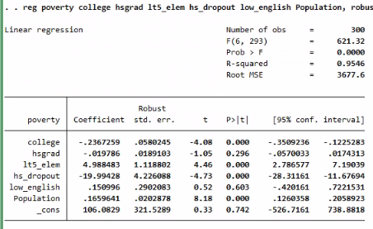
Stata Output – Pooled OLS Regression

Slide 7
Conclusions
Low education increases poverty
For every person with < 5 years elementary school, 5 more people are expected to be added to the poverty count
Significant: p < 0.01
Higher education reduces poverty
For every 1,000 college graduates, the poverty count should decrease by 237 people
Significant: p < 0.01
High School Dropouts unexpected results
Dropouts link to a decrease in poverty at a significant level
Likely caused by multicollinearity or lack of overall data

Slide 8
Opportunity to improve analysis
Expanding overall scope: adding in additional indicators of poverty such as housing cost, employment, and income distribution.
Fixed Effects Analysis: Control for unobserved variables over time like the ones listed above.
Data: Having access to cleaner, more robust, and complete data would allow us to have more observations in Stata, leading to a better analysis.

Slide 9
Questions?

