Slide 1
Effect of Living in Rural Counties on Poverty and Unemployment in North Carolina
Econometrics, May 5th 2025
Emily Charlip and Ethan Lee

Slide 2
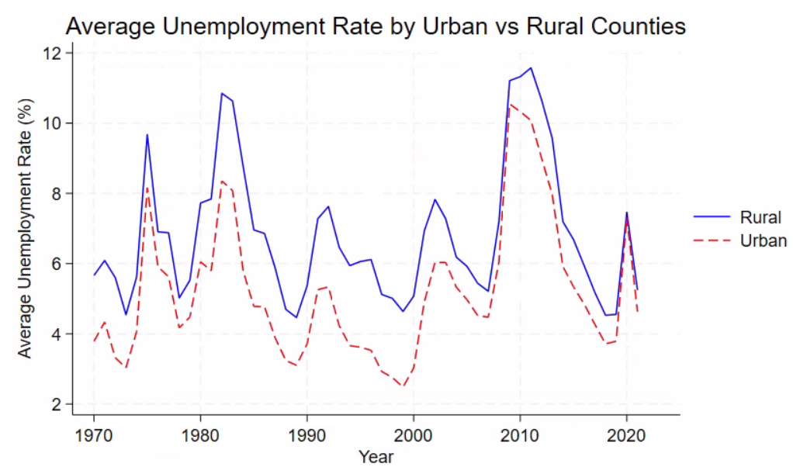
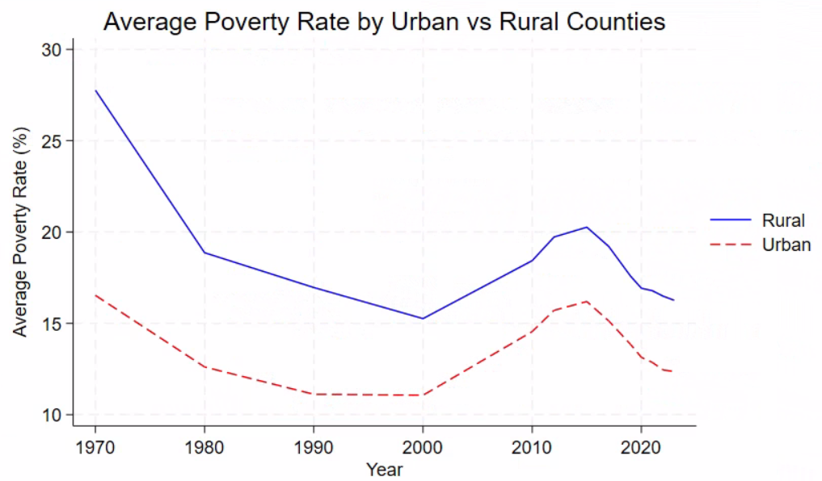
Question
Does living in a rural county significantly affect unemployment and poverty rates?
Current NC Unemployment Rate: 3.7%
Current NC Poverty Rate: 12.8%

Slide 3
Variables
Dependent:
Poverty Rate
Unemployment Rate
Independent:
Rural vs. Urban Counties
Personal Income
Unemployment
Labor Force
i = Alamance County, Alexander County, …. NC Counties
t = 1969, 1970, … 2024

Slide 4
Data
North Carolina Employment and Income Data - NC Office of State Budget and Management
Variable | Description | Observations | Mean | Std. Dev. | Min | Max
areaname | Area name (string) | 0 | - | - | - | -
year | Calendar year | 5,600 | 1996.5 | 16.16 | 1969 | 2024
percentpoverty | Percent of population below poverty line | 1,300 | 17.44 | 5.93 | 5.02 | 46.0
persincome | Personal income ($) | 4,800 | 1,690,982 | 4,101,509 | 7,568 | 57,100,000
unemplrtebyloc | County unemployment rate (%) | 5,199 | 6.46 | 2.83 | 1.1 | 29.1
laborforce | Labor force by place of residence | 5,499 | 38,075 | 61640.29 | 1,283 | 679,533
rural | Counties considered rural | 5,600 | 0.76 | 0.41428 | 0 | 1

Slide 5
Estimation Strategy
Models Used:
Fixed Effects (FE) and Random Effects (RE) panel regressions
Model Rationale:
FE: Controls for unobserved, time-invariant county characteristics
RE: Captures both within- and between-county variation

Slide 6
Strengths & Weaknesses of Approach
Strengths:
Strong within-county explanatory power (FE R² > 0.65)
Inclusion of year dummies captures macroeconomic trends
RE model enables comparison across counties, allowing for broader generalizations
Weaknesses:
Collinearity issues (e.g., rural/urban variable dropped in FE due to limited variation)
Some statistically significant results had economically negligible effects (e.g., income effects on poverty/unemployment)
Potential omitted variable bias if relevant predictors were excluded (e.g., education, industry composition)

Slide 7
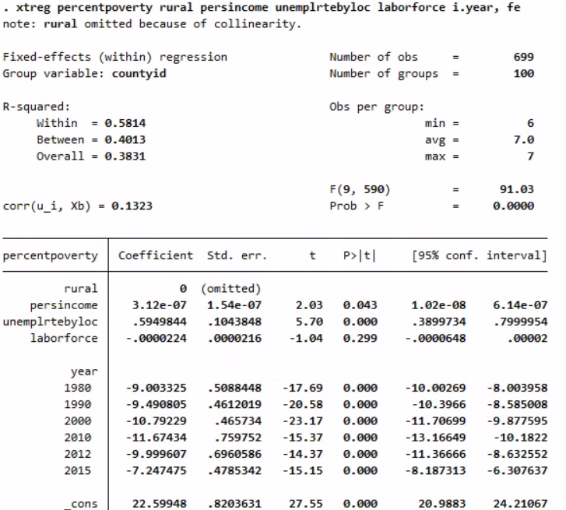
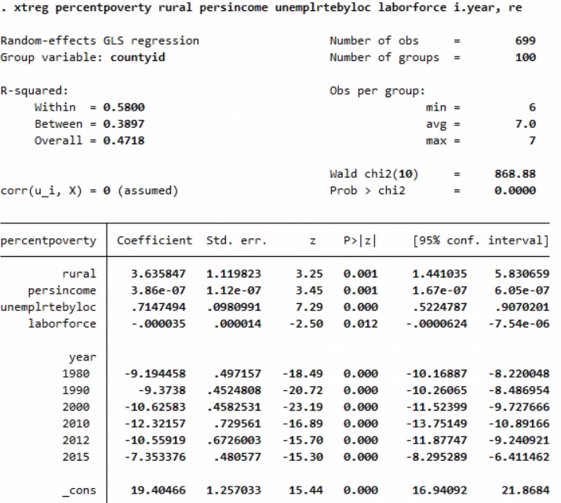
Results - Poverty
Fixed Effects:
Random Effects:

Slide 8
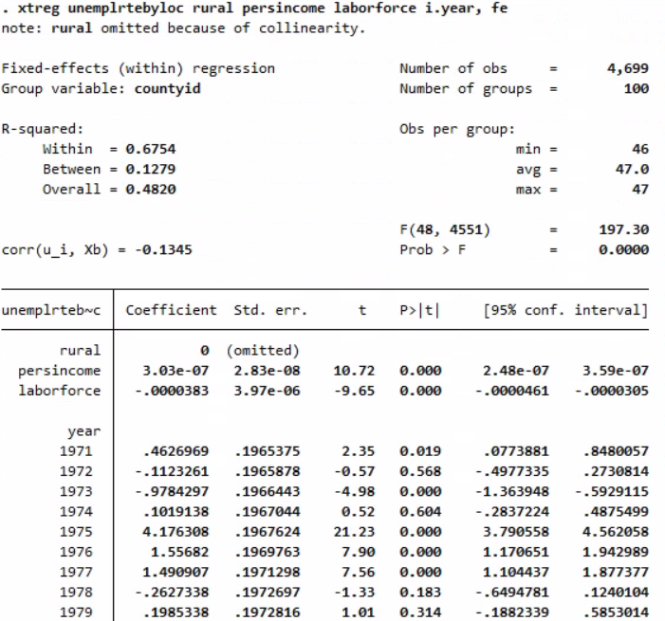
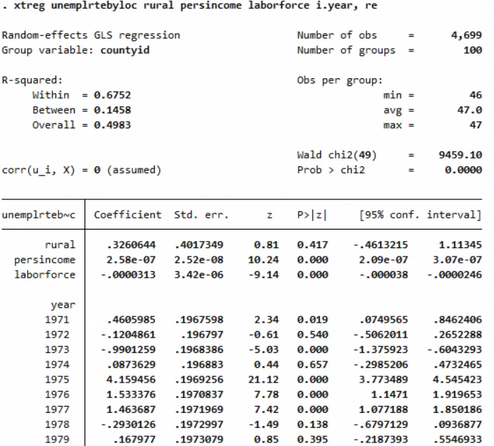
Results - Unemployment
Fixed Effects:
Random Effects:

Slide 9
Conclusions
Unemployment rate is a strong and consistent predictor of poverty across models
Personal income has a significant but very small effect on both poverty and unemployment
Rural counties show higher poverty in RE model, suggesting geographic disparities
Yearly trends demonstrate meaningful reductions in poverty and unemployment over time
Policy Recommendation:
Target unemployment reduction initiatives, especially in rural areas
Use employment trends to inform future income and poverty alleviation programs

Slide 10
Potential Improvements
Compare counties across the country
Control for additional variables not included in this dataset
Impacts of Inflation
COVID-19 Effects
Education Levels
Gender, Race, Age data
More granular data

Slide 11
Thank you!

