Slide 1
Impact of Household Size on Personal Income
By: Morgan Chapman and Danny Welsh
Date: May 5, 2025

Slide 2
Question
How does the number of individuals living in a home affect personal income?
This is relevant because it sheds light on how household size influences income distribution. Larger households often have lower per capita income as income is shared among more people, which is important for understanding economic inequality and living standards.

Slide 3
What are dependent and independent variables?
Dependent Variable: Personal Income
Indicates the economic status and standard of living of individuals.
Often used to assess the wealth distribution and economic well-being of a population.
Can be affected by factors such as employment rate, industry type, education, and overall economic conditions.
Helps compare income disparities and economic opportunities between regions or countries.
Independent Variable: The number of individuals living in a home
Affects the division of personal income, as more people in a household may mean income is shared or spread across more individuals.
Often used to study trends in living arrangements and household economics, such as whether larger or smaller households have a higher or lower income.

Slide 4
Estimation Strategy
Ordinary Least Squares Regression strategy with robust standard errors:
to account for likely heteroskedasticity in income data
To ensure that the statistical inferences about the effect of household size on personal income are valid and reliable, without needing a more complex model.
Strengths:
Linear and easy to understand, robust standard errors corrects heteroskedasticity, unbiased coefficients
Drawbacks:
Small sample limitations, other methods (like Weighted Least Squares, etc.) may produce more efficient estimates.

Slide 5
Control Variables
Age
Controlling for age helps prevent age-related income effects from being incorrectly attributed to household size.
Year
Including the year adjusts for macro-level economic shifts, ensuring you’re not confusing time effects with household size effects.
Gender
Controlling for gender prevents systematic income differences between men and women from biasing the results.
Employment status
By including employment status, you account for a direct driver of income, making the analysis of household size more accurate.

Slide 6
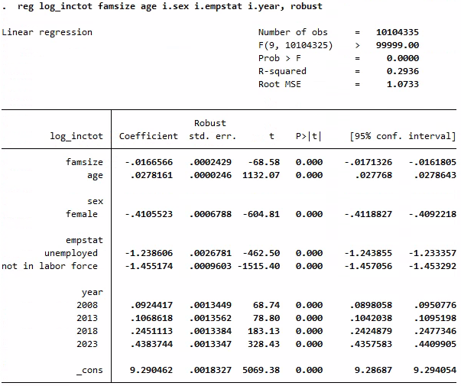
Stata - Regression
Observations: ~10.1 million
R-squared: 0.2936 means ~29.4% of variation in log income is explained.
Robust SEs used: Yes, appropriate given heteroskedasticity.
F-statistic: Highly significant, so model is jointly significant.

Slide 7
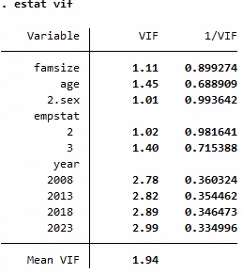
Stata - Multicollinearity Test
All VIF values are well below 10 (max = 2.99)
Mean VIF = 1.94, indicating low overall multicollinearity
Highest VIF observed for year 2023 (2.99), still within safe range
Model does not have significant multicollinearity
Notes:
Variance Inflation Factor

Slide 8
Conclusions
Each additional household member reduces income by ~1.67%
A one-year increase in age is associated with a 2.78% increase in income
Strong positive effect of age and being employed
Clear gender wage gap and year-to-year income growth
Model explains 29.4% of the variation in income
Robust errors used due to heteroskedasticity

Slide 9
What are ways you can further improve the analysis?
Use Log Transformation of Income
Explore Non-Linear Effects
Try Alternative Estimators
Use Panel Data: track the same individual households over time
More control variables such as industry, education, etc…
Use IV to see if household size might be endogenous

