Slide 1
Does government corruption affect income inequality across countries?
Nathaniel Jones & Dylan Bristow
ECO-5720
Spring 2025

Slide 2
Data Introduction
Corruption may limit the effectiveness legal policies, reduce access to education and healthcare, widening the distribution of wealth.
In the Quality of Government data, we used these variables:
cname - Country Name
ccodealp - letter Country Code
ti_cpi - Corruption Perceptions Index
wdi_expedu - Government expenditure on education, total (% of GDP)
wdi_gdpcap - GDP per capita (constant 2015 US dollar)
wdi_gini - Gini index

Slide 3
Variables
DV:
Gini Index
measures income inequality (higher values indicate more inequality)
IV:
Corruption Perceptions Index
higher values represent less corruption
Control:
GDP per capita
controls for a country's level of economic development.
Government expenditure on education (% of GDP)
controls for social policy efforts that may reduce inequality.

Slide 4
Estimation Strategy
Gini_{i}=β₀​+β₁​⋅Corruption_{i}+β₂⋅GDP per Capita_{i}+β₃⋅Education Spending_{i}​+ϵ_{i}
cross-sectional ordinary least squares (OLS) regression model
identifying correlations between variables across countries in a single time period
Will include key control variables such as GDP per capita and education spending, helping to reduce omitted variable bias and isolate the partial effect of corruption
Assumes that any remaining unobserved factors influencing inequality are not correlated with the included independent variables

Slide 5
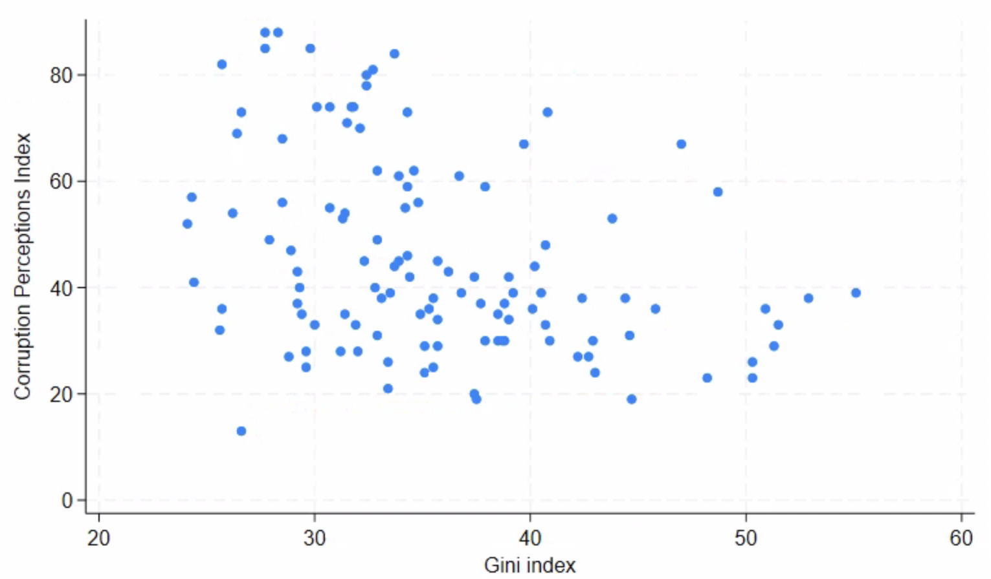
Data

Slide 6
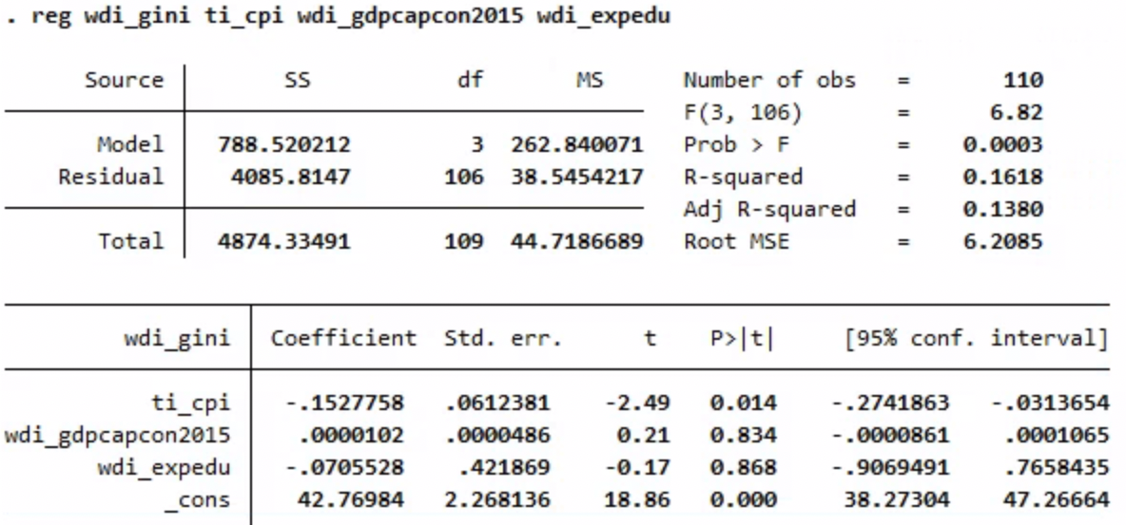
Data

Slide 7
Conclusions
Less corruption is significantly associated with lower income inequality
1-point improvement in the Corruption Perceptions Index corresponds to a 0.14-point reduction in the Gini coefficient
Improving government integrity may contribute to more equitable income distribution
GDP and education spending effects are inconclusive in this cross-sectional setup

Slide 8
Improvements & Limitations
Low R²
Many important factors influencing income inequality are not being captured
Many factors play a role into corruption and income inequality, hard to quantify
Potential endogeneity
It’s possible that high inequality enables corruption

Slide 9
References
Basic dataset. University of Gothenburg. (n.d.). https://www.gu.se/en/quality-government/qog-data/data-downloads/basic-dataset

