Slide 1
The Effects of Education and Economic Strength on Countries’ Perceived Corruption
Firzana Syazania; ECON 5720 Final Project

Slide 2
Table of contents
01
02
03
04
05
Introduction
Data
Empirical Strategy
Results
Conclusion

Slide 3
01
Introduction

Slide 4
To what extent does Education and Economic Strength influence Perceived Corruption?
Research Question

Slide 5
Definition of Corruption
“The abuse of entrusted power for private gain”
Transparency International
Notes:
Corruption can take many forms, and can include behaviours like:
public servants demanding or taking money or favours in exchange for services,
politicians misusing public money or granting public jobs or contracts to their sponsors, friends and families,
corporations bribing officials to get lucrative deals

Slide 6
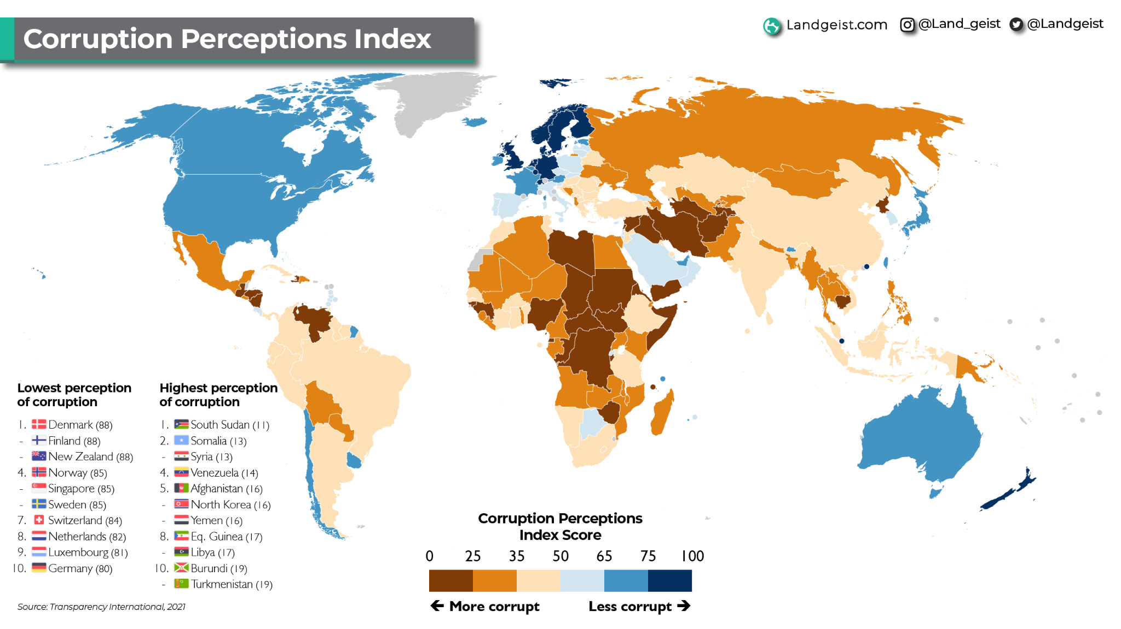
Notes:
https://www.sciencedirect.com/science/article/pii/S0176268019301156

Slide 7
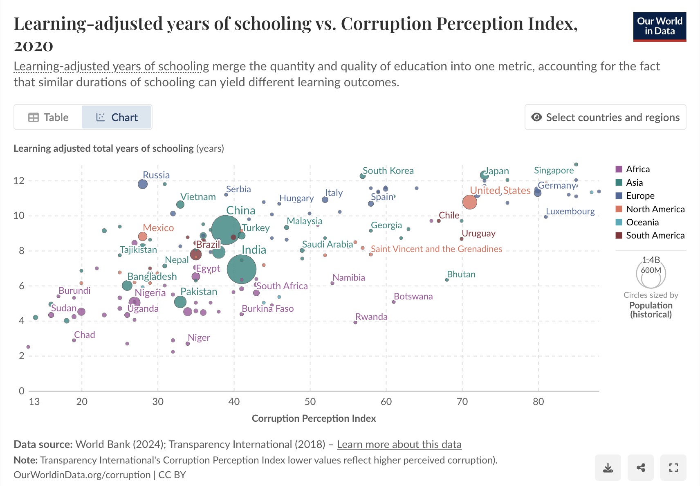
Notes:
https://ourworldindata.org/grapher/average-years-of-schooling-vs-corruption-perception-index the circles denote population size

Slide 8
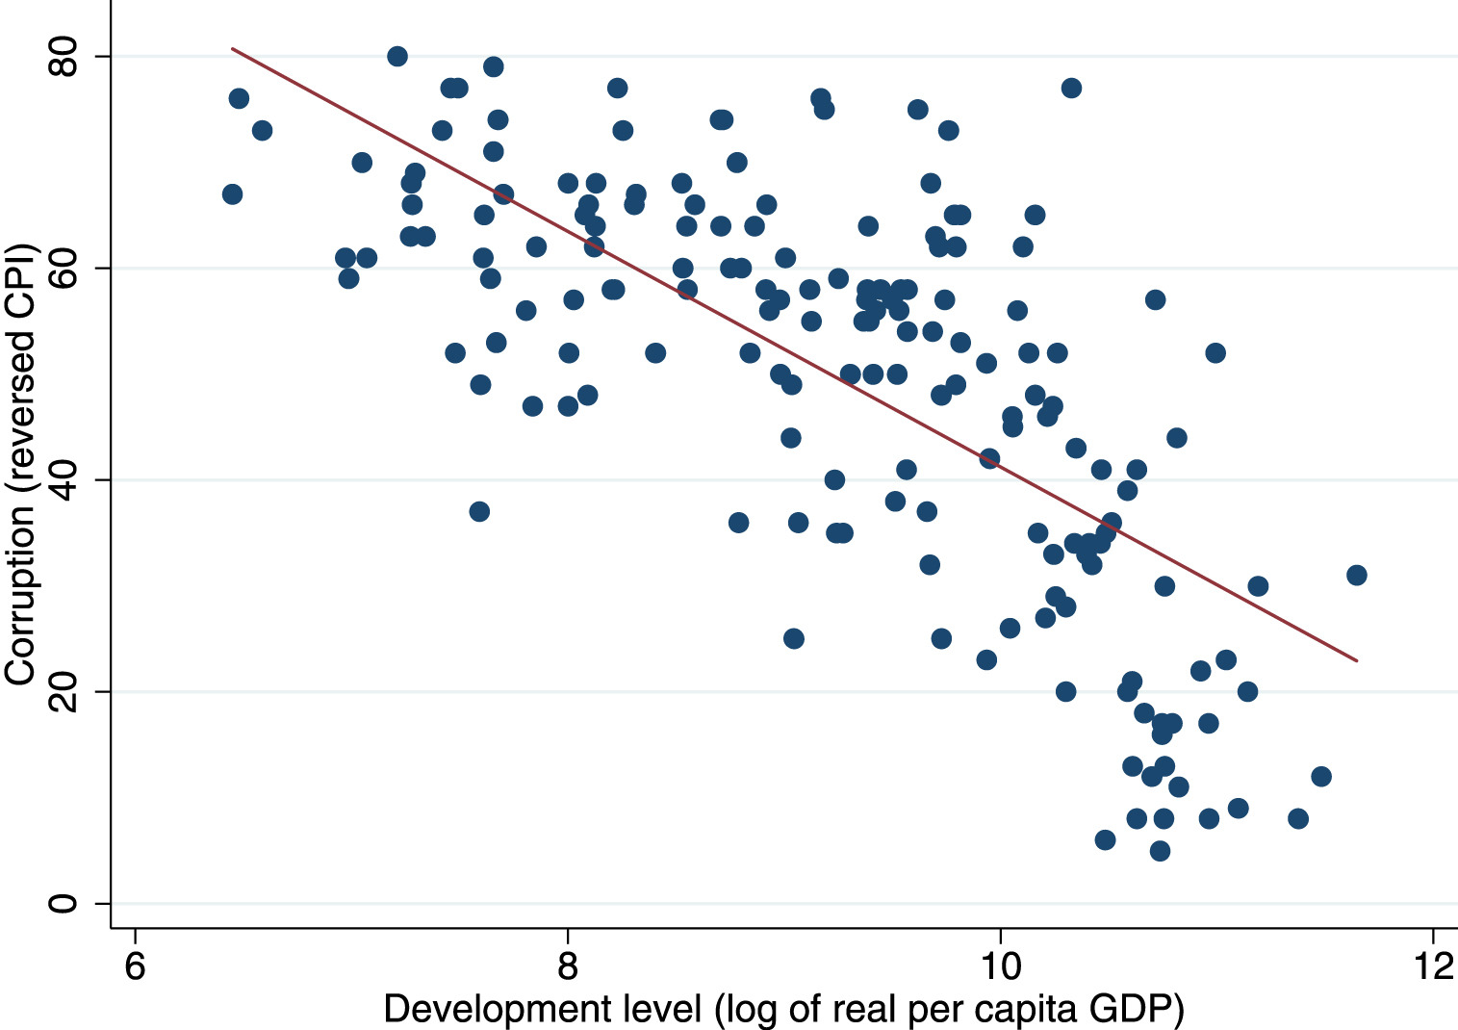
Notes:
https://www.sciencedirect.com/science/article/pii/S0176268019301156

Slide 9
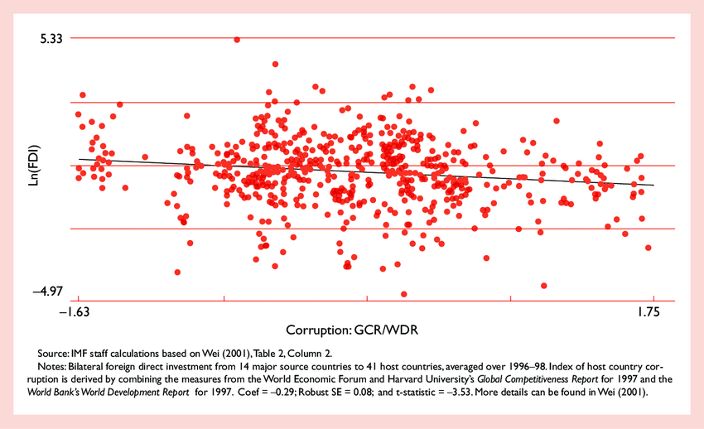
Why is it important to keep track of Corruption Perceptions?
Rise in violence & conflict
Impact on FDI
Transparency International’s 2022 Corruption Perceptions Index, found that governments hampered by corruption lack the capacity to protect the people, while public discontent is more likely to turn into violence.
Countries perceived to have higher corruptions are associated with a decrease in foreign direct investments and economic growth, while increasing inflation
Notes:
https://apnews.com/article/politics-corruption-index-56dc50609f54ae8d39d852a8c685f959
“Transparency International’s 2022 Corruption Perceptions Index, which measures the perception of public sector corruption according to experts and businesspeople,
The report also pointed out how after decades of conflict, South Sudan is in a major humanitarian crisis with more than half of the population facing acute food insecurity — and corruption is exacerbating the situation.
https://www.sciencedirect.com/science/article/pii/S0176268019301156

Slide 10
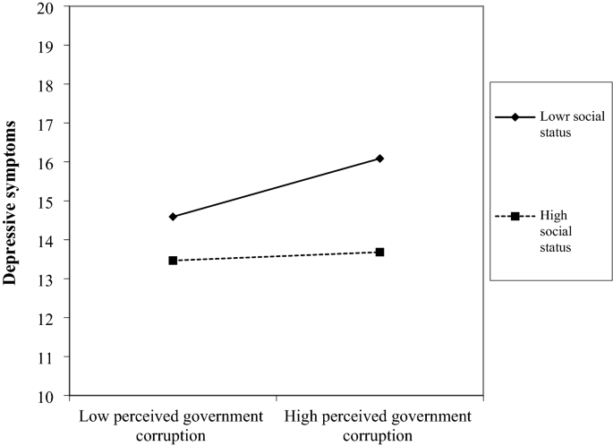
Why is it important to keep track of Corruption Perceptions?
Rise in violence & conflict
Impact on FDI
Transparency International’s 2022 Corruption Perceptions Index, found that governments hampered by corruption lack the capacity to protect the people, while public discontent is more likely to turn into violence.
Countries perceived to have higher corruptions are associated with a decrease in foreign direct investments and economic growth, while increasing inflation
Increase in depressive symptoms
A study consisting of 185 countries suggested that perceived government corruption had a negative impact on mental health and this influence was more obvious in high-income countries compared with low-income countries
Notes:
https://apnews.com/article/politics-corruption-index-56dc50609f54ae8d39d852a8c685f959
“Transparency International’s 2022 Corruption Perceptions Index, which measures the perception of public sector corruption according to experts and businesspeople,
The report also pointed out how after decades of conflict, South Sudan is in a major humanitarian crisis with more than half of the population facing acute food insecurity — and corruption is exacerbating the situation.
https://www.sciencedirect.com/science/article/pii/S0176268019301156

Slide 11
02
Data

Slide 12
Data Set
Dataset used: Quality of Government Standard Time-Series
Information:
Consists of approximately 2100 variables from more than 100 data sources related to Quality of Government, for 211 countries
Data from 1946 to 2024 is included, and the unit of analysis is country-year (e.g., Sweden-1946, Sweden-1947, etc.)
Limitations:
Not every single year has data for each variable
E.g. current analyses can only be done for year 2005 & 2015 because only those years have data for all three variable for each country
Final cleaned data set consisted of 106 countries
Notes:
https://gupea.ub.gu.se/bitstream/handle/2077/68646/gupea_2077_68646_1.pdf

Slide 13
Variables
Education
Economic Performance
Perceptions of Corruption
Variable name: bl_asymf
Average schooling years, females and males between 15 and 64 years old.
Independent Variable
Variable name: bti_ep
Economic Performance: The economy’s performance points to solid development. From 1 to 10.
Independent Variable
Variable name: wbgi_cce
‘Control of Corruption’ measures perceptions of corruption. The particular aspect of corruption measured by the various sources differs somewhat, ranging from the frequency of ’additional payments to get things done’, to the effects of corruption on the business environment, to measuring ’grand corruption’ in the political arena or in the tendency of elite forms to engage in ’state capture’.
Dependent Variable

Slide 14
03
Empirical
Strategy

Slide 15
Empirical Strategy
1
2
3
Cross-Section Regression
Pooled Cross-Section Regression
First-Differencing Model
To examine the influence of education and economic strength for 2005 and 2015 separately.
If results from cross-section are significant, then examine the regression effects of pooling 2005 and 2015 data together.
Due to potential country-level unobserved time-invariant variables, first-differencing method was then used for the two-period (2005 & 2015) panel data.

Slide 16
Potential unobserved time-invariant variables
Variable | Why?
Geographic Location | Affects international trade, economic development, etc. (climate, resource abundance)
Colonial History | Influences legal systems, long-term trust in government
Religion & Culture | Cultural norms, tolerance for corruption, public-sector expectations
Type of Education System | Affects literacy and mass education
Historical Governance | Influences corruption controls if democracy vs autocracy

Slide 17
04
Results

Slide 18
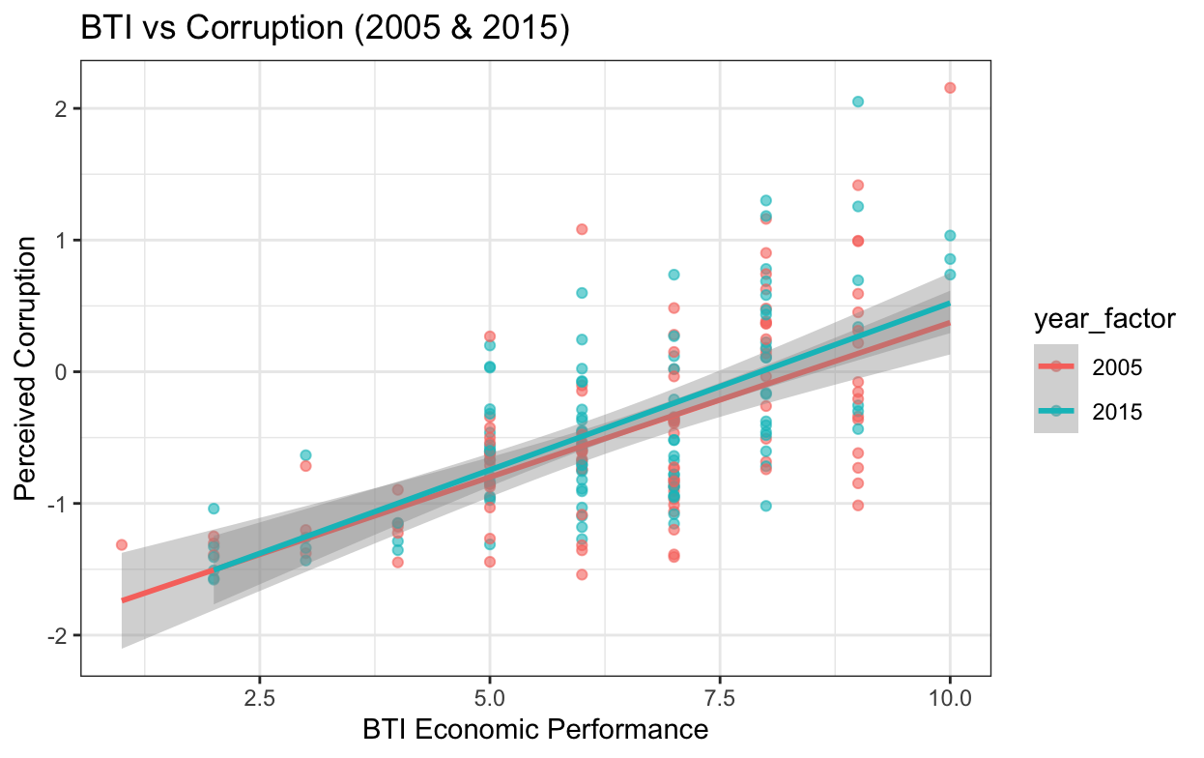

Slide 19
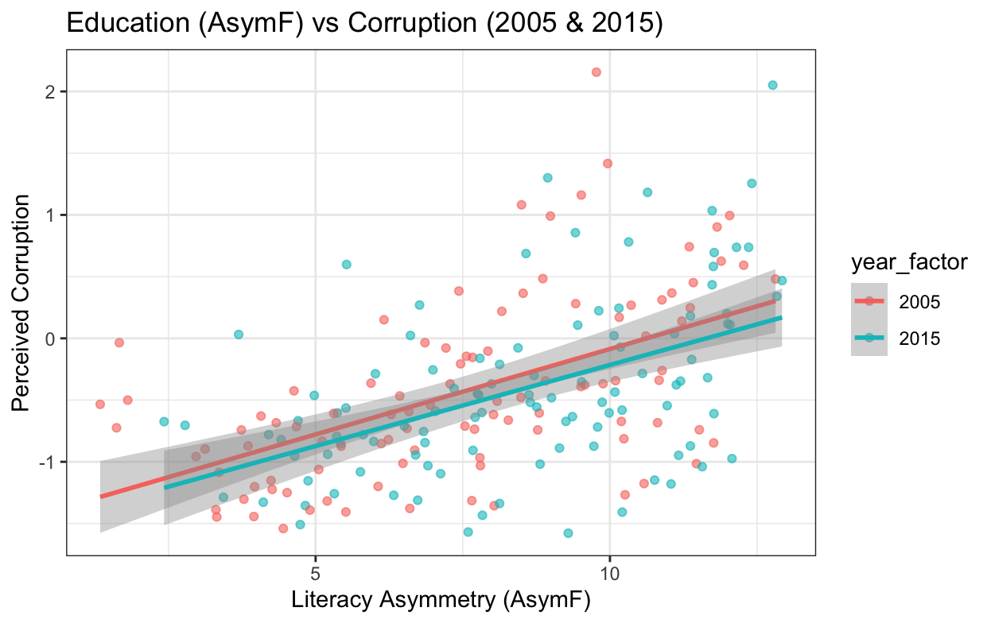

Slide 20
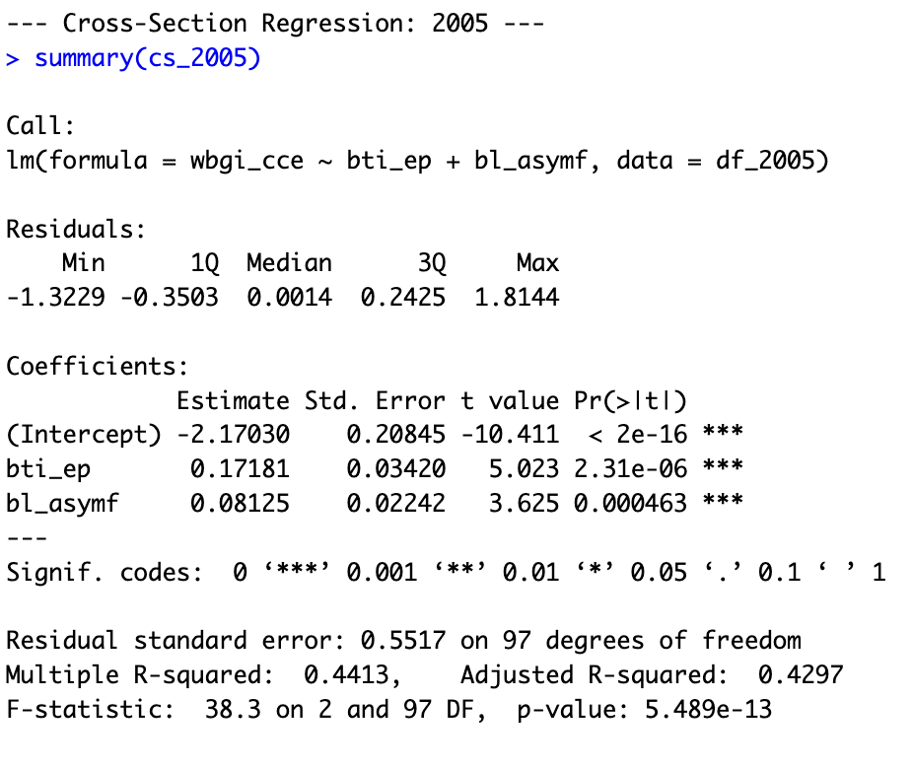
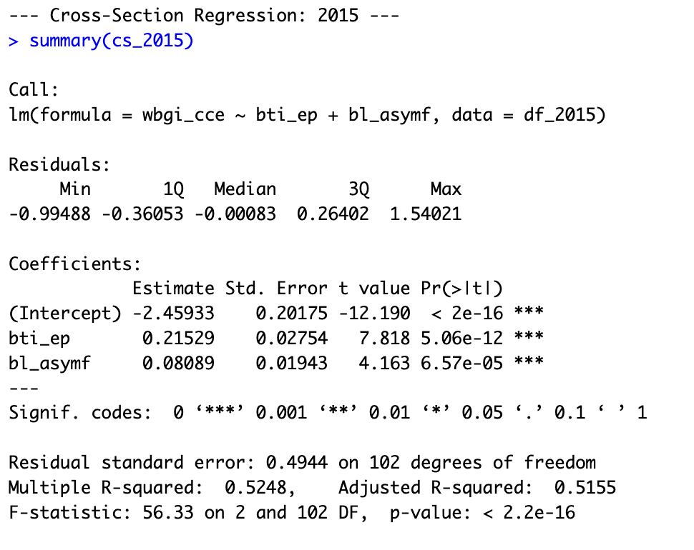
Cross-Section Regression

Slide 21
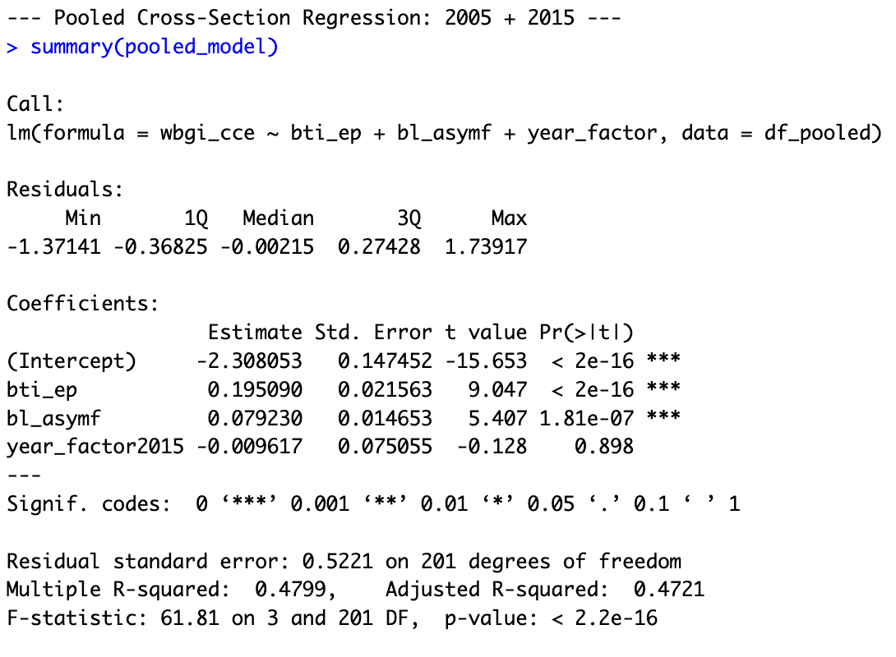
Pooled Cross-Section Regression
Year dummy (2015) was not significant, suggesting that after controlling for economic performance and education, the average level of perceived corruption was not that different between 2005 and 2015.
Corruption perceptions are relatively stable over time and are more influenced by structural contingencies rather than short-term shocks.

Slide 22
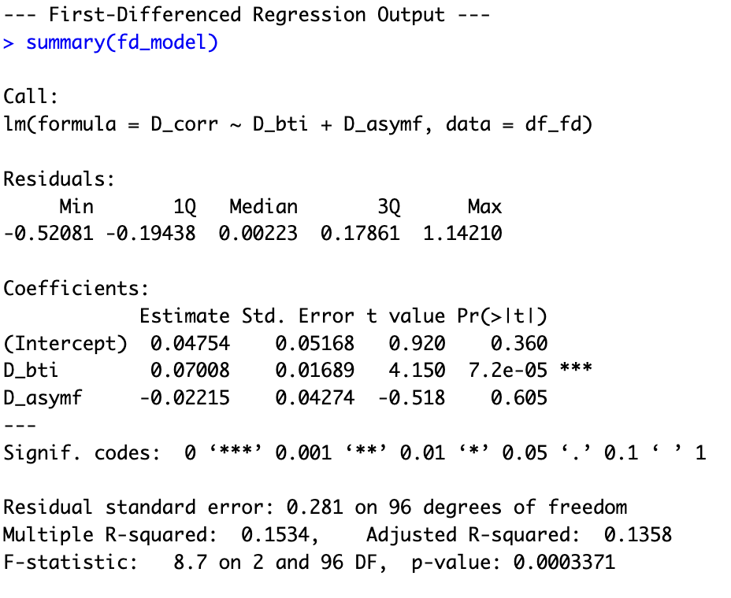
First-differencing model
Education was no longer a significant predictor of corruption perceptions
Suggesting that unobserved time-invariant factors were present compared to the pooled model
Short-term improvements in economic performance were correlated with improved perceptions of corruption, however, changes in education may take longer to see the impact of.

Slide 23
05
Conclusion

Slide 24
Biggest Takeaway
Countries that are restricted in resources and time should prioritize to improve its economic performance first in order to improve corruption perceptions; there are time-invariant factors that influence corruption perceptions

Slide 25
Strengths & Drawbacks of approach
Strengths
Drawbacks
Able to empirically validate that there were unobserved time-invariant factors which would have biased initial pooled results
Results actually contradict previous literature, likely because of limitations within the data itself

Slide 26
References
Baier, S. L., & Bergstrand, J. H. (2007). Do free trade agreements actually increase members' international trade? Journal of International Economics, 71(1), 72–95. https://doi.org/10.1016/j.jinteco.2006.02.005
Bauhr, M. (2016). Need or greed? Conditions for collective action against corruption. Governance, 30(4), 561–581. https://doi.org/10.1111/gove.12232
Dee, T. S. (2004). Are there civic returns to education? Journal of Public Economics, 88(9–10), 1697–1720. https://doi.org/10.1016/j.jpubeco.2003.11.002
Dutta, Nabamita, and Sanjukta Roy. "Media, Education and Corruption: Investigating the Associations." Economic Affairs 33.2 (2013): 207-19. Web.
Frost, P. (2021). How does education influence individuals' perception of different types of corruption? A quantitative study including 21 European countries [Bachelor's thesis, University of Gothenburg]. GUPEA. http://hdl.handle.net/2077/68646
Gründler, K., & Potrafke, N. (2019). Corruption and economic growth: New empirical evidence. European Journal of Political Economy, 60, 101810. https://doi.org/10.1016/j.ejpoleco.2019.08.001ResearchGate+2OUCI+2IDEAS/RePEc+2
Our World in Data. (2024). Learning-adjusted years of schooling vs. Corruption Perception Index, 2020 [Chart]. World Bank; Transparency International. https://ourworldindata.org/grapher/average-years-of-schooling-vs-corruption-perception-index
Rasmussen, Stig Hebbelstrup Rye, and Asbjørn Sonne Nørgaard. "When and Why Does Education Matter? Motivation and Resource Effects in Political Efficacy." European Journal of Political Research 57.1 (2018): 24-46. Web
Rothstein, Bo, and Uslaner, Eric M. "All for All. Equality, Corruption and Social Trust." World Politics 58.1 (2006): 41-72. Web.
Transparency International. (n.d.). Who we are. Transparency.org. https://www.transparency.org/en/about

Slide 27
Thanks!
Do you have any questions?
Please keep this slide for attribution

