Slide 1
An Uncertain Relationship: Unemployment Rates and Business Starts and Failures
Rachael N. Smith
Walker College of Business, Appalachian State University
ECO 5720: Applied Econometrics
Dr. Jayjit Roy
May 5, 2025

Slide 2
Topic Overview
Two perspectives:
Higher unemployment
Consider starting businesses (Carree & Dejardin, 2020).
Higher unemployment
Demand drop
Lessening of labor force
Reduction in profits
Increase in businesses closing (Bernstein et al., 2020).

Slide 3
Data and Variables
Data Sets:
“State Comparisons - Employment and Income”
(The North Carolina Office of State Budget & Management, 2025b).
“State Comparisons - Business and Industry”
(The North Carolina Office of State Budget & Management, 2025a).
Dependent:
Business Failures
Business Starts
Independent:
Unemployment Rate
Control:
Percentage Below Poverty Level
Civilian Labor Force Participation Rate

Slide 4
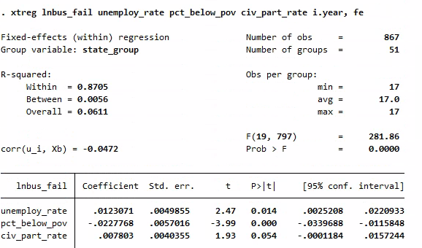
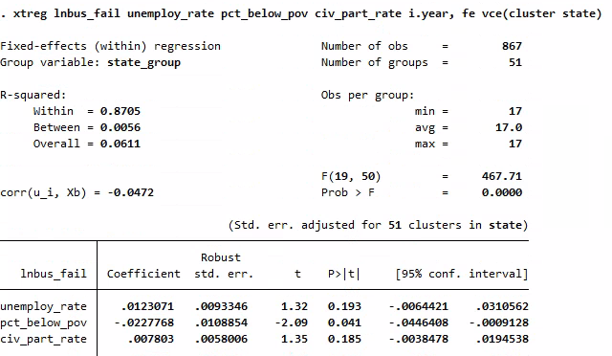
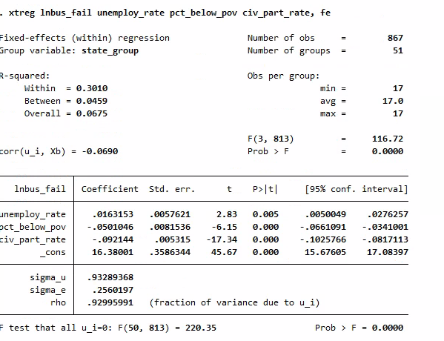
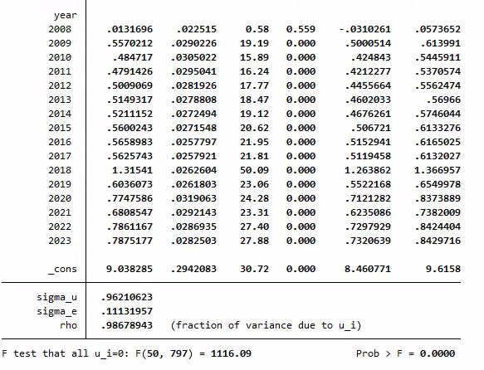
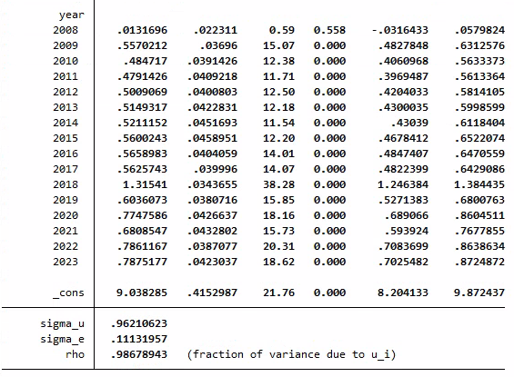
Fixed Effects Results (Business Failures)

Slide 5
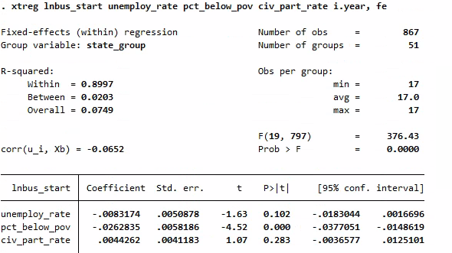
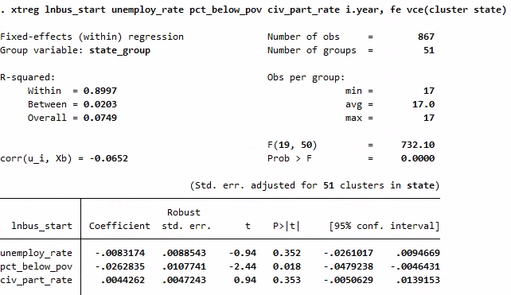
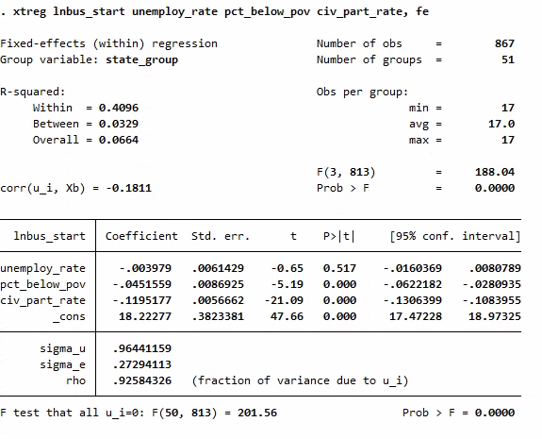
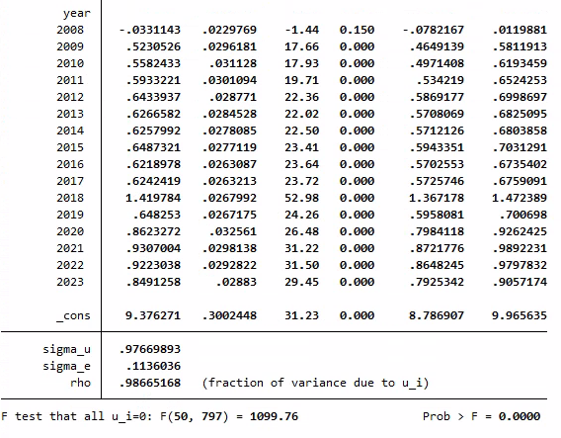
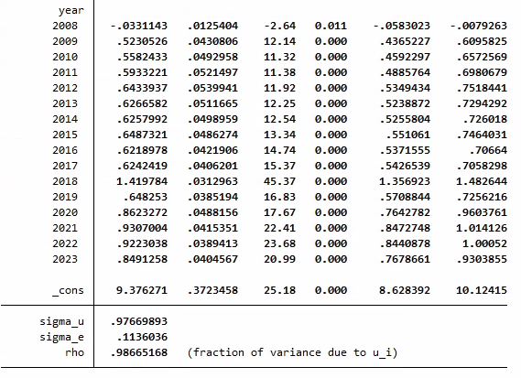
Fixed Effects Results (Business Starts)

Slide 6
Strengths, Drawbacks, & Improvements

Slide 7
References
Benson, L. S., Dalaker, J., & Lawhorn, J. M. (2024, May 2). Identifying areas of economic
distress: Examples and considerations. Library of Congress. https://www.congress.gov/crs-product/R48059
Bernstein, J., Richter, A. W., & Throckmorton, N. A. (2020, July 14). Entry, exit of firms
amplify the business cycle. Federal Reserve Bank of Dallas. https://www.dallasfed.org/research/economics/2020/0714
Carree, M., & Dejardin, M. (2020). Firm Entry and Exit in Local Markets: 'Market Pull' or
'Unemployment Push' Effects, or Both?. International Review of Entrepreneurship, 18(3), 371-386.
https://search.ebscohost.com/login.aspx?direct=true&db=ent&AN=150659654&site=eds-live&scope=site
The North Carolina Office of State Budget & Management. (2025a, April 16). State
comparisons - Business and industry. The North Carolina Office of State Budget & Management. https://linc.osbm.nc.gov/explore/dataset/state-comparisons-business-and-industry/information/?disjunctive.area_name&disjunctive.year&disjunctive.variable
The North Carolina Office of State Budget & Management. (2025b, April 17). State
comparisons - Employment and income. The North Carolina Office of State Budget & Management. https://linc.osbm.nc.gov/explore/dataset/state-comparisons-employment-and-income/information/?disjunctive.area_name&disjunctive.year&disjunctive.variable
Wooldridge, J. M. (2019). Introductory Econometrics: A Modern Approach (7th ed.).
Cengage Learning US. https://appstate-bookshelf.vitalsource.com/books/9798214346847

