Slide 1
High School Dropout
Regression Analysis
Kimberly Shellman &
Daniel Ahmedoff
ECO 5720
Dr. Roy
5/5/2025

Slide 2
Question and Relevance
Does local public school funding, staffing, and academic performance influence high school dropout rates in North Carolina counties?
Dependent
Dropouts
Independent
Expenditures, Personnel, SAT Score (Model 2 only)
Notes:
Dropouts: Number of public high school dropouts in county
Expenditures​: Local public school expenditures (in $000s) in county
Personnel​: Number of instructional personnel in county
u: Error term capturing unobserved factors affecting dropout rates
This is a relevant policy question because high dropout rates are associated with long-term social and economic disadvantages such as reduced income, higher unemployment, and increased public costs. Understanding whether higher spending and academic performance reduce dropout rates can inform decisions about how educational resources should be allocated.

Slide 3
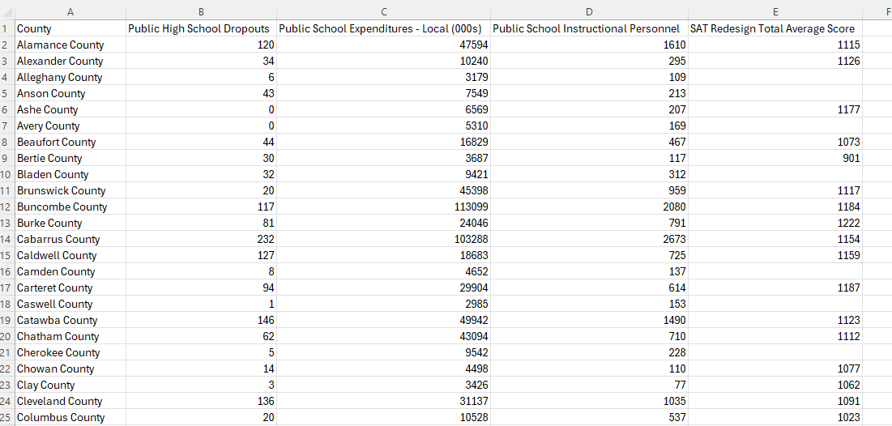
Data Description
Log Into NC
Education
Created our own dataset
Notes:
We used the website Log Into NC and went under the Education category
We were able to make our own dataset by selecting variables that stood out to us.
We chose
Public High School Dropouts
Public School Expenditures - Local (000s)
Public School Instructional Personnel
SAT Total Average Score
SAT Total Average Score was the only variable that had missing values everything else had a numerical value for each county

Slide 4
Estimation Strategy
Ordinary Least Squares (OLS) Regression
Model 1
Model 2
Dropouts_{i}​ = β_{0​} + β₁​⋅Expenditures_{i​} + β₂​⋅Personnel_{i​} + u_{i}​
Dropouts_{i}​ = β_{0​} + β₁​⋅Expenditures_{i​} + β₂​⋅Personnel_{i​} + β₃​⋅SATScore_{i}​ + u_{i}​
Notes:
The estimation strategy is Ordinary Least Squares (OLS) regression using a cross-sectional dataset of 102 North Carolina counties.
We chose this method because:
It is the standard approach for estimating linear relationships.
The interpretation of coefficients is straightforward.
We decided to try two OLS models because SATSCORE had missing values
Model 1 includes all 102 counties and focuses on the relationship between local education funding and staffing and the number of dropouts. It uses the maximum amount of available data and provides a general estimate of how resources relate to dropout counts.
Model 2 includes SAT scores but drops about 32 counties since some were missing that data. Adding SAT scores helps control for academic performance and gives a better idea of what might be driving dropout rates. The downside is that we lose some data, which could affect the strength of the results

Slide 5
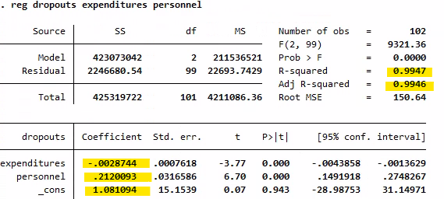
Model 1 Regression
Notes:
Expenditures: A $1,000 increase in local education spending is linked to nearly 3 fewer dropouts. This relationship is statistically significant and suggests funding may help reduce dropout rates.
Personnel: Surprisingly, more instructional staff is associated with a slight increase in dropouts. This might reflect reverse causality—districts with more dropouts may be hiring more staff, not the other way around.
Intercept: The constant is not statistically significant and doesn’t carry real-world meaning since no county would have zero spending or staff.
R-squared: The model explains 99% of the variation, which sounds impressive, but may signal multicollinearity or overfitting, especially since expenditures and staff levels are likely related.

Slide 6
Model 1 Limitations
Omitted Variable Bias
Reverse Causality
Multicollinearity
No Adjustment Per Capita
Notes:
Omitted variable bias: The model does not include other important factors like poverty, school size, graduation rate, student-teacher ratio, or demographics—all of which likely influence dropout rates.
Reverse causality: Higher dropout rates might cause districts to increase spending or staffing in response, which would bias the coefficients.
Multicollinearity: The high R-squared and condition number (from earlier output) suggest expenditures and personnel are highly correlated, which could distort individual coefficient estimates.
No per capita adjustment: The dropout count is not normalized (e.g., dropouts per 1,000 students), which may skew comparisons across counties of different sizes.

Slide 7
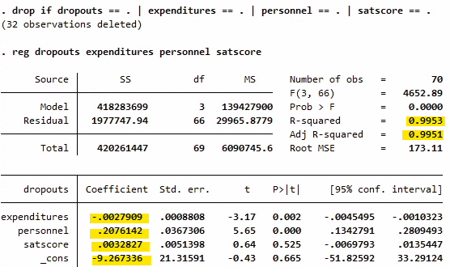
Model 2 Regression
Notes:
Expenditures: For every $1,000 increase in local school spending, dropout counts go down by about 2.8 students. This effect is statistically significant, which supports the idea that more funding can help reduce dropout rates.
Instructional personnel: We found that adding one more staff member is linked to about 0.21 more dropouts. While this is statistically significant, it’s also counterintuitive. This might be a case of reverse causality, where schools with dropout problems hire more staff in response. It could also be due to missing factors like poverty or school quality that we didn’t include in the model.
SAT scores: The effect is negative, but it’s not statistically significant. That means SAT performance doesn’t show a reliable connection to dropout rates in this sample. It’s possible that variation in who takes the SAT or smaller sample size affects the result.

Slide 8
Model 2 Limitations
Sample Selection Bias
Omitted Variable Bias
Multicollinearity
Measuring performance based on SAT
Notes:
Sample Selection Bias
Because only 70 out of 102 counties have SAT data, we’re estimating the model on a smaller and possibly non-representative sample. These counties may differ in important ways — like being larger, better funded, or more urban — which can bias all the coefficient estimates, not just SAT score.
Omitted Variable Bias
The model doesn’t control for factors like poverty rates, student demographics, graduation incentives, or school quality — all of which could influence dropout rates. If those factors are also correlated with spending or staffing, their absence could distort our results and lead to biased conclusions.
Multicollinearity
Spending and personnel are likely strongly correlated meaning the model has a hard time separating their individual effects. This can inflate standard errors and make our coefficient estimates less reliable, even if they appear statistically significant.
SAT Measurement Issue
Not all students take the SAT, and participation rates can vary by county. So the average SAT score may not reflect overall academic performance

Slide 9
Analysis Conclusions
More funding → fewer dropouts
Staff increase → more dropouts
Possible reverse causality present
SAT scores not significant
Omitted variables may distort results
High R², but interpret cautiously
Notes:
The results suggest that increased local education spending is significantly associated with fewer high school dropouts, even after accounting for staffing levels and SAT scores. Specifically, every $1,000 increase in spending is linked to nearly 3 fewer dropouts. This supports the idea that financial investment in schools may help reduce dropout rates.
However, the number of instructional personnel is surprisingly associated with a slight increase in dropouts. This could reflect reverse causality, where schools hire more staff in response to dropout issues, or the impact of omitted variables like poverty or school climate.
SAT scores, while included to account for academic performance, are not statistically significant in this model. This might reflect differences in who takes the test or other unmeasured academic factors. Overall, the model explains a large portion of variation in dropout rates, but caution is needed when interpreting causality.

Slide 10
Analysis Improvement
Add control variables
Normalize dropout counts
Handle reverse causality
Address selection bias
Check multicollinearity (VIF)
Use robust errors
Notes:
Include more control variables: Factors like poverty rate, urban/rural classification, family income, or student-teacher ratios could help reduce omitted variable bias and better isolate the effect of spending.
Normalize dropout counts: Use a dropout rate (e.g., per 1,000 students) instead of raw counts to make counties comparable regardless of size.
Address potential reverse causality: Use lagged variables, instrumental variables, or panel data methods if available to better capture causal relationships.
Account for selection bias: Since SAT data is only available for a subset of counties, limiting the analysis to those counties could bias the results. Techniques like multiple imputation or using propensity score weights could help.
Check for multicollinearity: Running a variance inflation factor (VIF) test can help assess whether spending and personnel are too strongly correlated to interpret separately.
Use robust standard errors: To correct for possible heteroskedasticity and improve inference reliability.

Slide 11
Thank you!

