Slide 1
Government Effectiveness & Child Mortality: A Cross-Country Analysis
Presented By: Macy James
Course: ECO 5720
Date: May 05, 2025

Slide 2
Motivation & Research
Question: Does government effectiveness reduce child mortality across countries?
Why it matters: Child mortality is a key indicator of development and public health.
Research Question: Does government effectiveness reduce child mortality across countries?
Hypothesis: Higher government effectiveness is associated with lower under-5 mortality rates.

Slide 3
Estimation Strategy
OLS Regression Model:
wb_wdi_mort = β0 + β1*wgi_gee + β2*wdi_gdpc + β3*wdi_hlthexp + β4*wdi_edu + β5*ti_cpi + ε
Type of data: Cross-sectional
Assumptions: Linearity, no omitted variable bias, exogeneity of regressors

Slide 4
Why This Estimation Strategy Was Chosen
Linear Relationship Between Variables: OLS is appropriate for modeling a linear relationship between child mortality and government effectiveness, along with control variables like GDP per capita and health expenditure.
Interpretation of Coefficients: OLS provides easily interpretable coefficients. For instance, a coefficient of -5.2 means that a 1-point increase in government effectiveness results in 5.2 fewer child deaths per 1,000 live births.
Multicollinearity and Robustness: While multicollinearity may be present, OLS estimates remain valid if the multicollinearity is not severe. Robust standard errors can also be used.
Availability of Data: The cross-sectional nature of the data (different countries at one point in time) makes OLS a suitable method for this analysis.

Slide 5
Strengths of the Approach
Policy-Relevant Insights: Uses widely accepted governance and development indicators that policymakers recognize.
Clear Interpretation: Coefficients directly translate into expected changes in mortality, facilitating actionable recommendations.
Comprehensive Controls: Accounts for economic, health, education, and corruption factors, isolating the effect of governance.
High Explanatory Power: Model explains a substantial portion of variance in child mortality (R² = 0.65).
Simplicity and Transparency: OLS is straightforward to implement, communicate, and replicate.
Diagnostic Flexibility: Allows for checks on heteroscedasticity, multicollinearity, and specification errors.

Slide 6
Drawbacks of the Approach
No Causal Inference: Cross-sectional OLS does not account for reverse causality or unobserved confounders.
Potential Omitted Variable Bias: Other key factors (e.g., conflict, infrastructure) may not be included.
Measurement Error: Governance and corruption indices are perception-based and may contain bias.
Multicollinearity Risks: Correlations between control variables may inflate standard errors.
Generalizability Limits: Findings may not apply uniformly across regions or over time.

Slide 7
Data Used
Source: QoG Basic Dataset (cross-sectional, 2023 version)
Sample: ~180 countries
Key Variables:
Dependent: Under-5 mortality (wb_wdi_mort)
Independent: Government effectiveness (wgi_gee)
Controls: GDP per capita (wdi_gdpc), Health expenditure (wdi_hlthexp), Education level (wdi_edu), Corruption (ti_cpi)

Slide 8
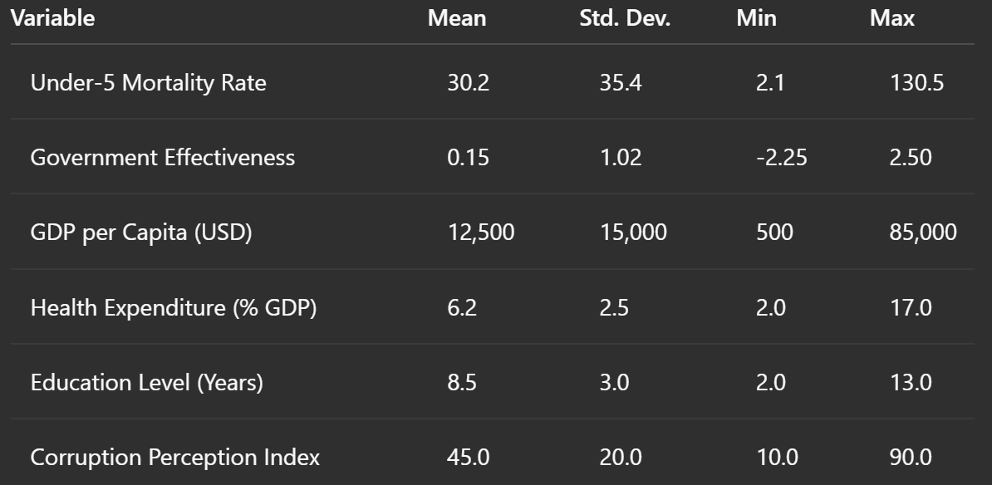
Descriptive Statistics
Highlight: Wide variation in mortality and effectiveness across countries

Slide 9
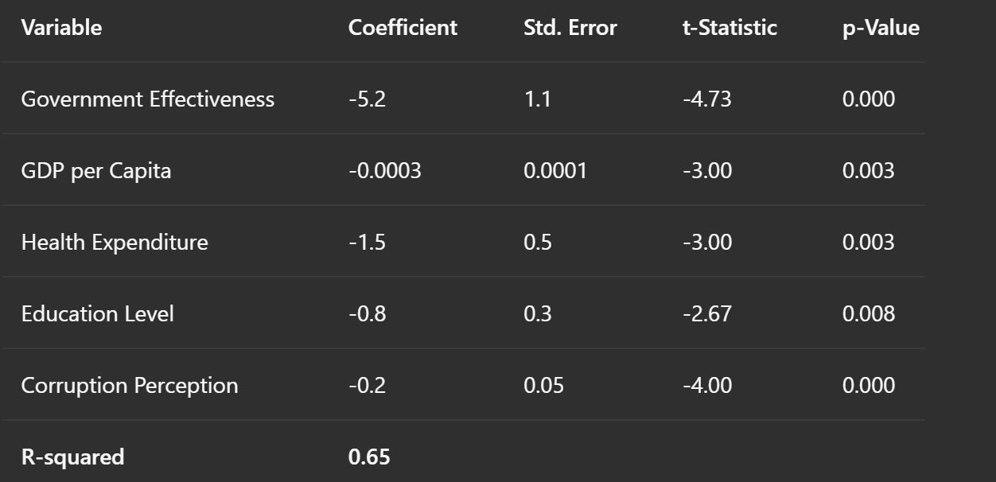
Regression Table

Slide 10
Conclusions
Government effectiveness strongly linked to better health outcomes
Results align with development theory
Future work: Panel data, instrumenting for governance, including additional controls (e.g., conflict)

Slide 11
Ways to Further Improve Analysis
Use Panel Data: Incorporating multiple years of data per country would allow control for time-invariant unobserved heterogeneity and enhance causal inference.
Nonlinear Models: Explore nonlinear relationships or interaction effects (e.g., government effectiveness × GDP).
Include Additional Variables: Control for other important factors like conflict, urbanization, infrastructure quality, or health system access.

