Slide 1
Sleep Hours & Depression
Bryan Walker

Slide 2
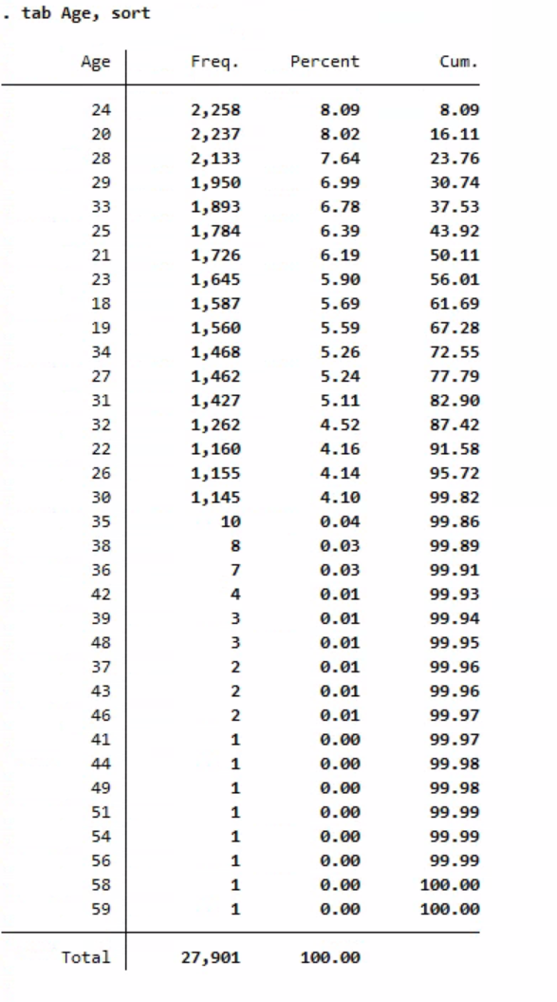
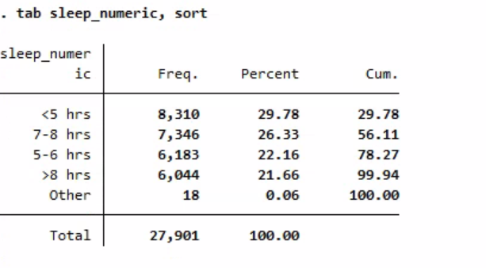
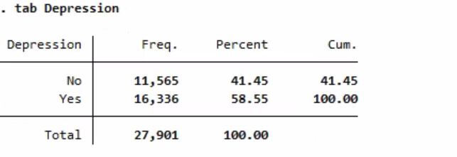
About the Data
Depression Indicator, Yes or no
Several categorical identifiers
Gender, Age, Profession
Information collected
Sleep duration, dietary habits, GPA, study satisfaction 1-5, previous thoughts of suicide

Slide 3
Data not used
Not statistically significant
Gender, city, degree
Empty/Duplicated values
Work pressure, job satisfaction, profession

Slide 4
Goal
Question to answer
Are there various factors, such as sleep levels, diet, etc, that contribute to increased levels of depression?
Specifically, the focus is on whether sleep levels have a significant effect, but investigation into other variables will also be done
Variables
Dependent/Response variable:
Depression: Binary variable
Independent Variables:
Sleep levels, diet, previous thoughts of suicide, mental health issues from parents
Age, GPA, work/study hours, academic pressure and study satisfaction 1-5

Slide 5
Estimation Strategy
A Logit model was utilized due to the nature of the data
Depression is a binary outcome; linear regression can predict impossible outcomes outside of the 0-1 range since it’s unbounded
Hypothesis:
Sleep levels will have a significant effect on depression levels, increased levels of sleep will result in a lower chance of depression
Higher levels of academic pressure will result in higher chances of depression
Previous thoughts of suicide will result in higher chance of depression

Slide 6
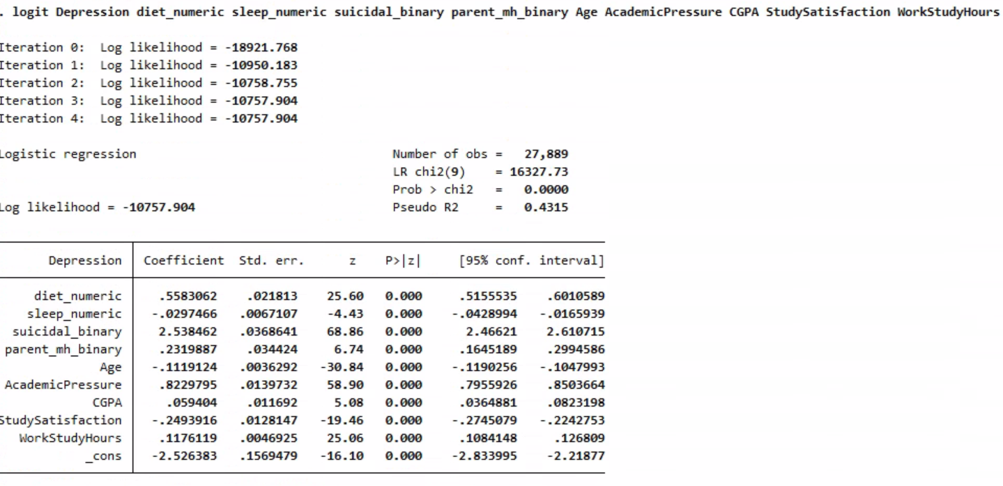
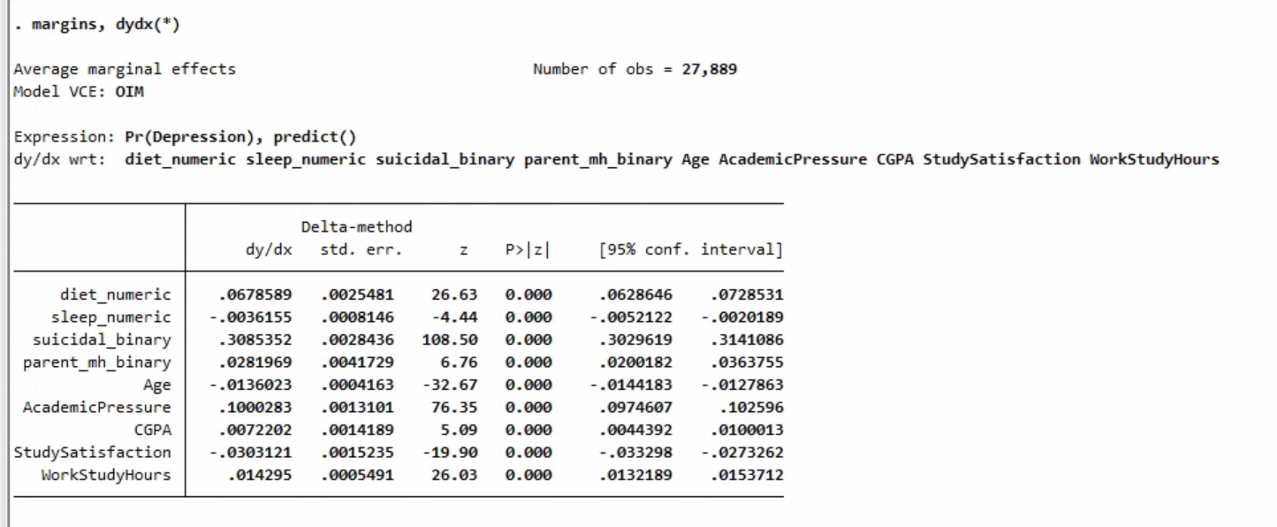
Logit Model
Used a Logit model for the binary outcome of Yes/No to depression
Calculated average marginal effects
Shows how much each variable changes the probability of depression, on average, across all observations

Slide 7
Interpretation of Results
Pseudo $R^{2}$ = .4315
Relatively high value for a Logit/Probit model, different requirements than Linear Regression $R^{2}$
Pseudo $R^{2}$ does not measure variance explained like linear regression, but a value above .20 is generally considered strong
Especially high for psychological data that can never fully be explained

Slide 8
Interpretation of Results
All factors included were statistically significant, but some had modest effects
Largest Effects: Suicide & academic pressure
Previous thoughts of suicide result in a 0.309 increase in probability of depression
1 additional point of academic pressure on a scale of 1-5 results in a 0.100 increase in probability of depression
Interesting point: CGPA
An increase of 1 point in GPA results in a 0.007 increase in probability of depression

Slide 9
Conclusion
Sleep levels do indeed decrease the probability of depression by .0037 for every additional hour of sleep
While this is statistically significant, the effect is marginal in comparison to other variables and not as large as I expected
Largest effects are seen in suicidal thoughts, academic pressure, and age
Technically, my hypothesis was correct, but the effect is immaterial in comparison to other factors in my opinion

Slide 10
Conclusion/Weaknesses
Sleep levels do decrease the probability of depression, but the effect is marginal
This could be due to a weakness in the data; simply measuring sleep hours may not be sufficient
Unobservable variables like income, home life, work life are likely causing bias
Missing data from work life
WorkStudy hours variable
Individuals could have depression and not identify themselves as depressed, and vice versa

Slide 11
Recommendations
Hours of sleep is not necessarily a great measure to connect sleep with depression
A stronger estimate may be to collect sleep quality instead of just total hours slept
Do you have Insomnia, yes or no?
Collect work life data, as these would likely be significant factors
Split WorkStudy hours into 2 different variables
Not possible to entirely fix the variation experienced from a psychological dataset

