Slide 1

The Effect of Worker Compensation Laws on Weeks Out of Work
ECO 5720-101
Grant Hatley & Grace Ball

Slide 2
Agenda
Econometrics Final Presentation
1.
Defining the Question
2.
IV & DV
3.
Estimation Strategy
4.
Control Variables
5.
Conclusion & Improvements

Slide 3

Econometrics Final Presentation
How do changes in workers’ compensation benefit levels affect the duration of workers’ compensation claims?
Notes:
Investigating the unintended consequences of increased financial incentives on the time workers remain out of work.
Hypothesis: Higher compensation benefits may unintentionally prolong worker’s absence due to incentives for extended recovery time.

Slide 4
What are the independent and dependent variables?
Econometrics Final Presentation
DV:
Claim duration (weeks out of work)
IV:
Policy change dummy (afchange)
High-earner dummy (highearn)
Demographic factors (gender, marital status, age)
Injury type (head, neck, upper extremity, trunk, low back, lower extremity, and occupational disease)
Notes:
Policy change dummy (afchange): Indicates observations after the policy change.
High-earner dummy (highearn): Indicates whether the worker is a high income earner affected by the cap.
Control variables: Demographic factors and injury types

Slide 5
Econometrics Final Presentation
Estimation Strategy
Regression Analysis:
A linear regression model to estimate the relationship between increased benefits and claim duration
Using the INJURY dataset to examine 7,150 observations
Equation:
Durat=β0​+β1​(afchnge)+β2​(highearn)+β3​(male)+β4​(married)+β5​(age)
Notes:
Expanded with additional variables for injury types to control for variations with the nature of injuries.

Slide 6

Control Variables
Econometrics Final Presentation
Demographic Controls:
Gender, marital status, age
Injury-type Controls:
Head
Neck
Upper extremity
Trunk
Low back
Lower extremity
Occupational disease
Notes:
Control Variables: These controls ensure that the effects of the policy change and earnings cap are not confounded by demographic or injury-related factors. This reduces omitted variable bias by accounting for other factors affecting claim duration.

Slide 7

Control and Treatment Group
Econometrics Final Presentation
Control Group
Low income workers
  Not affected by the benefit cap
Treatment Group
High income workers
  Were affected by the previous cap

Slide 8
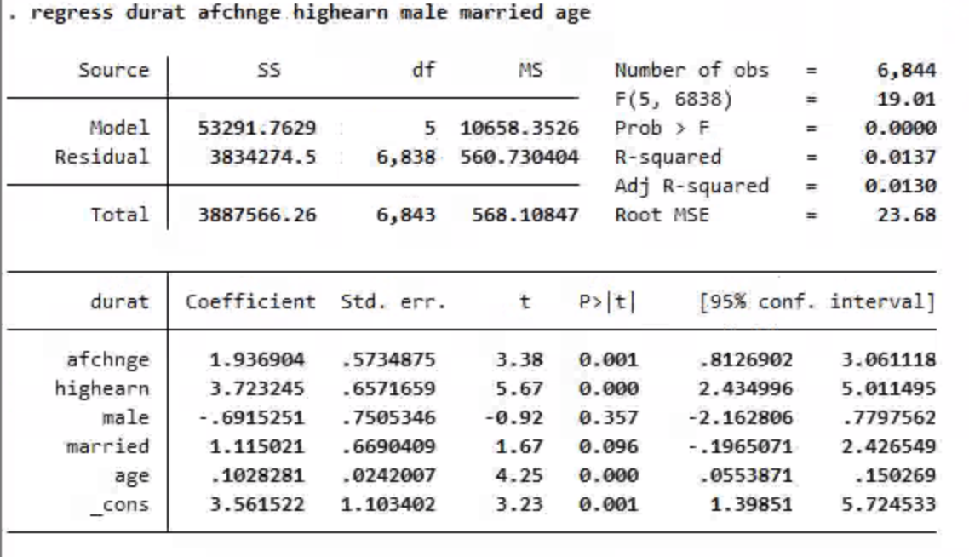
Econometrics Final Presentation
Notes:
This is a regression showing the effect of duration on post-policy change observations, high-income earner, gender, marital status, and age.
The regression results show that, as expected, the duration that employees received benefits increased after the change to the benefit plan took effect. This is the result that we were attempting to express with this model. With a positive coefficient of 1.94, the duration that benefits were received by employees after the policy change increased by 1.94 weeks on average. The p-value of .001 shows that this result is statistically significant.

Slide 9
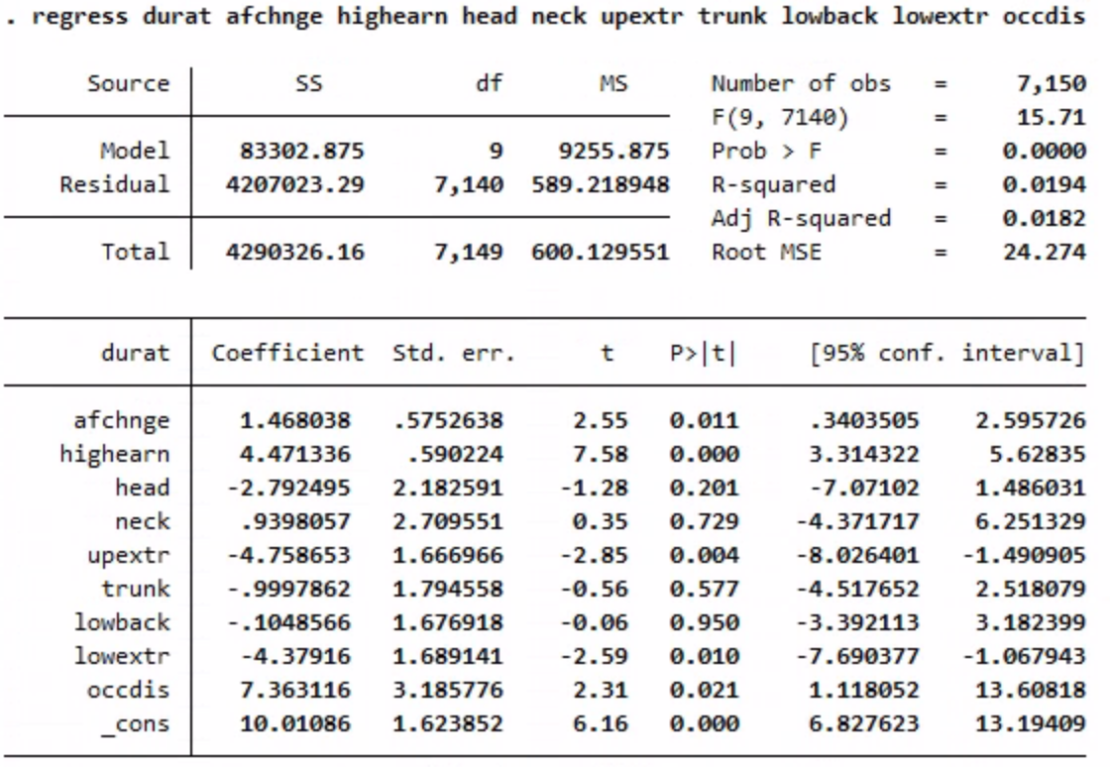
Econometrics Final Presentation
Notes:
This is a regression showing the effect of duration on post-policy change observations, high-income earner, and the different types of injuries.
The second regression analysis reveals that certain injury types significantly affect claim duration. Occupational diseases (occdis) increase claim duration by 7.36 weeks (p = 0.021), while injuries to the upper extremity and lower extremity reduce claim duration by 4.76 weeks (p = 0.004) and 4.38 weeks (p = 0.010), respectively. This indicates that occdis prolong recovery, whereas extremity injuries may lead to quicker resolution.

Slide 10
Conclusions
Econometrics Final Presentation
Policy changes significantly increased claim durations (1.94 weeks on average)
  P-value: 0.001
High earners and older workers experienced longer claim durations
Certain injury types (occupational disease) extended durations, while others (extremity injuries) shortened them.
Notes:
Policy Changes:
Statistical significance of the result (p-value = 0001) confirmed that policy change impacted claim durations
Supports the hypothesis that higher benefits create financial incentives for workers to remain out of work longer.
High earners and older workers:
Showing that income and age play a large factor in the length of benefits.

Slide 11
What are some ways in which you can further improve the analysis?
Experiment Results (Bar Chart)
Econometrics Final Presentation
Inclusion of important missing variables
Interaction terms
Logarithmic functions
Control for multicollinearity or heteroskedasticity issues
Notes:
By using a logarithmic function to explain age we are able to capture that the affect of age becomes stronger as individuals get older
Interaction terms help explore conditional effects (highearners vs lowearners)

Slide 12
References
Econometrics Final Presentation
References:
Lane, T. J. (2022). Collider Bias in Administrative Workers’ Compensation Claims Data: A Challenge for Cross-Jurisdictional Research. Journal of Occupational Rehabilitation, 32(2), 161–169. https://doi.org/10.1007/s10926-021-09988-1
Lane, T. J., Sheehan, L., Gray, S., & Collie, A. (2022). Regional Differences in Time Off Work After Injury: A Comparison of Australian States and Territories Within A Single Workers’ Compensation System. Journal of Occupational Rehabilitation, 32(2), 252–259. https://doi.org/10.1007/s10926-020-09947-2
Meyer, B. D., Viscusi, W. K., & Durbin, D. L. (1995). Workers’ Compensation and Injury Duration: Evidence from a Natural Experiment. The American Economic Review, 85(3), 322–340.
Wooldridge, J. M. (2020). Introductory econometrics a modern approach Hauptband Jeffrey M. Wooldridge. South-Western, Cengage Learning.

Slide 13
Thank You!
Econometrics Final Presentation

