Slide 1
Happiness and Life Expectancy
Former Students

Slide 2
Relevance
Question
Happiness can lead to a longer life
How does the perception of happiness affect one’s life expectancy at birth?
Power of positive thinking
Measures collective happiness

Slide 3
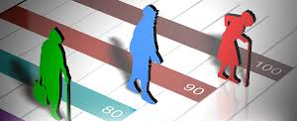
What are the dependent and independent variables?
IV: National subjective happiness scores (whr_hap)
Measure of how happy people feel about their lives
Rated on a scale from 0 (worst) to 10 (best)
Helps understand how people in different countries feel about their lives
A way to compare happiness levels between nations
DV: Life expectancy (wdi_lifexp)
Average years a newborn is expected to live
Based on how long people live in a country
Indicated a country’s overall health
Helps compare how long people live in different countries

Slide 4
Estimation Strategy
Fixed effects estimation
Controls for unobserved variables that are constant over the years
Ex. Geographic factors that could influence a nation’s life expectancy
Years: 2005 to 2018
Data for our variables of interest only span these years
Base year = 2005

Slide 5
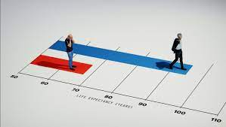
Control Variables
Population
Access to electricity
Access to sanitation services
CO2 emissions
Gender inequality
Civil liberties
Homicide rate
Unemployment rate
Democratization index
Economic freedom index
GDP per capita

Slide 6
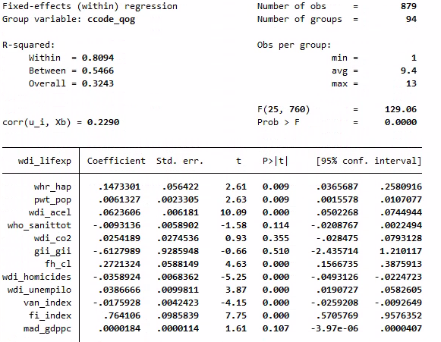

Slide 7
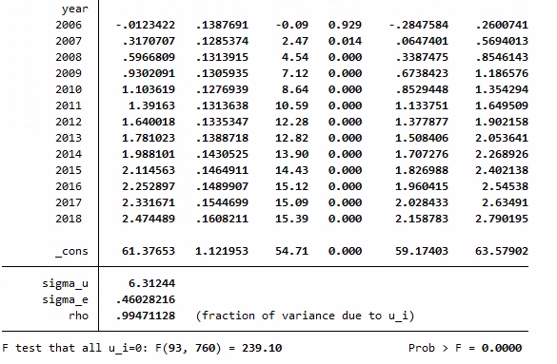

Slide 8
Conclusions
Happiness has a slightly positive effect on life expectancy
For each 1-point increase on the national average happiness scale, life expectancy increases by 0.15 years
Significant: p < 0.05
Other variables with positive effects on life expectancy:
Civil liberties index: 0.272 years, significant (p < 0.01)
Economic freedom index: 0.764 years, significant (p < 0.01)
Variables with negative effects on life expectancy:
Gender inequality index: -0.613 years, not significant (p = 0.51)
Homicide rate: -0.036 years, significant (p < 0.01)

Slide 9
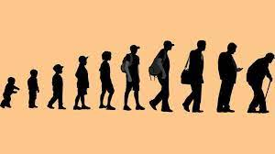
What are some ways in which you can further improve the analysis?
Cross-Country Comparisons
Analyze variations to understand how cultural and social economic factors influence the happiness-life expectancy link
Control variables that were unavailable in our panel version of the dataset:
Smoking rates
COVID-19 cases/deaths
Welfare policies
Notes:
Kenneth

Slide 10
Thank you!
Stata commands:
use "C:\Users\quiggkm\Documents\qog.dta"
xtreg wdi_lifexp whr_hap pwt_pop wdi_acel who_sanittot wdi_co2 gii_gii fh_cl wdi_homicides wdi_unempilo van_index fi_index mad_gdppc i.year, fe

