Slide 1

North Carolina MLB Attendance Potential
Would Raleigh or Charlotte be a better MLB host city?
Natalie Flack
April 8, 2026

Slide 2
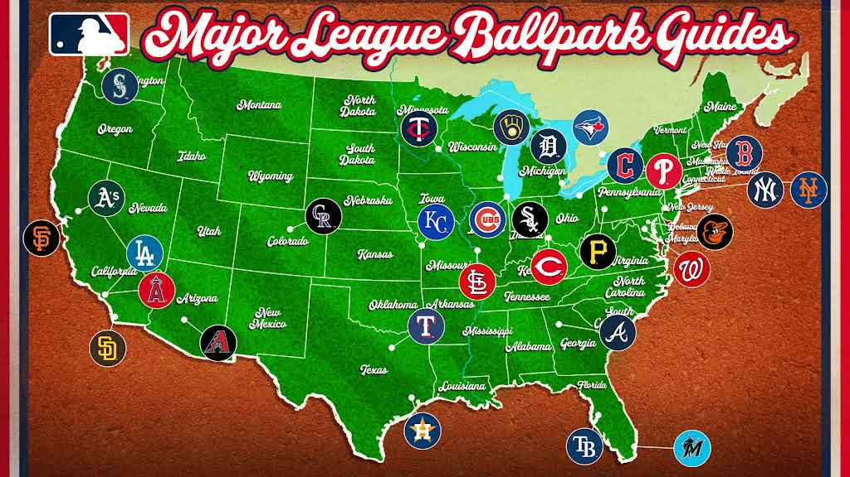
Context
The MLB is looking to expand the league to 32 teams (30 teams currently)
There is a significant gap in the southern states.
North Carolina is in the discussion for one of the two host city locations.

Slide 3
Question 1:
What factors drive MLB attendance?
Question 2:
Which city would generate higher attendance and revenue?

Slide 4
Model Setup
Revenue Framework
Attendance = β₀ + β₁Population + β₂Income + β₃Growth + β₄Compention + β₅Performance + u
Dependent Variable: Attendance
Independent Variables:
Population (market size)
Income (ability to spend)
Growth (future demand)
Competition (other teams)
Performance (win percentage)
Revenue = Attendance x Ticket Price

Slide 5
Expected Relationships
Variable
Expected Effect
Population
Income
Growth
Competition
Performance
+
+
+
-
+
Larger, wealthier, and growing markets would increase attendance while more sports competition reduces it. Better team performance woud increase attendance.

Slide 6
Prediction Workflow
01
02
03
04
Estimate Model using MLB Data
Plug in Charlotte and Raleigh Values
Predict Attendance
Estimate Revenue

Slide 7
Thank you

