Slide 1
Democracy & Environmental Outcomes
Luke Barber
April 8, 2026

Slide 2

Research Question
Do Democratic Countries Have Better Environmental Outcomes?

Slide 3
Dual Degree in Political Science and Data Analytics
Concentration in Environmental Policy
Previous coursework in environmental economics and comparative politics
Fulfilling final portfolio requirement for the program this summer and need analytics projects
Environmental issues are a pressing global concern and varying government structures are likely to address these problems differently
Motivation

Slide 4
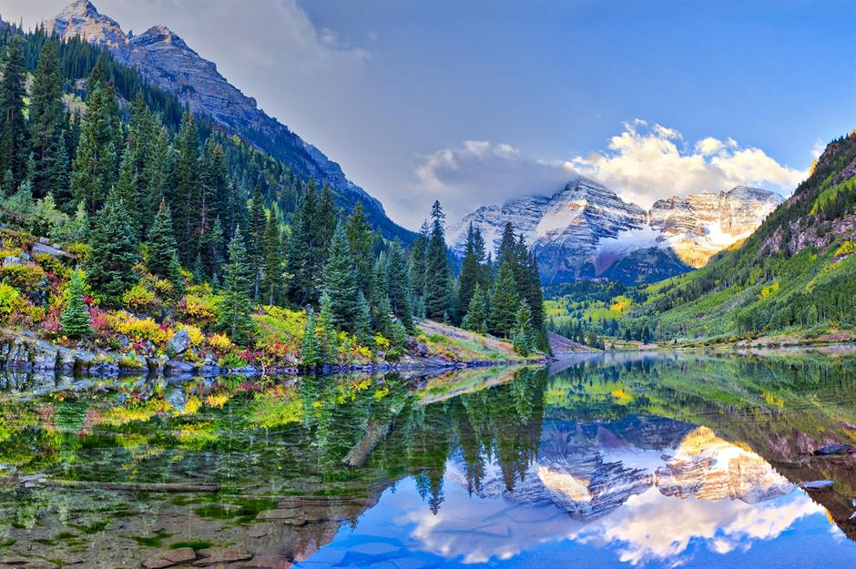
Available Data:
The QoG Institute
Environmental Indicators Dataset
Massive dataset, 400 variables, 1940s to present day. Most relevant:
CO2 emissions per capita: edgar_co2pc (alt).
Democracy measures: ccodevdem
Controls: GDP, Population, Environmental Spending, Fossil Fuel Use, etc. . . .
Continuing to explore other variables/measures
Dataset encompasses cross-country panel data on environmental, political and economic variables over time.
Measures environmental performance of countries. Most recent version updated in 2023.

Slide 5
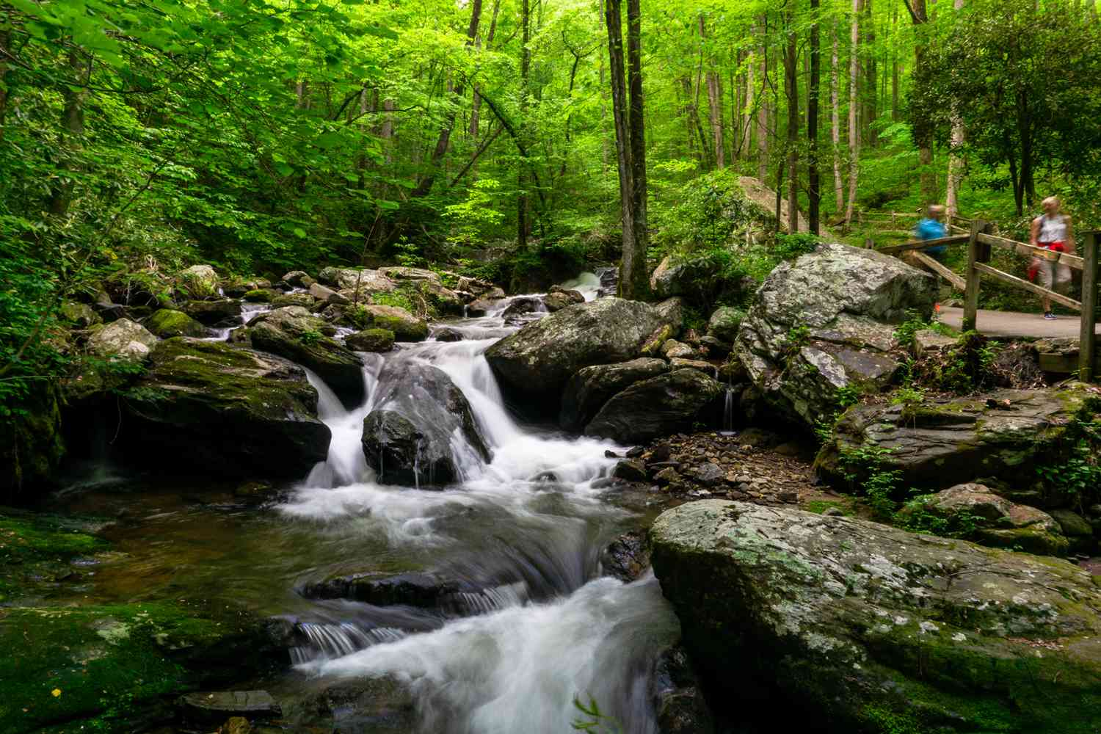
Pollutionit​=β0​+β1​Democracyit​+β2​GDPit​+β3​Xit​+uit​
Baseline Model:
Pollutionit​=β0​+β1​Democracyit​+uit​
Introducing controls:
Panel Data Approach:
Pollutionit​=β1​Democracyit​+αi​+γt​+uit​

Slide 6

it: country (i) and time (t)
Pollution: dependent variable
Intercept: baseline pollution (B0)
Democracy: independent variable 1
GDP: main control variable
X: Other control variables (population, industrial activity) u: Error term fixed effects for country and year
Explanation

Slide 7
Questions?

