Slide 1
Does A slower QB time to throw cause higher pass completion rates In the NFL?
A qualitative review of the current data from the National Football League
Jacob Hartkemeyer
Ashley Turak
Notes:
Ashley & Jake

Slide 2
Question:
Does QB time to throw cause higher pass completion rates In the NFL when accounting for current game conditions?
Relevance:
Gives insights into ideal play calling for an organization (given the QB isn’t being pressured)
Informs changes in training methods & tactics for coaching staff
Notes:
Ashley

Slide 3
Measured Variables
Independent Variable: Time-to-throw (s)
Average time QB holds the ball
Dependent Variable: Completion rate per pass
Completion (1)
Incompletion (0)
Interception (0)
Notes:
Ashley

Slide 4
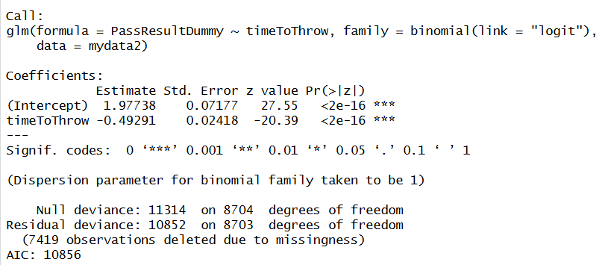
Dataset: https://www.kaggle.com/competitions/nfl-big-data-bowl-2025/overview
Notes:
Jake

Slide 5
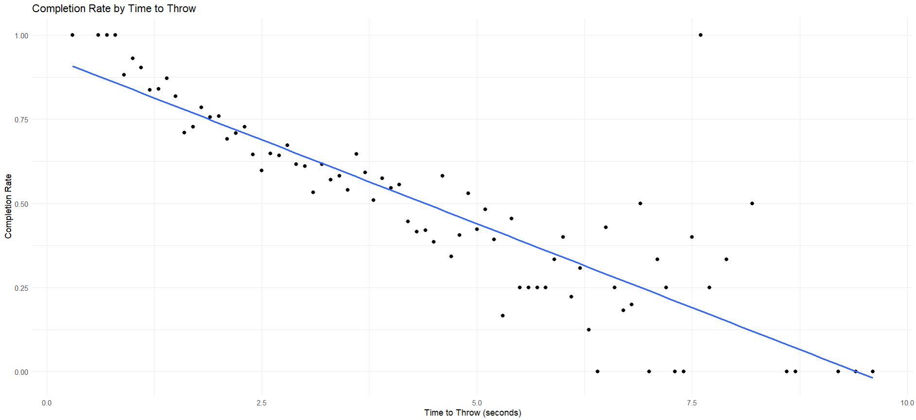
Dataset: https://www.kaggle.com/competitions/nfl-big-data-bowl-2025/overview
Notes:
Jake

Slide 6
Control Variables
Game Situation
  Down
  Yards To Go
  Quarter
  Win Probability Before Play
Formation of Team
  Offense Formation
  Reciever Alignment
Player Motion & Defensive Team
  WR Player Speed & Acceleration
  Defensive Team Pass Coverage
Notes:
Ashley

Slide 7
Hypothesis
Null Hypothesis (H₀):
There is no relationship between a quarterback’s average time to throw the ball and pass completion rates, after accounting for relevant game and play factors such as down, yards to go, offensive formation, and defensive coverage.
Alternative Hypothesis (H₁):
A shorter average time to throw is associated with higher pass completion rates, controlling for the same game and play factors.
Notes:
Ashley & Jake (one hypothesis each)

