Slide 1


Slide 2
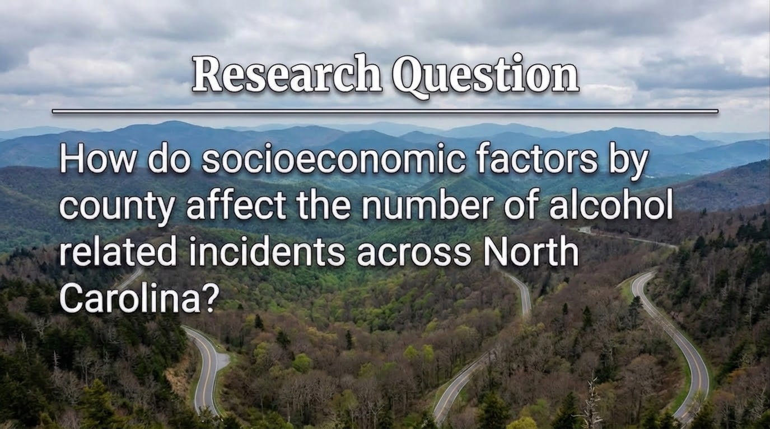
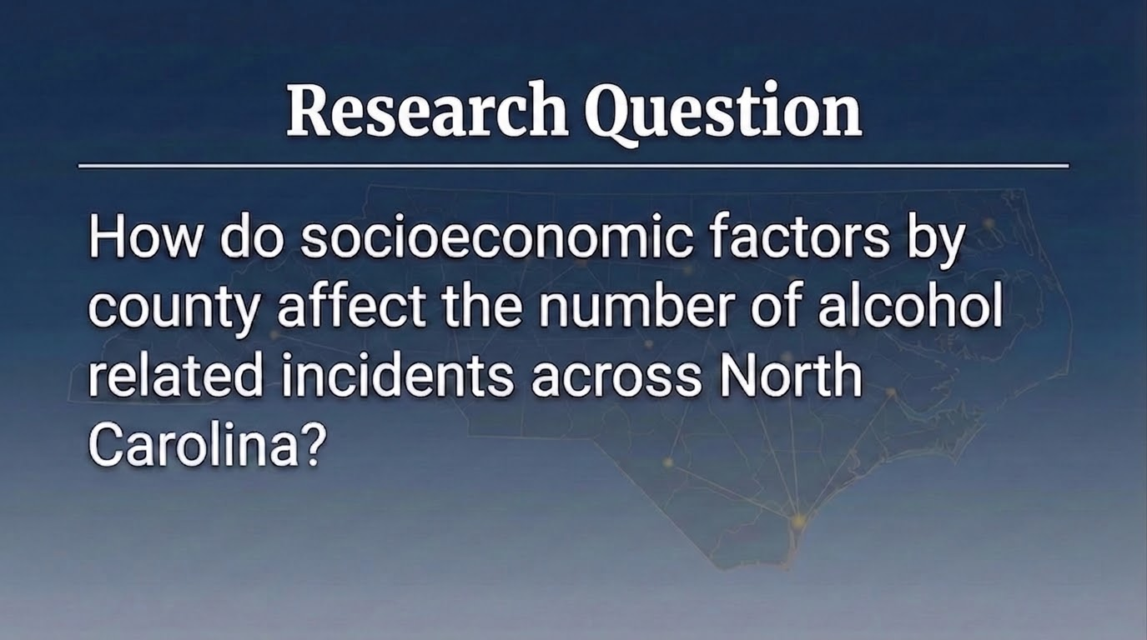

Slide 3

Motivation
Why Analyze This Issue?
Inform Law Enforcement
Public Knowledge & Safety
Effective Policy
Direction of Resources and Awareness

Slide 4
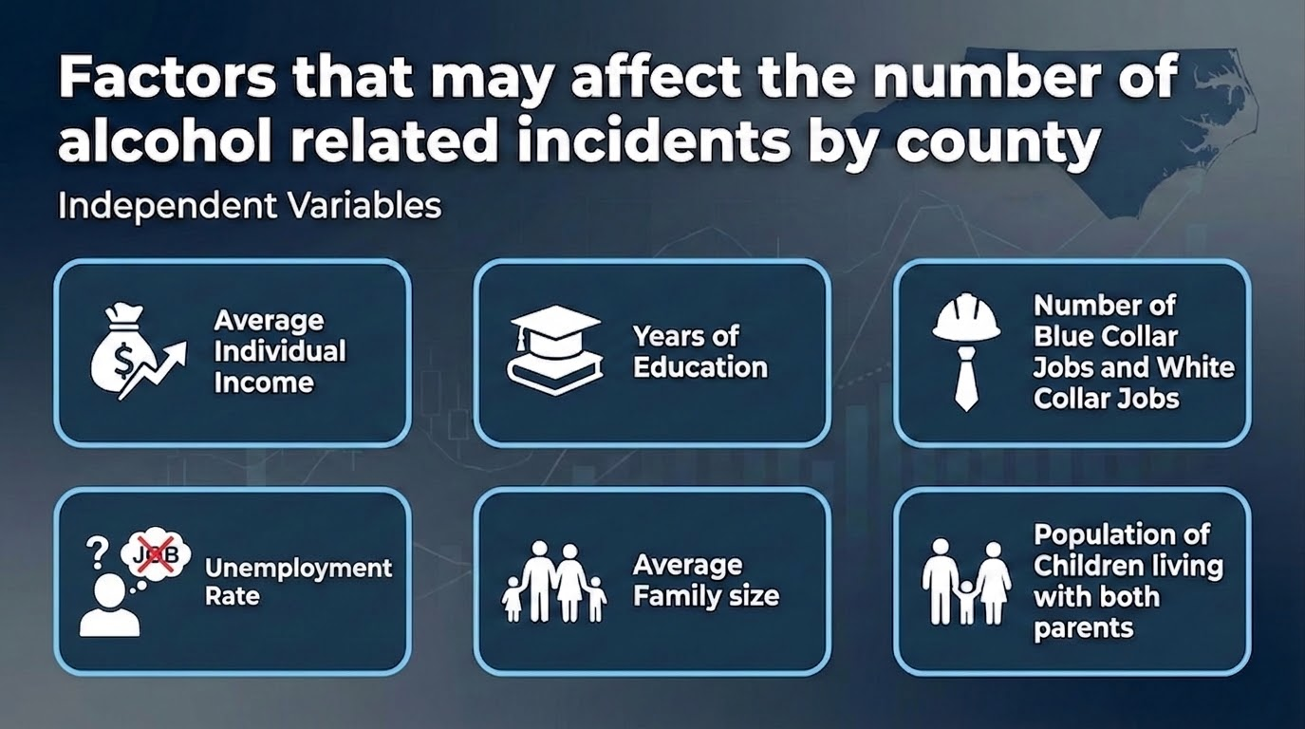
Factors that may affect the number of alcohol related incidents by county
Independent Variables
Average Individual Income
Years of Education
Number of Blue Collar Jobs and White Collar Jobs
Divorce Rate
Average Family size
Population of Children living with both parents
Notes:
Average Individual Income
Lower income counties tend to have more alcohol-related incidents due to financial stress driving alcohol misuse
Years of Education
Higher education levels correlate with fewer incidents as more educated populations tend to make safer decisions around drinking
Number of Blue Collar vs. White Collar Jobs
Counties with more blue collar jobs tend to have higher incidents due to work culture that normalizes heavy drinking and higher physical/financial stress
Unemployment Rate
Higher unemployment strongly predicts more incidents as job loss creates financial stress, loss of routine, and social isolation
Average Family Size
Larger families may increase financial pressure and stress, potentially driving higher alcohol-related incident rates
Population of Children Living with Both Parents
Counties with more two-parent households tend to have fewer incidents, reflecting greater family stability and structure

Slide 5
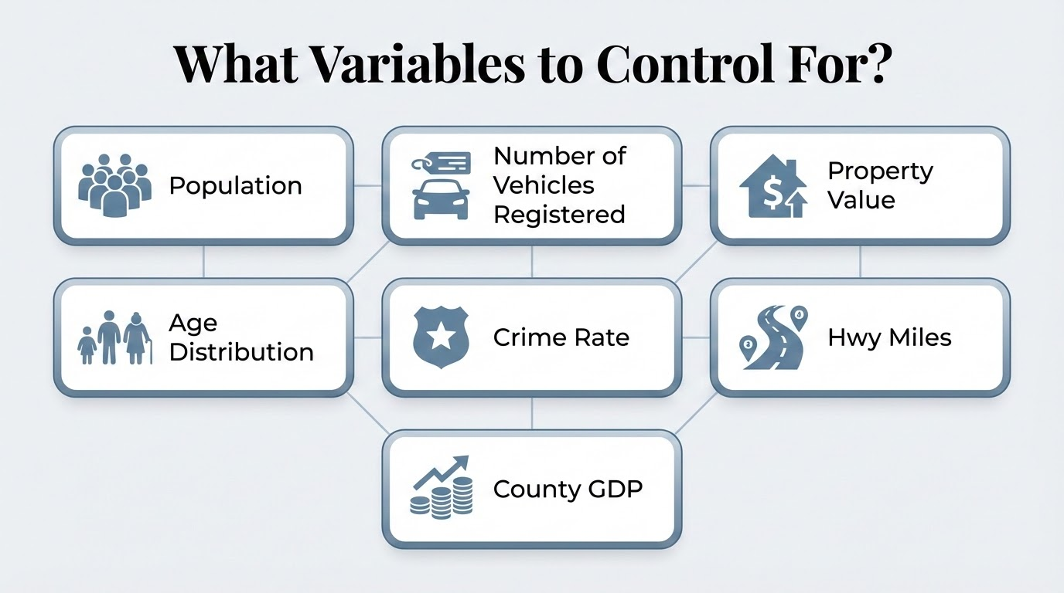
What Variables to Control For?
Population
Number of Vehicles Registered
Property Value
Age Distribution
Crime Rate
Hwy Miles
County GDP

Slide 6
Data Set Source & Manipulation
Data Processing
OSBM Website for North Carolina
- Alcohol Related Incidents in North Carolina
- Data Set on Households in North Carolina
- Poverty Rate by County
Years 2018 - 2024 omting 2020 & 2021
Use Excel Data Query to combine and merge data sets
Upload to R studio to run regression analysis
Notes:
We plan to combine multiple data sets from the OSBM website for North Carolina to form a collective data set that includes all variables by county for the years 2018 - 2024 omitting the years 2020 and 2021 because of the effect of covid on driving and socioeconomic factor such as employment and income.

