Slide 1
Is the New NFL Kickoff Rule Effective?
By Kyle Vetter

Slide 2
Why is this relevant?
At the start of the 2024 year the NFL completely revamped how kickoffs are run.
The NFL is trying to increase the number of returns, the length of returns, and prevent injuries.
I am testing to see if there is an increase in returns or in the length of return.

Slide 3
Variables in Analysis
Independent variables
Rule – 2023 or 2024 season
Penalty – if penalty occurred during kickoff
KickLand – where the kick landed if the ball was returned
i.WK – dummy variable for week
i. ReTM_id – dummy variable for receiving team
i.KickTM_id – dummy variable for kicking team
Dependent Variables
YDR – the amount of yards received
TCHB – If it was a touchback or not

Slide 4
Model Estimation
2 Different panel data set estimations.
First: Test for a change in yards run after ball is received.
$YDR= {β }_{0}+{β }_{1}\left(Rule\right)+{β }_{2}\left(KLand\right)+{β }_{3}\left(Penalty\right)+{β }_{4}\left(i.WK\right)+{β }_{5}\left(ReTeam_{id}\right)+{β }_{6}(i.KickTM_{id})$
Second: Test for change in number of touchbacks.
$TCHB= {β }_{0}+{β }_{1}\left(Rule\right)+{β }_{2}\left(YDR\right)+{β }_{3}\left(Penalty\right)+{β }_{4}\left(i.WK\right)+{β }_{5}\left(ReTeam_{id}\right)+{β }_{6}(i.KickTM_{id})$
Why I chose this method:
I am comparing data from 2 different time periods. I am comparing the 2023 NFL football season and the 2024 NFL season.
This analysis observes multiple entities that is repeated over set measurements of time.

Slide 5
Strengths and Weaknesses
Strengths
Accounts for time variability
Incorporates multiple variables as control variables to isolate the rules effect.
Easy to further update data to continue analysis
Weaknesses
Limited Variability in teams
Unable to capture influence such as game strategy or weather.
Having more years and games would help analysis.

Slide 6
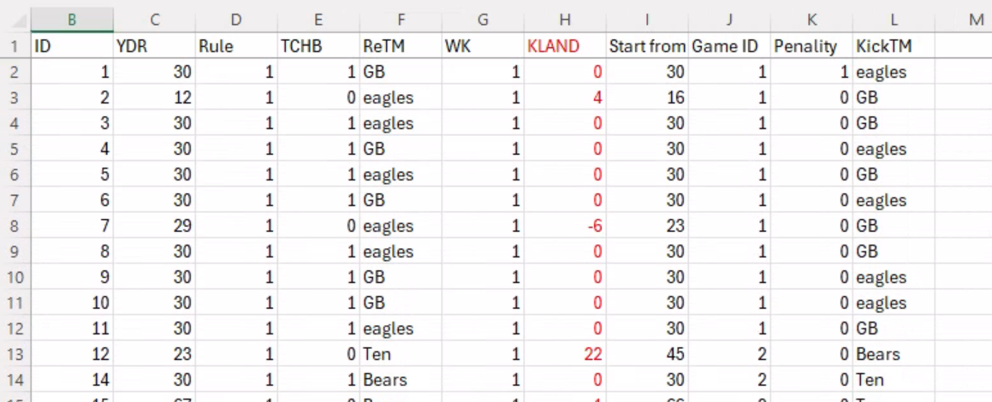
Dataset Used
I created my own dataset for this analysis
Using ESPN I entered the following variables
ID, Yards run, Rule/year, if it was a touchback or not, who the receiving team was, where the kick landed, where they started from, Game ID, if there was a penalty, and the kicking team.
The dataset is for the first 9 weeks of the 2023 and 2024 season

Slide 7
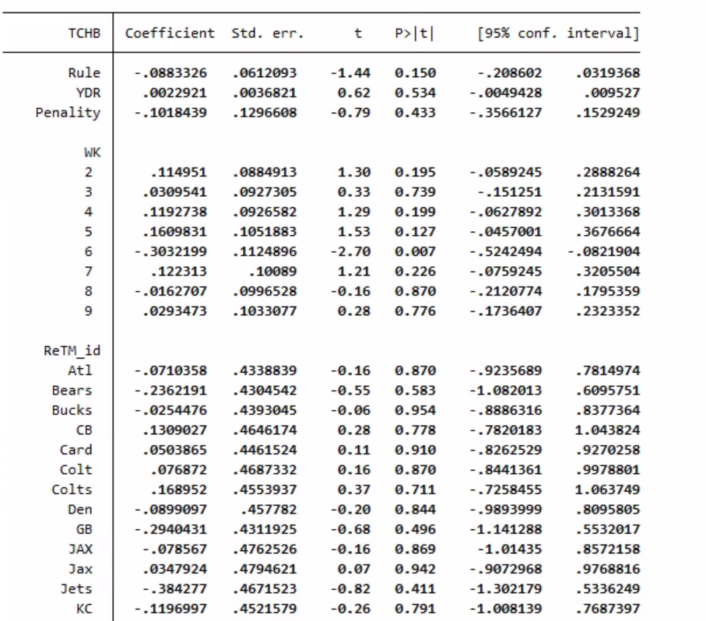
Touchback Analysis

Slide 8
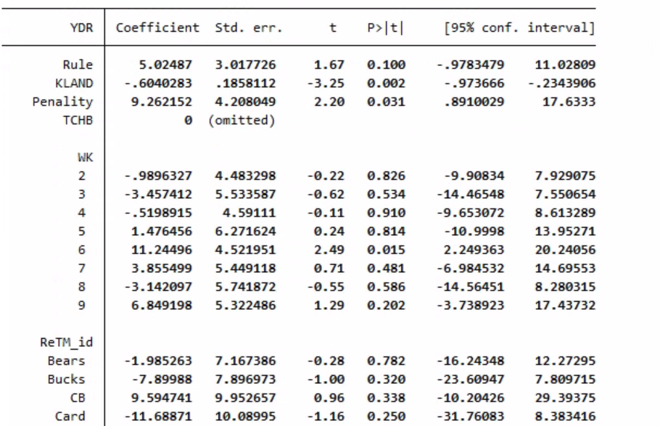
Yards Run Analysis:
(bring focus to non-touchbacks)

Slide 9
Conclusions
Touchbacks
The P-value of .150 shows that there is not a significant difference between the number of touchbacks between the the 2023 season and the 2024 season.
Yards run
The P-value of .100 is significant to the 90% confidence level.
Based on these results it shows we are 90% confident there is a 5-yard increase in the yards run after receiving during kickoffs.

Slide 10
Potential Improvements in analysis
Increasing the time of the study will help, this is the first year the new rule has been put in place and teams might not have taken advantage of the new rule yet.
The touchback is close to being significant, increasing the dataset might show the 8% decrease in touchbacks.
Including more variables such as weather could help tease out the effects of the new rule.

Slide 11
Thanks! Any questions?

